Slide 1
ACLP Members’ Annual Business Meeting

Slide 2
Notes
Download meeting handouts from: tinyurl.com/2020-papers
Submit questions using Q&A box
This meeting is being recorded

Slide 3
Establishment of Quorum
The executive office conducted the collection of proxy votes prior to the start of this meeting. The Academy currently has a total of 1401 voting members, thereby requiring 141 to establish a quorum to conduct the business of the Academy.
228 proxies have been received prior to this meeting; 4 were discarded as incomplete, leaving 224 valid proxy votes. Counting those members present and completed proxy votes received, a quorum for the conduct of the organisation’s business has been established.

Slide 4
Minutes of last meeting President's Report Treasurer's Report Secretary's Report

Slide 5
Approve prior meeting minutes
Vote to approve minutes of 2019 meeting
Proxy voting
Approve: 214
Do not approve: 0
Abstain: 10

Slide 6
The State of the Academy Business meeting November 2020 ----- Michael Sharpe MA, MD, FACLP President

Slide 7
The ACLP 2020 Board

Slide 8
The ACLP 2020 Executive Committee

Slide 9
The ACLP Strategic plan for 2020
Advocate, for Our Patients and for C-L Psychiatry
Educate, Train, and Partner to Promote Good Patient Care
Inspire, Develop and Nurture, the C-L Psychiatry Community
Optimize, the ACLP Organizational Structure

Slide 10
Then came COVID-19 How did it go?

Slide 11
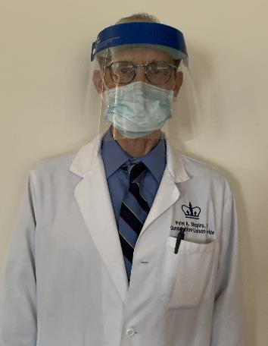
We advocated for our patients and for C-L psychiatry
Huge challenge to C-L psychiatry clinicians
They did a terrific job of advocacy
‘Frontline’ work and supporting others
Presidential COVID-19 Task force
led by Peter Shapiro MD
what ACLP should learn from the pandemic

Slide 12
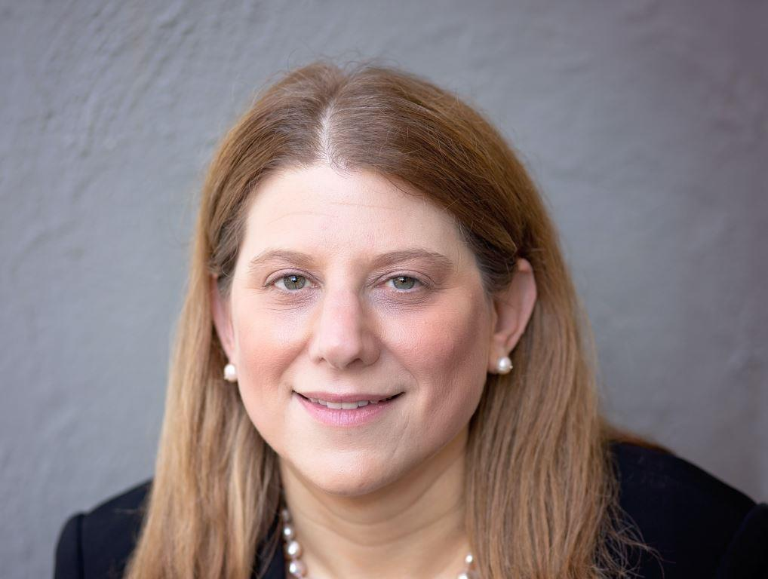
We advocated for the Academy
We continued building our links with
EAPM, CAMP, NIMH and others
We made progress in our relations with APA and AMA
Built on great work by Rebecca Brendel MD JD
Now nominated for President-Elect of APA

Slide 13
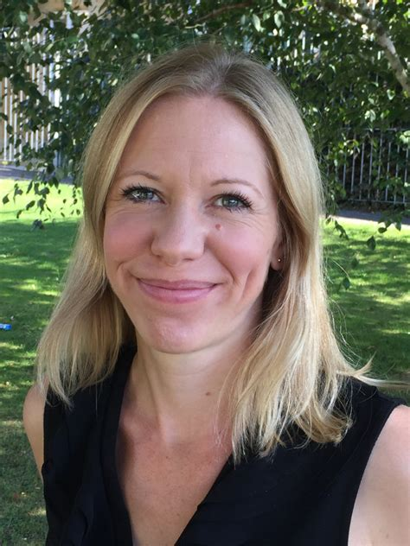
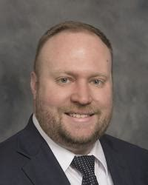
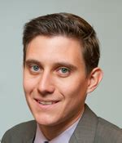
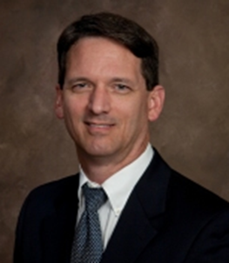
We Educated and Inspired through our Annual Meeting
Delivered a virtual meeting
Jesse Fann and Jane Walker
Supported by Subcommittee chairs, James Vrac and PAI

Slide 14
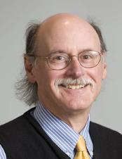
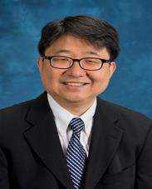
We Educated through our Journal - now and for the future
Recruited an Editor-in-Chief
Hochang Ben Lee replaces Ted Stern
Agreed a new contract
With Elsevier as on-line only Journal
Gave it a new name
‘JACLP’ from January 2021

Slide 15
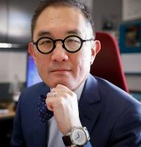
We continued to optimize our Organization
ZOOM meetings of Board, Exec. committees and SIGS
Effective meetings continued on Zoom
We continued the planned reduction in Board size
Presidential Task Force on DEI
Presidential task force led by Kewchang Lee MD
Diversity, Equality and Inclusion and ACLP

Slide 16
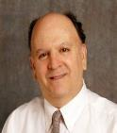
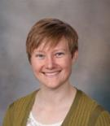
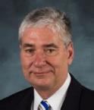
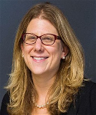
Leaving the ACLP Board in November 2020
Jon Levenson
Sandy Rackley
James Rundell
Rebecca Brendel
Jesse Fann

Slide 17
A summary of 2020
In the face of the COVID-19 pandemic:
A poor organization fails,
A good organization survives,
A great organization thrives
I am proud to have served as President of this great organization

Slide 18
Treasurer's Report

Slide 19
Financial Management
2020 budget: $1.3m revenue / $1.26m expenses
2020 actual: hard to project, but looking more positive than expected given circumstances
Current assets of $2m
The Board receives detailed monthly financial reporting
ACLP is audited by an independent auditor every year. Audit Committee met with auditor in June - clean opinion for 2019
Reserves with Schwab monitored closely by Finance Committee. Reserves have performed well during turbulent times this year

Slide 20
Secretary's Report

Slide 21
Secretary's Report
Bylaw amendments proposed (circulated to membership on Aug 21):
Main purpose is to reduce the size of the Board per the Board's announced strategy at the annual members' business meeting in San Diego, California
Remove a governor position and change references to governor to the immediate past president.
Remove three board ex officio roles (ACLP's representatives to the APA's Council on Consultation-Liaison Psychiatry, and Assembly Committee of Representatives of Subspecialties and Sections (ACROSS); and the Annual Meeting Committee chair).
Reduce the number of board directors from nine to seven.
Amend the composition of the Audit Committee due to the elimination of a governor position.
Replace the board director appointment with the president-elect on the Nominating Committee; increase the committee size to seven with the addition of two non-board director appointments.
Clarify committee compositions.
Modify language to make the bylaws gender neutral.

Slide 22
Approve bylaw amendments
Vote to approve bylaw amendments as presented
Proxy voting
Approve: 211
Do not approve: 1
Abstain: 12

Slide 23
Secretary's Report
Governance section in the members’ only area of the website includes:
F990s (tax return)
Audit reports
Board minutes, financial disclosure reporting
Regulatory documents, such as IRS determination letter
Meeting announcements; bylaw amendments
Surveys, misc. reports
Policy Manual

Slide 24
Membership Report Editor-in-Chief's Report Nominating Committee Report

Slide 25
Membership

Slide 26
Editor-in-Chief's Report

Slide 27
Nominating Committee

Slide 28
Elections
President-elect: Philip Bialer, MD, FACLP
Vice President: Maryland Pao, MD, FACLP
Treasurer: Madeleine Becker, MD, FACLP
Secretary: E. Sherwood Brown, MD, PhD, FACLP
Board Directors:
Thomas Heinrich, MD, FACLP, second 3-year term
Mary Ann Cohen, MD, FACLP; to fill the unfinished term of 2-years vacated by Dr. Brown

Slide 29
Approve slate of candidates for board election
Vote to approve as presented the slate of candidates for officers and board directors
Proxy voting
Approve: 215
Do not approve: 0
Abstain: 9

Slide 30
Thank you for joining us! Q&A?

