Slide 1
Applying to C-L Fellowship During COVID-19
Presented by: American Psychiatric Association Council on Consultation-Liaison Psychiatry and the Academy for Consultation-Liaison Psychiatry
Sunday June 14, 2020
5-6 pm EST/2-3 pm PST
This webinar is being recorded, and will be posted online for later viewing

Slide 2
Webinar Outline
Overview of C-L fellowship application process (15 minutes)
Timeline
Application process
Data from 2019 fellowship Match
Introduction of C-L fellowship panel
Q&A with attendees (45 minutes)

Slide 3
C-L Psychiatry Especially Prominent in COVID-19
Treating neuropsychiatric adverse effects of COVID-19 and its treatments
Helping patients and families cope with psychological impact of COVID-19
Advocating for psychiatric care of underserved during COVID-19
Serving as psychological support for hospital systems during COVID-19

Slide 4
C-L Psychiatry Has Many Facets!
Inpatient Consults (general)
Emergency Psychiatry
Women’s Mental Health, Perinatal Psychiatry
Psycho-Oncology
Transplant Psychiatry
Cardiac Psychiatry
Neuropsychiatry
Addictions
Pain Psychiatry
Burns/Trauma Psychiatry
HIV/AIDS Psychiatry
Pediatric C-L
Proactive C-L
Integrated and Collaborative Care

Slide 5
C-L Fellowship: 2020-2021 Timeline
July 2020: Contact programs inquiring about C-L fellowship positions
July-September 2020: Complete, send out C-L fellowship applications (rolling cycle)
September-November 2020: Fellowship interviews
December 16: NRMP Rank lists due for both applicants and programs
January 6: C-L Fellowship Match!

Slide 6
C-L Fellowship: Deciding Where to Apply
Geographic location
Reputation: fellowship, residency, department, medical center
Number of fellows per year
Consult volume, workflow, team composition
Clinical experiences, inpatient vs outpatient
Didactics, extra-clinical opportunities
Academic time, research, teaching
Particular faculty and supervisors
Moonlighting
Notes:
Each person will of course have their own priorities, just some considerations for all applicants

Slide 7
C-L Fellowship: Contacting Programs
July: Contact each program you’re interested in, brief and professional email indicating your interest and requesting additional information and/or application materials
Example email:
Dear Dr. Shah,
Hello! Hope this finds you well! I am applying for C-L fellowship this summer, and wanted to email you with my strong interest in Brigham's fellowship.
I also wanted to ask if you could please send me any formal application materials and requirements, as directed on the website. Looking forward to applying to the fellowship; have a nice weekend!
Sincerely,
Chandan Khandai
PGY-4 Psychiatry, Northwestern

Slide 8
C-L Fellowship: Application Materials
Will vary based on program! May include any/all of the following:
Common CLP fellowship application vs institutional application forms
Personal statement
CV
3 Letters of Recommendation (including 1 from residency PD)
Licensure forms (state, DEA)
Medical degree
Medical school dean’s letter
USMLE score report
International: ECFMG certificate, visa paperwork if applicable
Notes:
Can also send prints of journal articles or other extra materials
Most programs appreciate electronic sending- ask the programs ahead of time! Ask also if separate files, or as one big attachment
Keep these as email attachments to yourself
LOR- schools might have forms for programs to fill out; also ask if LOR can be emailed by senders, or need to be mailed

Slide 9
C-L Fellowship: Interviews
May 11: AAMC workgroup recommends virtual interviews for residency and fellowship, including for local applicants
Days off: Interview/academic days vs vacation days
August-October: Interview invites go out- reply promptly!
September-November: Interviews!
General tips:
Ensure a quiet place with good wi-fi and lighting for virtual interviews
Create a list of questions you may want to ask during the interview
Keep a copy of your application for each program, know what you said!
Have pdfs of your CV, publications available if needed to send to interviewers
Notes:
Reply promptly to have most choice of dates

Slide 10
C-L Fellowship: Ranking and Match Process
Register/re-register for the NRMP Match
October 7: NRMP Match opens
November 4: Rank list opens
After interviews: send your NRMP number to programs!
December 16: Rank order list deadline for applicants and programs
January 6: Match Day!

Slide 11
C-L Fellowship: Post-Match
Congratulations!
Start date of fellowship orientation vs finish date of residency
Permanent licenses you will need, is DEA mandatory?
If relocating:
Housing- buy vs rent, neighborhoods
Car vs public transit
Benefits: healthcare, vacation, disability
Finding new doctor, dentist, therapist, bank, childcare, house of worship, etc.
Reach out to current fellows/faculty for advice!
Notes:
MA, NY, CA licenses take a long time- start immediately after match for applying for license

Slide 12
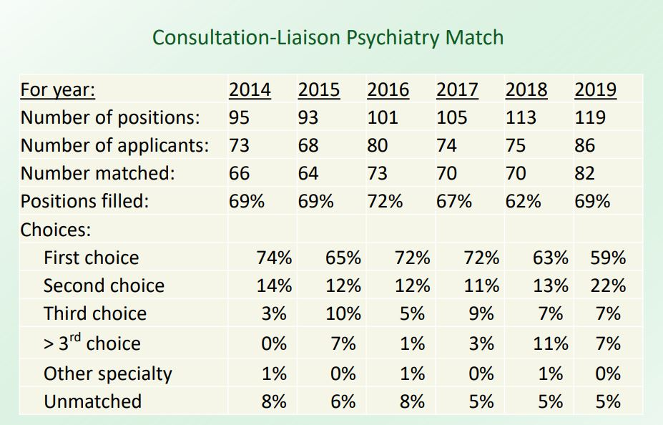
C-L Fellowship: Match Data
Notes:
There are more fellowship spots than applicants!
VAST majority of applicants get either their first or second choice

Slide 13
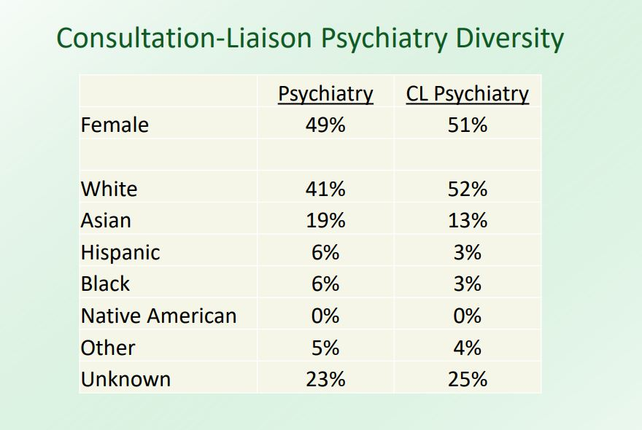
C-L Fellowship: Match Data

Slide 14
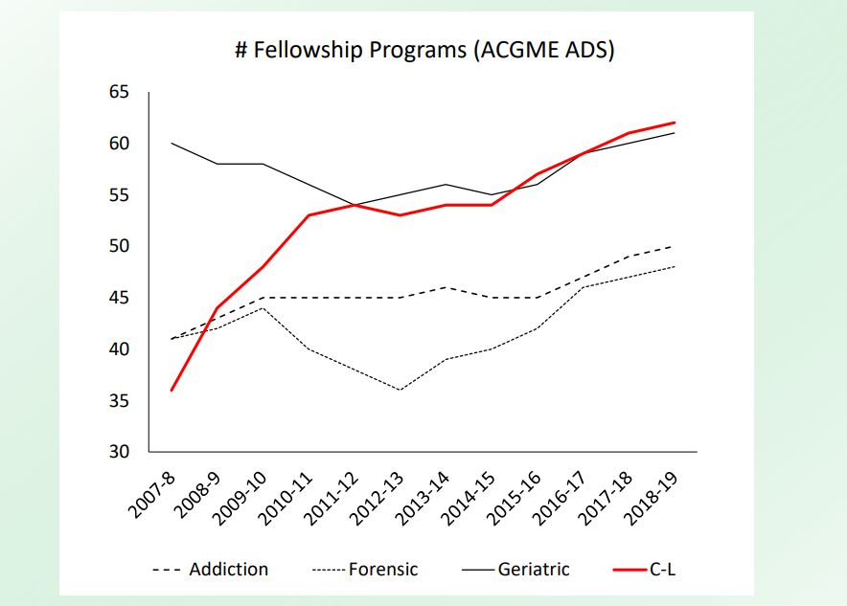
C-L Fellowship: Match Data

Slide 15
Resources for Prospective Applicants
APA Consultation-Liaison Psychiatry home page
APA Council on Consultation-Liaison Psychiatry (CoCLP)
ACLP Residents/Fellows Section
Guide: Becoming a CLP Fellow
Directory of US NRMP Match-Participating CL Fellowships
Common CLP Fellowship Application
ACLP Trainee Mentorship Program (due July 15)
ACLP Trainee Travel Award, Webb Fellowship (due July 1)
ACLP Early Career Psychiatrist (ECP) SIG and listserv!

Slide 16
Applying to C-L Fellowship: Q&A!

Slide 17
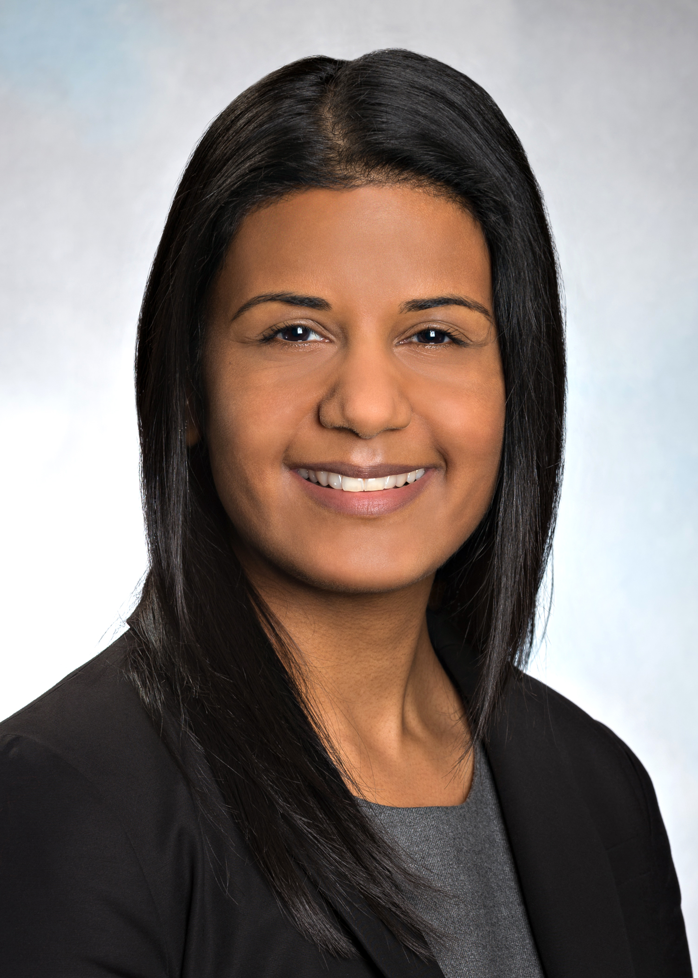
Applying to C-L Fellowship: Q&A Panel
Sejal Shah, MD
C-L Fellowship Director, Brigham and Women’s
Chair, APA Council on C-L Psychiatry (CoCLP)

Slide 18
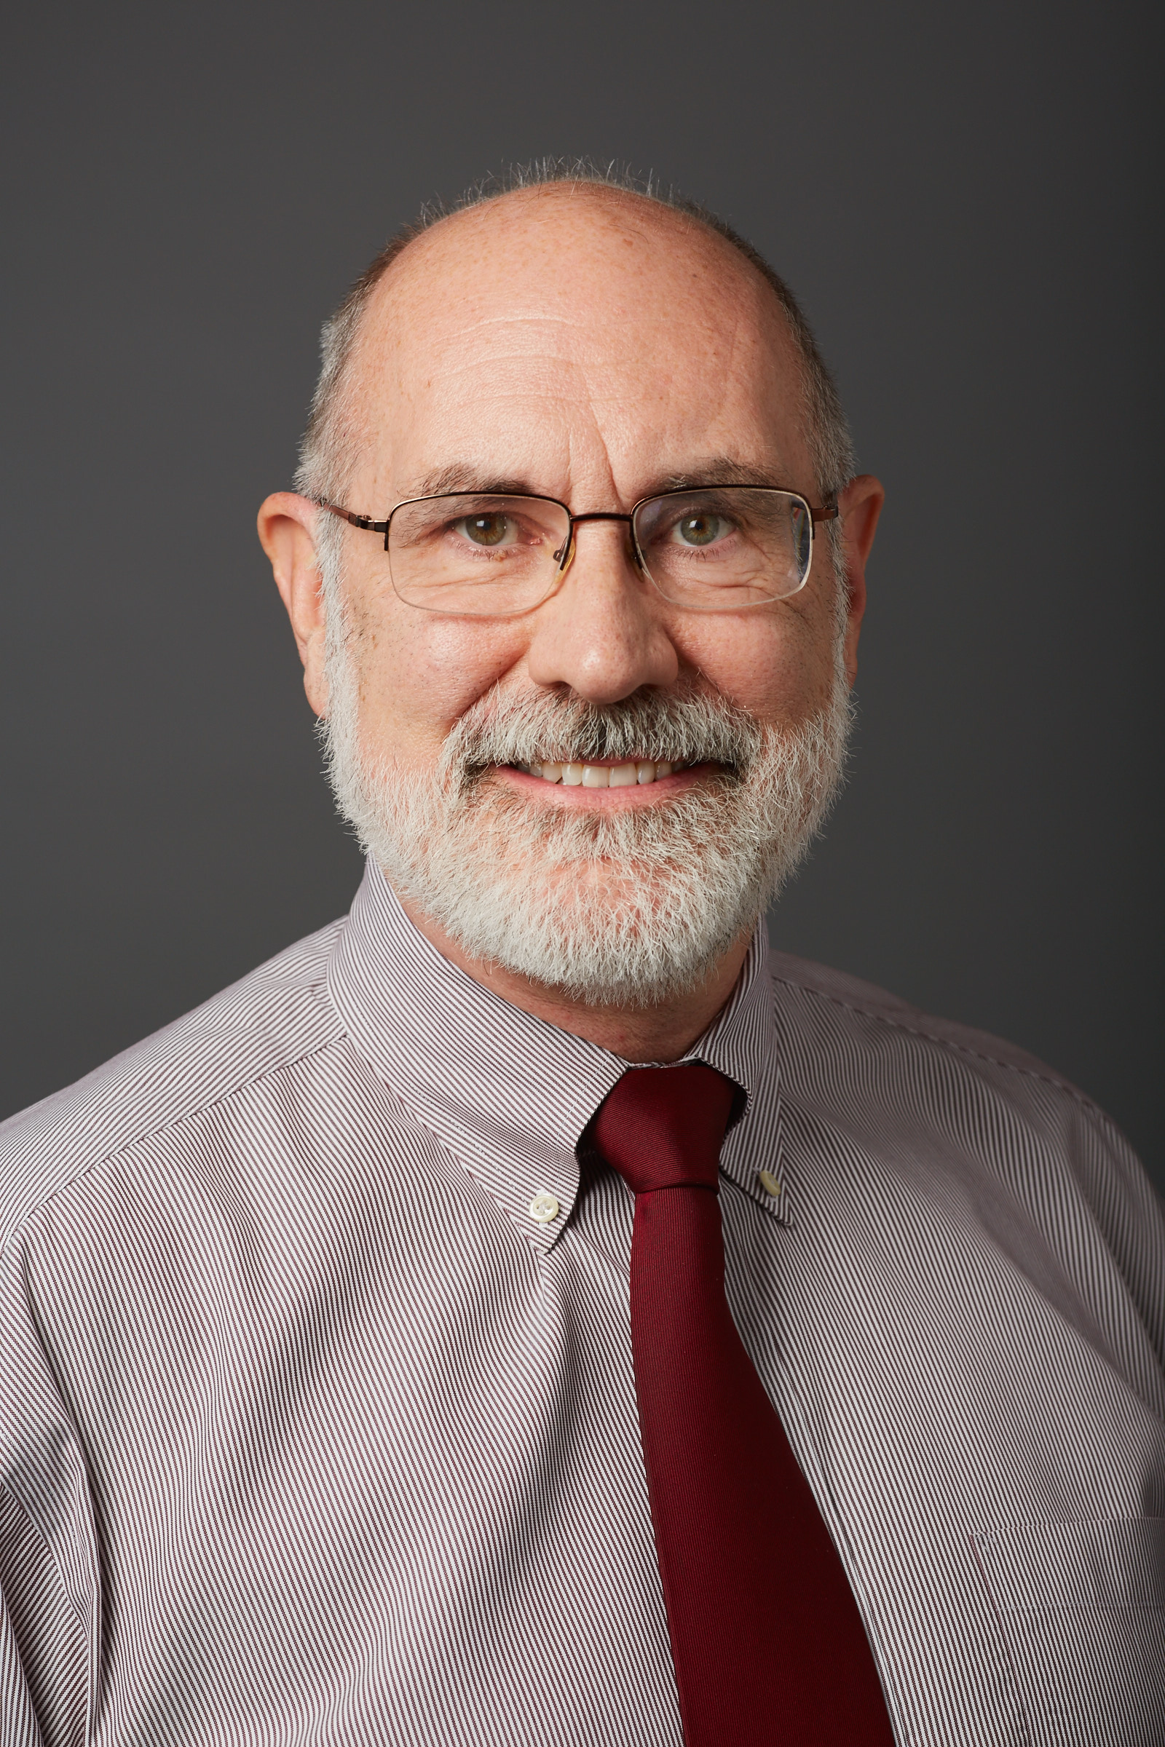
Applying to C-L Fellowship: Q&A Panel
Paul Desan, MD, PhD
C-L Fellowship Director, Yale
Chair, ACLP Education Committee

Slide 19
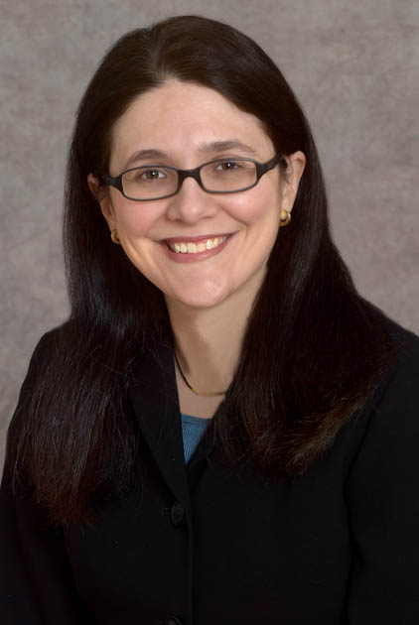
Applying to C-L Fellowship: Q&A Panel
Sara Nash, MD
C-L Fellowship Director, Columbia

Slide 20
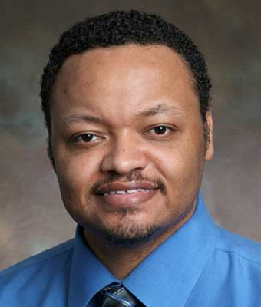
Applying to C-L Fellowship: Q&A Panel
Raymond Young, MD
C-L Fellowship Director, Emory

Slide 21
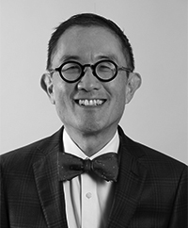
Applying to C-L Fellowship: Q&A Panel
Kewchang Lee, MD
C-L Fellowship Director, University of California-San Francisco

Slide 22
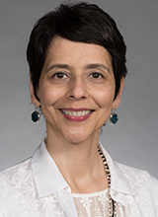
Applying to C-L Fellowship: Q&A Panel
Marcella Pascualy, MD
C-L Fellowship Director, University of Washington

Slide 23
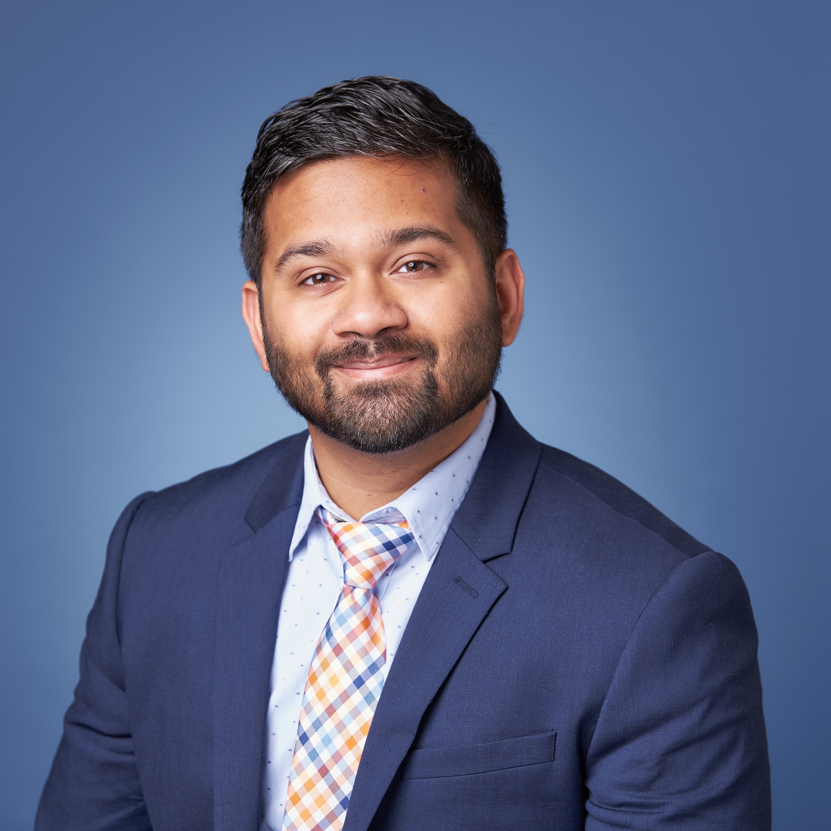
Applying to C-L Fellowship: Q&A Panel
Abhisek “Chandan” Khandai, MD
C-L Attending, University of Illinois at Chicago

Slide 24
And now, for Q&A!
If you’d like to ask a question, please message “All panelists” via Zoom chat, and we will answer questions as they come in!
If you want to ask a question confidentially, privately message Chandan and I will ask it for you!

Slide 25
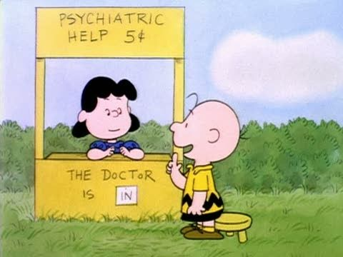
Thank you for joining us!
If you still have questions, email Michelle Dirst at mdirst@psych.org and she’ll forward them to us!
Special thanks to:
Michelle Dirst, APA Director of Practice Management Policy
James Vrac, ACLP Executive Director
Our amazing panel!

