Slide 1
Applying to C-L Psychiatry Fellowships in 2024: A Virtual Q&A
Presented by: Academy for Consultation-Liaison Psychiatry and American Psychiatric Association
Sunday June 2, 2024
6-7:30 pm EST/3-4:30 pm PST
This webinar is being recorded, and will be posted online for later viewing

Slide 2
Webinar Outline
Overview of C-L fellowship application process (15 minutes)
  Why C-L Psychiatry?
  Application timeline
  Application process
  Match data
ERAS: A Refresher (15 minutes)
Introduction of Q&A panel
Q&A with attendees (60 minutes)

Slide 3
Why C-L Psychiatry: So Many Facets!
Inpatient Consults (general)
Emergency Psychiatry
Women’s Mental Health, Perinatal Psychiatry
Psycho-Oncology
Transplant Psychiatry
Cardiac Psychiatry
Neuropsychiatry
Addictions Consults
Pain Psychiatry
Burns/Trauma Psychiatry
HIV/AIDS Psychiatry
Pediatric C-L
Proactive C-L
Integrated and Collaborative Care
Palliative Care
Geriatric Psychiatry

Slide 4
Why C-L Psychiatry: Diversity, Equity, and Inclusion (DEI)
Patients with psychiatric and substance use disorders are underserved in our general medical system
Minorities and underserved populations are underserved in our mental health system
C-L Psychiatry serves an important role in redressing disparities!
Embedded role within the larger healthcare system
Entry point for vulnerable patients into mental health treatment
Opportunities for advocacy and education of physician peers, health care staff

Slide 5
Why C-L Psychiatry Fellowship?
Required for the ABPN Consultation-Liaison Psychiatry Boards
Additional year to transition from trainee to attending
Sub-subspecialized training, ex. women’s mental health, psycho-oncology, transplant psychiatry
Exposure to new models of care: embedded clinics, collaborative care models, e-consultation, proactive consultation

Slide 6
C-L Fellowship: 2024-2025 Timeline
June-July 2024: Contact programs inquiring about C-L fellowship positions
July-September 2024: Complete, send out C-L fellowship applications (rolling cycle)
September-November 2024: Fellowship interviews
December 18, 2024: NRMP Rank lists due for both applicants and programs
January 8, 2025: C-L Fellowship Match!

Slide 7
C-L Fellowship: Deciding Where to Apply
Geographic location
Reputation: fellowship, residency, department, medical center
Number of fellows per year
Consult volume, workflow, team composition
Clinical experiences, inpatient vs outpatient
Didactics, extra-clinical opportunities
Academic time, reimbursement for educational costs, research, teaching
Policies for time off: Vacation, illness, parental leave, conferences
Well-being resources
Culture around diversity, equity, and inclusion (DEI)
Specific faculty and supervisors
Moonlighting
Notes:
Each person will of course have their own priorities, just some considerations for all applicants

Slide 8
C-L Fellowship: Two Ways to Apply 2024-2025!
Continuing 2024-2025 application season, C-L fellowship programs will have the OPTION to use either the ERAS application AND/OR institutional application
*We will talk about the institutional application on the next slide, and the ERAS process later in the talk*

Slide 9
C-L Fellowship: Institutional Application Materials
Will vary based on program! May include any/all of the following:
Common CLP fellowship application vs institutional application forms
Personal statement
CV
3 Letters of Recommendation (including 1 from residency PD)
Licensure forms (state, DEA)
Medical degree
Medical school dean’s letter
USMLE or COMLEX score report
International: ECFMG certificate, visa paperwork if applicable
  Canadian residents who have passed licensing exam requirements in Canada are eligible for US C-L fellowships!
Notes:
Can also send prints of journal articles or other extra materials
Most programs appreciate electronic sending- ask the programs ahead of time! Ask also if separate files, or as one big attachment
Keep these as email attachments to yourself
LOR- schools might have forms for programs to fill out; also ask if LOR can be emailed by senders, or need to be mailed

Slide 10
C-L Fellowship: Contacting Programs
June-July 2024: Contact each program you’re interested in, brief and professional email indicating your interest and requesting additional information and/or application materials, ex. ERAS or institutional application? Separate files or one big attachment for materials? Visa?
Example email
Dear Dr. Shah,
Hello! Hope this finds you well! I am applying for C-L fellowship this summer, and wanted to email you with my strong interest in Brigham's fellowship.
I also wanted to ask if you could please send me any formal application materials and requirements, as directed on the website. Looking forward to applying to the fellowship; have a nice weekend!
Sincerely,
Chandan Khandai
PGY-4 Psychiatry, Northwestern

Slide 11
C-L Fellowship: Interviews
2024-2025 season: AADPRT continues to recommend virtual interviews
Days off: Interview/academic days vs vacation days
August-October: Interview invites go out- reply promptly!
September-November: Interviews!
General tips:
  Ensure a quiet place with good wi-fi and lighting for virtual interviews
  Create a list of questions you may want to ask during the interview
  Keep a copy of your application for each program, know what you said!
  Have pdfs of your CV, publications available if needed to send to interviewers
  Thank the program post-interview!
Notes:
Reply promptly to have most choice of dates

Slide 12
C-L Fellowship: Ranking and Match Process
Regardless of ERAS or standard application, all fellowships use the NRMP Match process!
Register/re-register early for the NRMP Match!
October 16, 2024: NRMP Match opens
November 6, 2024: Rank list opens
After interviews: send your NRMP number to programs!
December 18, 2024: Rank order list deadline for applicants and programs
January 8, 2025: Match Day!

Slide 13
C-L Fellowship: Post-Match
Congratulations!
Start date of fellowship orientation vs finish date of residency
Permanent licenses you will need, is DEA mandatory?
If relocating:
  Housing- buy vs rent, neighborhoods
  Car vs public transit
  Benefits: healthcare, vacation, disability
  Finding new doctor, dentist, therapist, bank, childcare, house of worship, etc.
  Moving allowance?
Reach out to current fellows/faculty for advice!
Notes:
MA, NY, CA, TX licenses take a long time- start immediately after match for applying for license

Slide 14
C-L Fellowship: Applicant Match Data 2014-2024
Year | 2014 | 2015 | 2016 | 2017 | 2018 | 2019 | 2020 | 2021 | 2022 | 2023 | 2024
Number of CL Fellowship Positions | 95 | 93 | 101 | 105 | 113 | 119 | 117 | 124 | 126 | 126 | 132
Number of CL Fellowship Applicants | 73 | 68 | 80 | 74 | 75 | 86 | 76 | 89 | 90 | 87 | 103
Number Matched | 66 | 64 | 73 | 70 | 70 | 82 | 71 | 84 | 83 | 82 | 98
CL Fellowship Positions Filled (%) | 69% | 69% | 72% | 67% | 62% | 69% | 61% | 68% | 66% | 65% | 74%
CL Applicant Choice Matched (%)
First Choice | 74% | 65% | 72% | 72% | 63% | 59% | 75% | 65% | 70% | 60% | 52%
Second Choice | 14% | 12% | 12% | 11% | 13% | 22% | 12% | 23% | 7% | 20% | 18%
Third Choice | 3% | 10% | 5% | 9% | 7% | 7% | 3% | 3% | 6% | 8% | 10%
>Third Choice | 0% | 7% | 1% | 3% | 11% | 7% | 4% | 3% | 10% | 7% | 15%
Other Specialty | 1% | 0% | 1% | 0% | 1% | 0% | 0% | 1% | 0% | 1% | 1%
Unmatched | 8% | 6% | 8% | 5% | 5% | 5% | 7% | 5% | 8% | 5% | 4%
More fellowship spots than applicants! And most applicants get first or second choice!
Notes:
There are more fellowship spots than applicants!
VAST majority of applicants get either their first or second choice

Slide 15
Psychiatry vs C-L Match: Demographic Data
2019
2023
 | Psychiatry | C-L Psychiatry
Female | 49% | 51%
White | 41% | 52%
Black | 6% | 3%
Latino | 6% | 3%
Asian | 19% | 13%
Native American | 0% | 0%
Other | 5% | 4%
Multiple | N/A | N/A
Unknown | 23% | 25%
 | Psychiatry | C-L Psychiatry
Female | 51% | 59%
White | 47% | 46%
Black | 8% | 5%
Latino | 11% | 8%
Asian | 25% | 32%
Native American | 0% | 0%
Other | 3% | 4%
Multiple | 5% | 2%
Unknown | 1% | 3%
(SLOWLY) increasing diversity within C-L fellowship applicants, but more work needed!
Notes:
2022 US pop estimates: White 59.3%, Black 13.6%, Latino 18.9%, Asian 6.1%, Native American 0.3%, Multiple 2.9%

Slide 16
Resources for Prospective Applicants
APA Consultation-Liaison Psychiatry home page
APA Council on Consultation-Liaison Psychiatry (CoCLP)
ACLP Residents/Fellows Section
  Guide: Becoming a CLP Fellow
  Directory of US NRMP Match-Participating CL Fellowships
  Common CLP Fellowship Application
ACLP Trainee Mentorship Program for residents (due August 31)
ACLP Trainee Travel Award, Webb Fellowship (both due July 1)
ACLP Early Career Psychiatrist (ECP) SIG and listserv
Facebook: Consultation-Liaison Psychiatry Educational Network (CL-PEN)

Slide 17
ERAS: A Refresher
Laurel Constantine
Senior ERAS Training Specialist, Association of American Medical Colleges (AAMC)

Slide 18
2025 MyERAS® Application Overview

Slide 19
Objectives
  Applying to ERAS®
  MyERAS Application Content Highlights
  Resources

Slide 20



ERAS Process
01
02
03
YOU APPLY
Learners apply to a residency or fellowship program using MyERAS
WE DELIVER
your application and supporting documents to residency or fellowship programs chosen by applicant
PROGRAMS RECEIVE
and review applications and other supporting documents

Slide 21




Services Offered by ERAS
MyERAS
DWS
PDWS
LoRP
For residency and fellowship applicants (MD, DO, IMG) in which learners complete their applications, select programs, assign supporting documents, and submit their materials to their selected programs.
For medical school contacts at Designated Dean's Offices (DDOs) to upload documents in support of applications submitted through MyERAS.
For program contacts (Directors, Coordinators, Reviewers, Interviewers, etc) to receive and review the applications and supporting documents.
For LoR Authors and uploaders to submit letters in support of applications submitted through MyERAS.

Slide 22








Key Stakeholders

Slide 23
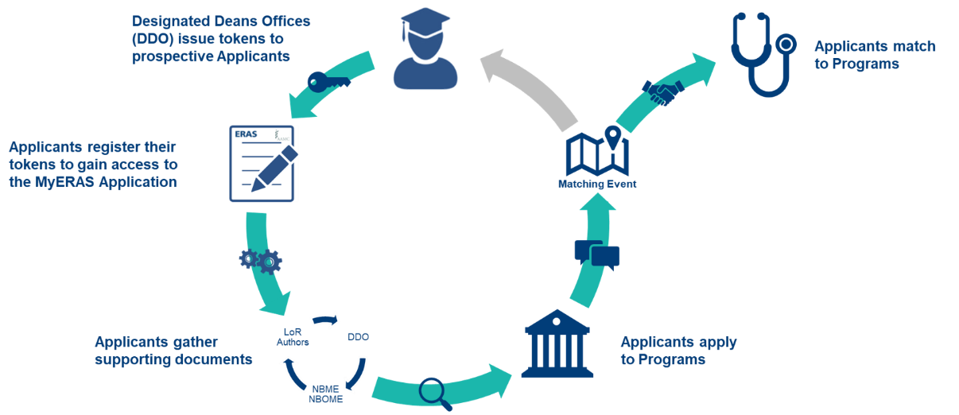
ERAS Application Process

Slide 24
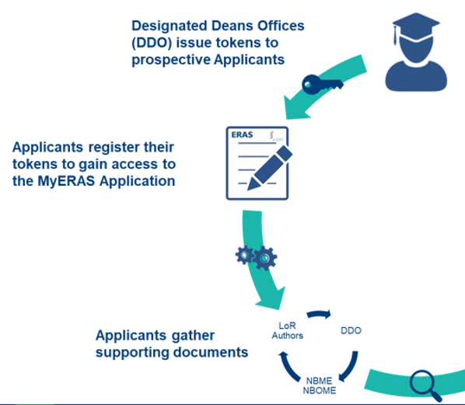
Season Start
Season begins on June 5
ERAS Communications
ERAS Applicant Webinar
    June 25: Effectively Utilizing MyERAS Webinar

Slide 25
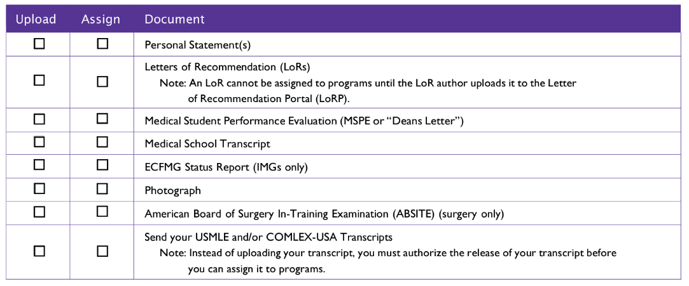
Applicant Fellowship Documents in ERAS
ERAS application and standard documents must be sent through ERAS

Slide 26


Experiences
Selected Experiences
(up to 10)
Meaningful Experiences
(up to 3)
Impactful Experience
All Applicants
If Applicable
Provide descriptive information
As applicable, select experience type, primary focus area, and key characteristic
Briefly describe activities, responsibilities, and context
From selected experiences, identify up to 3 meaningful.
Write short essay reflecting on experience and explain why it was meaningful and how it influenced you
This question is intended for applicants who have overcome major challenges or obstacles.
Family background
Financial background
Community setting
Educational experiences
Other general life circumstances

Slide 27
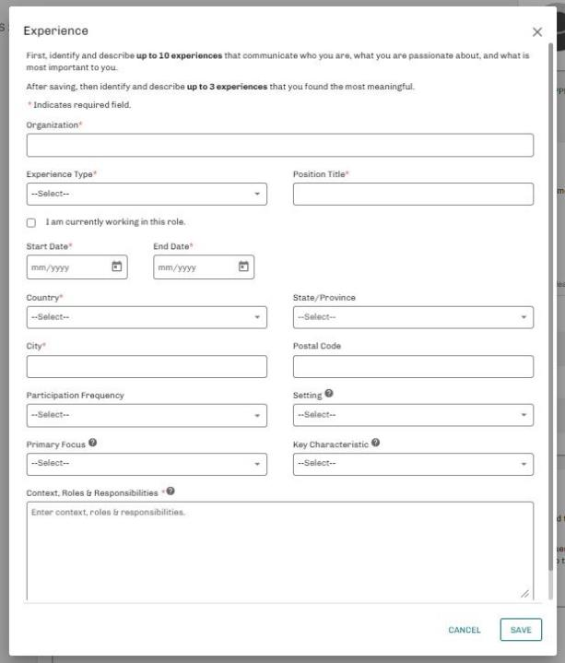

Slide 28



Geographic Preferences
Geographic Preference Divisions
(up to 3)
Setting Preference
Location Standardization
All Applicants
Select up to three geographic divisions; using US census divisions OR indicate no preference
Short description to provide explanation for each
Indicate a degree of preference from urban to rural setting OR indicate no preference
Short description to provide explanation
Urban, urban/suburban, suburban, suburban/rural, rural
Standard Collection of all location information:
Country
State
City
Postal Code
Setting
Applies to:
Addresses
Hometown(s)
Experiences
Education
Training

Slide 29

Summary of MyERAS 2025 Changes
Standardizing/structuring the collection:
  Higher education institution and field of study (replacing open/free text entry).
  Honors, awards, and memberships (replacing open/free text entry).
  Medical education interruptions (moved and updated language).
  Board and healthcare-related certifications.
    Removing separate collection of ACLS, PALS, BLS.
Collecting only languages applicants have good or better proficiency (including English).
Reduce limit on Hometowns from 5 to 3.
Hobbies and interests being collected again in Experiences section as a standalone question.

Slide 30

Applying to Programs
July Cycle Fellowship Application
Openings:
Applicant opening – July 3
Program Opening – July 17

Slide 31
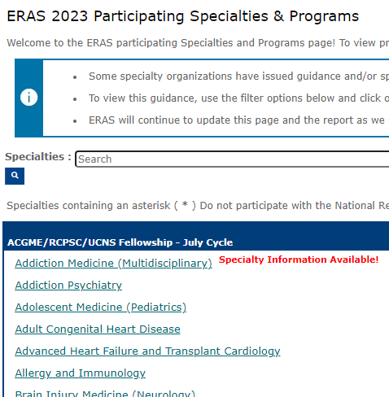

ERAS Participating Programs & Specialties
54 participating Residency Specialties
78 participating Fellowship Specialties

Slide 32
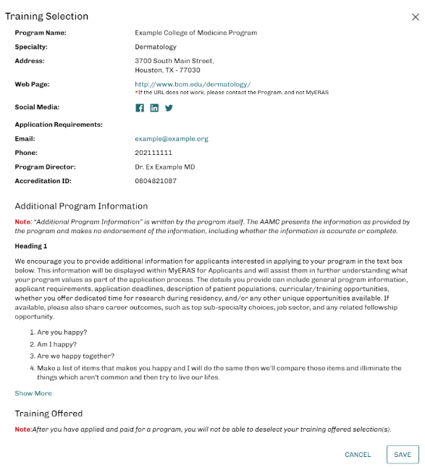
Program Listings in MyERAS
Specific criteria or document requirements each program is seeking in their applicants

Slide 33
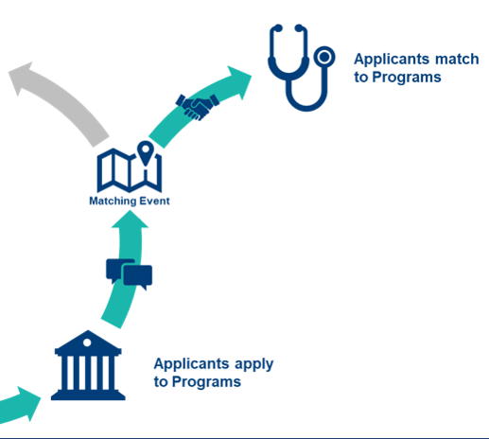
Interviewing & Matching with Programs
Review Documents
Conduct Interviews
Upcoming Match Events

Slide 34
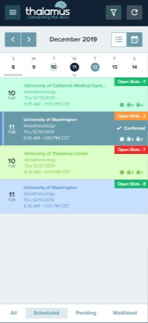
What can applicants expect for Thalamus in ERAS 2025?
All Thalamus products are entirely free to applicants.
Majority of program interviews will be managed in Thalamus.
Virtual, hybrid and in-person interviews.
Web + mobile versions to schedule anywhere at anytime.
ERAS integration enables early account access.

Slide 35
ERAS Resources

Slide 36
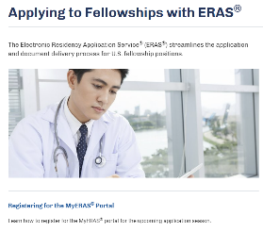
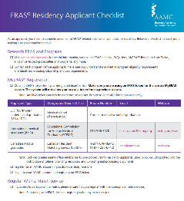
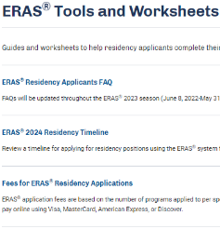
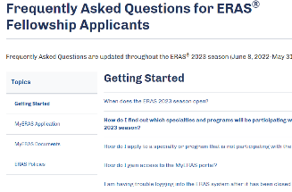
Resources for the Application Season
MyERAS User Guide
Fellowship Application Checklist
ERAS Timeline
FAQs for ERAS Fellowship Applicants
https://students-residents.aamc.org/applying-fellowships-eras/applying-fellowships-eras

Slide 37
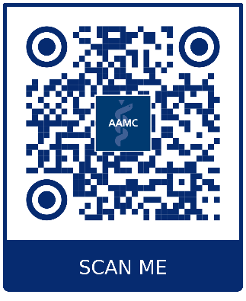
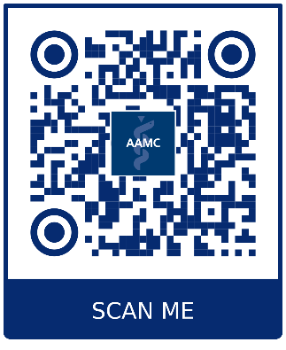
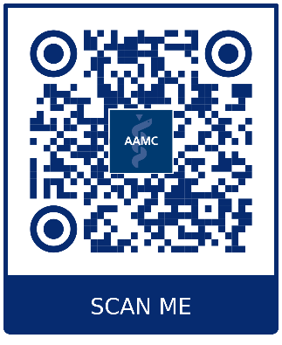
For more information:
Supplemental ERAS Application Data and Reports:
What’s New in the 2025 MyERAS Application
The MyERAS Application and Program Signaling for ERAS 2025

Slide 38



Additional Assistance
Contact our AAMC Support Center (ASC)
ASC Hours of Operation
Via our Contact Form
By Phone
  Weekdays
  8 a.m. – 6 p.m. ET
For Applicants: 202-862-6264

Slide 39
Applying to C-L Psychiatry Fellowships in 2024: Q&A!

Slide 40
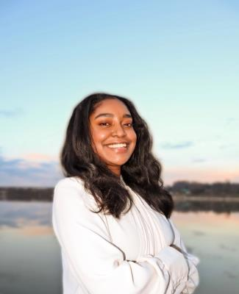
Applying to C-L Psychiatry Fellowships in 2024: Q&A Panel
Laurel Constantine
Senior ERAS Training Specialist, Association of American Medical Colleges (AAMC)

Slide 41
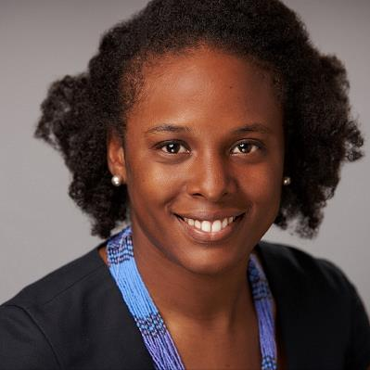
Applying to C-L Psychiatry Fellowships in 2024: Q&A Panel
Adrienne Taylor, MD
C-L Psychiatry Fellowship Director, Brigham and Women’s
Associate Director of Medical Psychiatry Service, Brigham and Women's

Slide 42
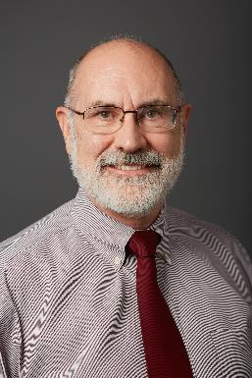
Applying to C-L Psychiatry Fellowships in 2024: Q&A Panel
Paul Desan, MD, PhD
C-L Psychiatry Fellowship Director, Yale
Director of Psychiatric Consultation Service, Yale
Vice President, ACLP Board of Directors

Slide 43
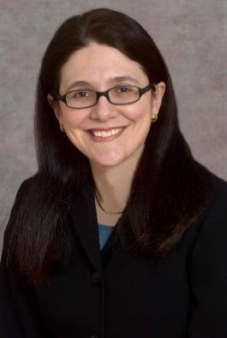
Applying to C-L Psychiatry Fellowships in 2024: Q&A Panel
Sara Nash, MD
C-L Fellowship Director, Columbia

Slide 44
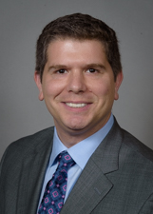
Applying to C-L Psychiatry Fellowships in 2024: Q&A Panel
Samuel Greenstein, MD
C-L Psychiatry Fellowship Director, Long Island Jewish-North Shore University Hospital

Slide 45
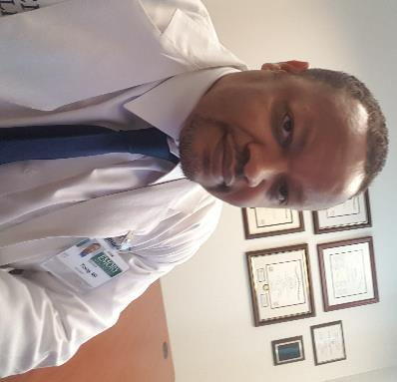
Applying to C-L Psychiatry Fellowships in 2024: Q&A Panel
Raymond Young, MD
C-L Psychiatry Fellowship Director, Emory
Division Chief of Psychiatric C-L Services, Emory

Slide 46
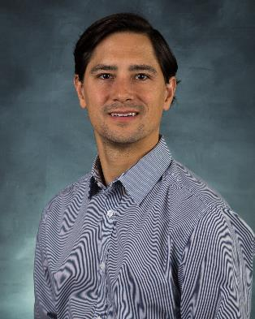
Applying to C-L Psychiatry Fellowships in 2024: Q&A Panel
Tom Soeprono, MD
C-L Psychiatry Fellowship Director, University of Washington
Director of Transplant Psychiatry, University of Washington
Chair, ACLP Resident Education Subcommittee

Slide 47
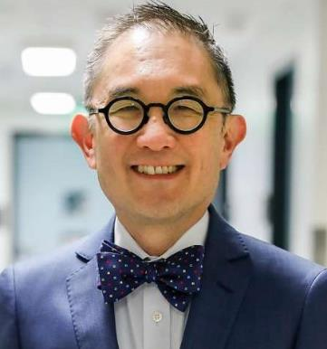
Applying to C-L Psychiatry Fellowships in 2024: Q&A Panel
Kewchang Lee, MD
C-L Fellowship Director, University of California-San Francisco
Chair, ACLP Fellowship Education Subcommittee
Director, ACLP Board of Directors

Slide 48
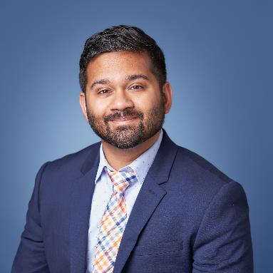
Applying to C-L Psychiatry Fellowships in 2024: Q&A Panel
Abhisek “Chandan” Khandai, MD
C-L Psychiatry Attending, UT Southwestern
Co-Chair, ACLP DEI Subcommittee

Slide 49
And now, for Q&A!
If you’d like to ask a question, please use the Q&A function in the chat, and we will answer questions as they come in!

Slide 50
Resources for Prospective Applicants: Redux
APA Consultation-Liaison Psychiatry home page
APA Council on Consultation-Liaison Psychiatry (CoCLP)
ACLP Residents/Fellows Section
  Guide: Becoming a CLP Fellow
  Directory of US NRMP Match-Participating CL Fellowships
  Common CLP Fellowship Application
ACLP Trainee and ECP Mentorship Program for residents (due Sept 15)
ACLP Trainee Travel Award, Webb Fellowship (both due July 1)
ACLP Early Career Psychiatrist (ECP) SIG and listserv
Facebook: Consultation-Liaison Psychiatry Educational Network (CL-PEN)
Upcoming AAMC Webinar: Effectively Utilizing MyERAS Webinar on June 25 at 7:00 p.m. ET

Slide 51

Thank you for joining us!
Special thanks to:
ACLP Fellowship Education Subcommittee
ACLP Mentorship Subcommittee
ACLP DEI Subcommittee
APA Council on C-L Psychiatry
James Vrac and Autumn Menefee, ACLP staff
Brooke Trainum, APA staff
Our amazing panel!
Feel free to email our moderator:
Chandan.Khandai@gmail.com
I want YOU to apply C-L!
This event is part of the ongoing ACLP Mentorship Workshop Series

