Slide 1
Cardiac Psychiatry: Review and Updates
Scott R. Beach, MD, FAPM
Avery D. Weisman Psychiatric Consultation Service
Program Director, Adult Psychiatry Residency
Massachusetts General Hospital
MGH Cardiac Psychiatry Research Group
Assistant Professor in Psychiatry, Harvard Medical School
Version of March 15, 2019

Slide 2
Outline
QT Interval and Psychiatric Medications
  Defining and calculating the QT and QTc intervals
  Antidepressants and QT prolongation
  Antipsychotics and QT prolongation
Cardiotoxicity with Clozapine
Depression in Cardiac Patients

Slide 3
Goals of this Update
Antidepressants and antipsychotics can have some effect on QTc
  Is citalopram different than other SSRIs?
  Has the citalopram warning had unexpected negative consequences?
  Which antipsychotic has the greatest risk of increasing QTc?
Clozapine has various forms of cardiotoxicity
  What are the current recommendations for screening and treatment?
Depression is associated with multiple forms of heart disease
  Is depression a risk factor for cardiac disease?
  What about depression and cardiac outcomes?
  What about depression in heart failure?

Slide 4
What is the QT Interval?
QT interval - ventricular depolarization and repolarization
Depolarization
  Rapid influx of sodium ions
  Measured by QRS interval
  A small handful of psychiatric medications block Na channels
    TCAs, carbamazepine, lithium, loxapine, trifluoperazine
Repolarization
  Potassium channels are the most important
  Also involves calcium and sodium channels
  Almost all drugs (including most psychiatric medications) that prolong QT do so by blocking Ikr
Duration of repolarization is inversely related to heart rate

Slide 5
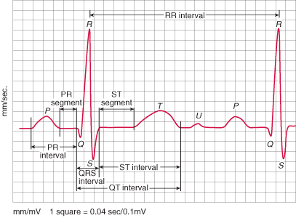
Normal ECG Recording
0.04 sec
Voltage (mV)
Time (sec)
Notes:
P: atrial depolarization
PR: onset of P wave to beginning of QRS; normally ranges from 0.12 to 0.20 sec; represents time between onset of atrial depolarization and onset of ventricular depolarization. If >0.2 sec, there is an AV conduction block
QRS: ventricular depolarization; normally 0.06 to 0.1 seconds (short) b/c ventricular depolarization occurs rapidly. If QRS is prolonged (> 0.1 sec), conduction is impaired within the ventricles (ex- BBB)
ST segment: Isoelectric period following the QRS is the time at which the entire ventricle is depolarized and roughly corresponds to the plateau phase of the ventricular action potential. The ST segment is important in the diagnosis of ventricular ischemia or hypoxia
T: ventricular repolarization
QT: beginning of QRS complex to the end of the T wave; represents the time for ventricular depolarization and repolarization , and roughly estimates the duration of an average ventricular action potential. This interval can range from 0.2 to 0.4 seconds depending upon heart rate. In practice, correct Q-T interval for HR (since shortens at faster HR) so expressed as a "corrected Q-T (QTc)" by taking the Q-T interval and dividing it by the square root of the R-R interval (interval between ventricular depolarizations). Should be manually measured in 1 lead b/c automated ECG machines usually measure the QT as longer than it actually is. Ideally get EKG at or near max daily blood level of medications affecting the QT interval. Most commonly used formula to correct the QT interval is Bazett’s.

Slide 6
How Do You Measure QT and Correct for Rate?
ECG uses Bazett’s formula: QTc = QT / RR^{1/2}
  RR and QT are measured in seconds
  Not accurate at heart rates significantly different than 60 bpm
AHA recommends linear formula
  Hodge’s: QTc = QT + 1.75(HR-60)
  Framingham: QTc = QT + 0.154(1-RR)
Most reliable method of measuring the QT is by hand
  Should be measured in lead with the longest interval (often V2 or V3)
QT interval not useful measure of risk in LBBB and paced ventricular rhythm - depolarization increased at baseline
  Use JT Index; JT = QT – QRS; JTI = [JT(HR+100)/518]
    Prolonged JTI >112 ms
For atrial fibrillation, there is really no good method

Slide 7
Example of Calculation of QTc using Bazetts vs. Hodges
Using Bazett,
If the QT interval derived by hand is 420ms,
And the HR is 120bpm,
Then the R-R interval is 60seconds * 1000/HR = 500ms = 0.5s
And the QTc is .420/√0.5 = .594s = 594ms
Using Hodges,
QTc = 420ms + 1.75(120-60) = 525ms

Slide 8
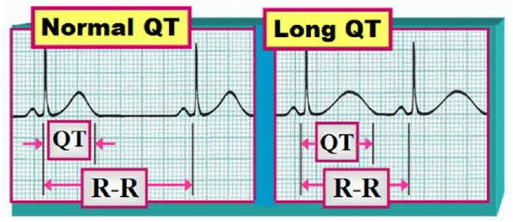
Prolonged QTc
QT < ½ of the R-R interval QT> ½ of the R-R interval
QTc (msec) Male Female
Normal < 430 < 450
Borderline 431-450 451-470
Prolonged > 450 > 470 (or 460)
https://www.kg-ekgpress.com/ecg_web_brain_DEMO_-_chapter_7_-_qt_interval/
Notes:
Because prolonged Q-T intervals can be diagnostic for susceptibility (biomarker) to certain tachyarrhythmias and large pop based studies have linked prolonged QTc to incr mortality, it is important to determine if a given Q-T interval is excessively long. If HR close to 60, can ID QTc prolongation by seeing if QT interval appears to be greater than half of the RR interval. Would want to manually measure too. In addition to HR, age and sex impact QT interval. QT interval generally longer in young women.
We use “normal” cut-off values but in reality the QTc interval presents a continuous RF for adverse events. QTc> 500 seems to be universally agreed upon as a RF for tdP; AHA expert committee group recommended that QTc over 99th percentile should be considered abnormally prolonged, which translated into 450ms for males, 470 ms for females (? Genetic or hormonal diffs that affect the QT interval, probably through an action on the molecular mechanisms that regulate ventricular repolarization).
2 ways to prolong QT: slow depolarization by blocking inward current thru Na channels (get widened QRS/prolonged PR) or slow repolarization by blocking K rectifier channels (T interval/QT)- most drugs- may have diff clin significance

Slide 9
What is Clinically Relevant QTc Change?
US Department of Health and Human Services;
www.fda.gov/downloads/RegulatoryInformation/guidances/ucm129357.pdf
FDA¹
  Threshold level of regulatory concern:
  Increase of 5 ms above baseline
Clinical Consensus
  QTc >500 ms (others say >450 or >480)
  Change from baseline: ≥ 30 ms OR ≥ 60 ms
Notes:
FDA provides definitions of clinically relevant changes in QTc intervals. FDA notes that there is no consensus concerning the choice of upper limit values for absolute QT/QTc interval and changes from baseline. While lower limits increase the false-positive rate, higher limits increase the risk of failing to detect a signal of concern. In clinical trials, a prolongation of QTc > 500 ms or an increase of more than 60ms during therapy has been a threshold of particular concern in terms of a/w incr risk tdp and should in most cases lead to discontinuation of the drug. Multiple analyses using different limits are a reasonable approach to this uncertainty. Threshold level of regulatory concern is an increase of around 5ms above baseline

Slide 10
Risk Factors for QT Prolongation
  Congenital Long QT Syndrome
    12% of patients with LQTS have QTc in the “normal range”
    5-10% of patients who develop TdP may be silent carriers of gene mutations
  Increased age
  Female sex (between adolescence and elderly)
    Normal QTc interval <460 ms for women and <450 ms for men
  Bradycardia, frequent ectopy
  Hypokalemia, hypocalcemia, and hypomagnesemia
  Multiple medical conditions
  Diurnal variation up to 75-100 ms - sleep is a risk factor
  Alcohol, cocaine
  Medications (partial list)
    Macrolide and quinolone antibiotics, methadone, antifungals (enzyme inhibition), antimalarials, cisapride

Slide 11
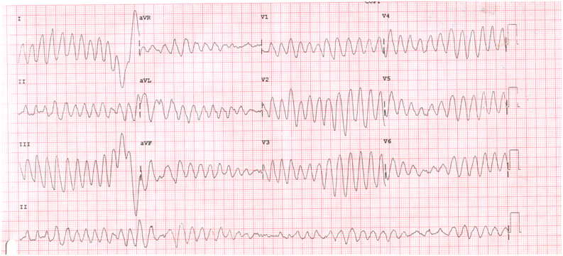
Torsades de Pointes (TdP)
Notes:
QT is at best only modestly a/w TdP but is still the best predictor available. Prolonged QT is established RF for TdP- an unusual but life-threatening polymorphic ventricular tachycardia/arrhythmia. Term means twisting of the points and refers to pattern of polymorphic ventricular tachycardia seen on EKG. Typically, the arrhythmia is short lived and asymptomatic, but it can unexpectedly degenerate into Vfib leading to syncope & sudden death. Mech not entirely clear. EKG warning signs that precede TdP include marked QTc prolongation, PVCs, etc. This rhythm is usually unresponsive to common antiarrhythmic meds but may resolve with infusion of Mg sulfate, overdrive pacing, or isoproterenol infusion to increase HR (and thus shorten the QTc) and removal of the offending agent. If left untreated, it may recur, with deterioration to Vfib and death. Prevalence of TdP in gen pop is rare, between 1/100,000 & 1/1,000,000

Slide 12
What is the Relationship between QTc and Torsades de Pointes (TdP)?
QT prolongation is a surrogate marker, but not always associated with TdP
Risk for cardiac event is 1.052^{x}; “x” is the 10msec increase in QTc over 400
  500msec = 1.66-fold increase compared to 400 msec
  525msec = 1.88-fold increase compared to 400 msec
  550msec= 2.14-fold increase compared to 400 msec
  600msec = 2.76-fold increase compared to 400msec

Slide 13
Antidepressants and QT Prolongation
Tricyclics
  Sodium channel blockers
  Pose danger at therapeutic doses, primarily in patients with pre-existing bundle branch disease or ischemic heart disease
  Amitriptyline and Maprotiline most commonly implicated; clomipramine may be least likely
SSRIs
  Had been considering safe; overall magnitude of QTc increase with most SSRIs is small
  Most studied in cardiac populations
  Case reports for all agents except paroxetine linked to QT prolongation or TdP existed prior to 2011
  New data to suggest that citalopram appears to be the worst offender (and escitalopram to a lesser extent)

Slide 14
The Citalopram Controversy
8/24/11: FDA Drug Safety Communication
  Citalopram should not be prescribed at doses greater than 40mg
  Citalopram should not be used at doses >20mg in those with liver dysfunction or over age 60
3/28/12: FDA Revised Recommendation
  Citalopram is not recommended at doses greater than 40mg
  Citalopram should be discontinued in anyone with QTc>500msec
Recommendations based on a single study showing increase of 8.5msec at 20mg and 18.5msec at 60mg
Actual QTc prolongation remains minimal (~6ms per 20mg citalopram)
Similar study conducted with escitalopram (4.5 msec at 10mg and 10.7 msec at 30mg) but no FDA recommendations

Slide 15
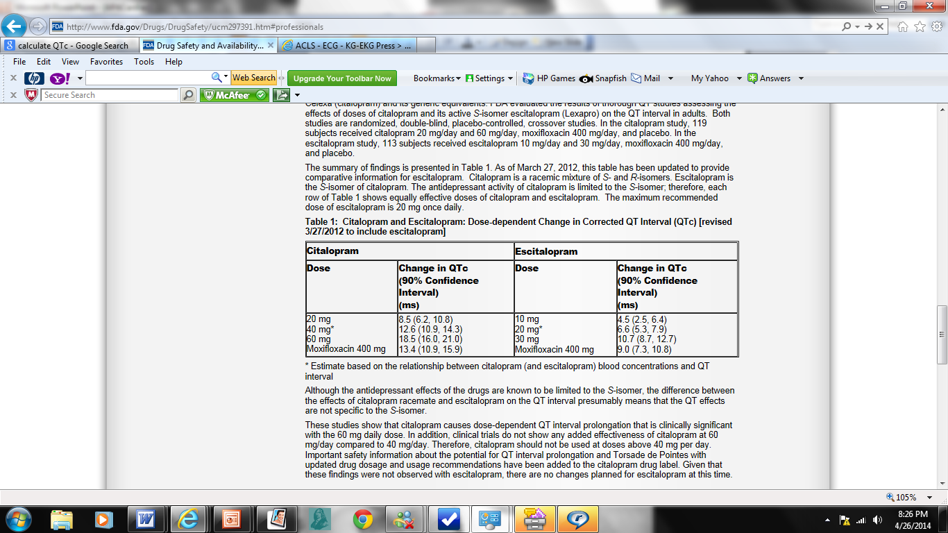
Citalopram and QTc: FDA Mandated Study Results
(N=119)
(N=113)
http://www.fda.gov/Drugs/DrugSafety/ucm297391.htm; revised 3/28/12
Notes:
Warnings regarding C based on randomized, multi-center DBPC Xover study mandated by the FDA- unpublished- also postmarketing reports of long QT and tDP a/w citalopram; FDA evaluated the results of 2 QT studies assessing the effects of doses of citalopram and its active S-isomer escitalopram (Lexapro) on the QT interval in adults. Both studies are randomized, double-blind, placebo-controlled, crossover studies. In the citalopram study, 119 subjects received citalopram 20 mg/day and (3 different 22 d txs separated by 14 d), moxifloxacin/placebo, and citalopram 60 mg/day. In the escitalopram study, 113 subjects received escitalopram 10 mg/day and 30 mg/day, moxifloxacin 400 mg/day/ placebo.
Citalopram- racemic mix of S- and R-isomers. Escitalopram is the S-isomer. These studies show that citalopram causes dose-dependent QT interval prolongation that is clinically significant with the 60 mg daily dose. In addition, clinical trials do not show added effectiveness of C at 60 mg/day compared to 40 mg/day. Even though absolute change in QTc was modest, FDA concluded that no evidence for therapeutic benefit of 60 compared with 40 to warrant the risk of additional QT prolongation at this higher dose. Therefore, citalopram should not be used at doses above 40 mg per day. Very controversial because good prospective and retrospective data suggesting no QT prolongation; also was small study that demonstrate QTc increases below the previously recognized threshold for concern.
Study of escitalopram found dose-dependent but substantially less marked increases for QTc and no FDA changes planned for escitalopram at this time. British Medicines and Healthcare Products Regulatory Agency did issue guidelines regarding escitalopram, specifically recommending avoiding use if prolonged QTc, LQTS, concomitant QT prolonging meds and suggested max dose of 10mg in those > 65 or those with hepatic impairment; C may be diff from other SSRIs- inhibits hERG in animal models
Of note 1 study of 215 pts who od’d on celexa found only 2% had QTc> 500; 32% had QTc>440

Slide 16
Is Citalopram Unique? Evidence Since the 2011 Warning
Cross-sectional study of ECG’s in 38,000 patients
  Citalopram associated with dose-dependent QTc increase of similar magnitude to FDA study
Systematic review and meta-analysis of 16 prospective studies (4292 patients)
  Compared to placebo, SSRIs increased QTc by 6.10 msec
  Compared to TCAs, SSRIs decreased QTc interval by 7.05 msec
  Citalopram (11ms) and escitalopram (7ms) had statistically greater QTc prolongation than placebo, with citalopram separating from all agents except escitalopram
Subanalysis of citalopram for agitation in Alzheimer’s
  Mean increase of 18.1msec after 3 weeks of 30mg daily
Retrospective study of drug-induced QT prolongation
  Association with citalopram after controlling for other risk factors
  Castro 2013, Beach 2014, Drye 2014, Girardin 2013

Slide 17
What about Citalopram and TdP?
Evidence is less clear
VA cohort study of 975,000 patients prescribed citalopram or sertraline 2004-2009
  Citalopram doses >40mg associated with lower risk of ventricular arrhythmia, noncardiac and all-cause mortality than doses 1-20mg
Tennessee Medicaid cohort study
  High-dose citalopram does not differ from other agents in terms of sudden cardiac death or mortality
Perhaps citalopram increases the QT interval but the actual risk of TdP associated with this increase is not clinically significant
  Zivin 2013, Ray 2016

Slide 18
Prescribing Lower Doses of Citalopram Has Risks Too
50-65% of patients prescribed doses of greater than 40mg at the time of the warning were prescribed 40mg or less within 2 years
  Increased prescriptions for interacting medications
FDA citalopram warning may result in increased rates of psychiatric hospitalization and mortality
  All cause hospitalizations or death significantly increased after dosage reductions (adjusted HR 4.5; 95%CI 4.1-5.0) as did hospitalizations for depression or all-cause death (adjusted HR 2.2, 95%CI 1.8-2.6)
  Hospitalizations for arrhythmias did not decline and all-cause death remained stable
Patients with citalopram reflexively reduced more likely to be prescribed sedatives or anxiolytics and had higher healthcare utilization
Austin 2014, Friesen 2015, Rector 2016, Gerlach 2016

Slide 19
What about Escitalopram?
Similar pattern of dose-related QT-lengthening in thorough QT study, but no FDA warning
Escitalopram does separate out in some studies
Meta-analysis of patient level data
  2407 patients prescribed escitalopram compared to 1952 patients on placebo
  Mean QTc increase of 3.5 msec
  1 patient had QTc >500msec and baseline change >60msec
  Incidence and types of cardiac adverse events similar between escitalopram and placebo
Not associated with greater mortality in Tennessee Medicaid cohort
Thase ME, et al. 2013, Ray 2016

Slide 20
Other Antidepressants
Bupropion
  Reports of QT prolongation in setting of overdose but confounded by tachycardia
Venlafaxine
  Two case reports of QT prolongation at therapeutic dose
  In overdose, 1% of 223 patients had QTc>500ms
Duloxetine
  One report of QT prolongation (but only to 460msec)
Mirtazapine
  In overdose, 0 of 103 patients had QTc>500ms
Vilazodone
  No association with QTc prolongation

Slide 21
How Should I Use Antidepressants in Patients at Risk for QT Prolongation?
Overall magnitude of QTc increase with SSRIs is small
Citalopram appears to be worst offender (and escitalopram to lesser extent) but actual QTc prolongation still minimal
Citalopram may not be first choice for patients with pre-existing cardiac disease
Do not reflexively reduce citalopram dose without careful risk/benefit evaluation
Compelling case can be made for using higher doses of citalopram in specific patients, but needs to be done judiciously and employing ECG monitoring
Not significant evidence separating citalopram from escitalopram to recommend switching all patients taking citalopram to escitalopram
No indication for baseline ECG with all antidepressant initiation
Consider baseline ECG and electrolytes before starting Citalopram in a patient with significant TdP risk factors

Slide 22
What About Other Psychiatric Medications?
Lithium
  Can prolong QTc at concentrations >1.2mmol/L, but no cases of TdP
Most anticonvulsant mood stabilizers have no QTc effect
  Carbamazepine rarely associated with QT prolongation
Trazodone has been associated with mild QTc prolongation, usually in overdose
Stimulants not linked to QTc prolongation or TdP
Benzodiazepines not linked to QTc prolongation or TdP

Slide 23
Antipsychotics and QT Prolongation
Pre-2002: Low-potency phenothiazines (thioridazine, chlorpromazine, mesoridazine) most associated with QTc prolongation
2002: FDA issues Black Box Warning for Ziprasidone
  Avoid in combination with other QT-prolonging agents, history of arrhythmia
2007: FDA issues warning for IV Haldol
  70 cases total; 58 of QT prolongation, 54 of TdP; most had other risk factors (cardiac, meds)
  Often-quoted study conferring greater risk with IV vs PO haldol failed to control for medical problems and other risk factors
2011: FDA strengthens Quetiapine warning
  Avoid use in combination with other QT-prolonging agents, history of arrhythmias, metabolic deficits
  Based on 12 post-marketing reports (incl. 4 TdP), mostly in OD or in combination with other agents
2016: Cumulative antipsychotic dose appears to mediate the association between multiple antipsychotics prescribed and QTc
Significant evidence for TdP with thioridazine, droperidol and haloperidol (especially IV)
Howland 2014

Slide 24
Head to Head Comparison of Antipsychotics
Head to head comparison #1: Healthy volunteers (similar study done in patients with schizophrenia); FDA requested of Pfizer
  Olanzapine performed best
  Quetiapine, risperidone and haloperidol moderate
  Thioridazine and ziprasidone longest
  No cases of TdP
Head to head comparison #2: 2013 Meta-analysis of 15 agents
  Ziprasidone and iloperidone worst for QTc prolongation
  Aripiprazole and lurasidone best
Harrigan 2004, Leucht 2013

Slide 25
Mean Changes in QTc from Baseline to Steady State in a Randomized Evaluation of 6 Antipsychotics in Patients With Psychotic Disorders- 2nd Pfizer Study
+3.6
+5.7
+7.1
+15.9
+30.1
Mean Change in QTc (msec)
Harrigan et al; J Clin Psychopharmacol 2004; 24:62–69
Notes:
N = 24-31 per group; Pfizer did 2 studies at FDA’s request- 1 in 2000 in healthy individuals; later study publ in 2004 in pts with psychotic disorders; in both olanzapine,risperidone, and quetiapine were found to have less QTc prolongation than thioridazine and comparable effects to oral haloperidol. The effects of 6 antipsychotics on the QTc interval in the absence and presence of cyt -450 inhibitor (which can augment the QTc prolongation) were characterized in a prospective, randomized study in which patients with psychotic disorders reached steady-state on 1 of 6 drugs. Note- Mean QTc did not exceed 500 milliseconds in any patient, in the absence or presence of metabolic inhibition. The mean QTc interval change was greatest in the thioridazine group. The presence of metabolic inhibition did not significantly augment QTc prolongation associated with any agent. Each of the antipsychotics studied was associated with measurable QTc prolongation at steady-state peak plasma concentration. Concluded that the theoretical risk of cardiotoxicity associated with QTc prolongation should be balanced against the substantial clinical benefits associated with atypical antipsychotics and the likelihood of other toxicities

Slide 26
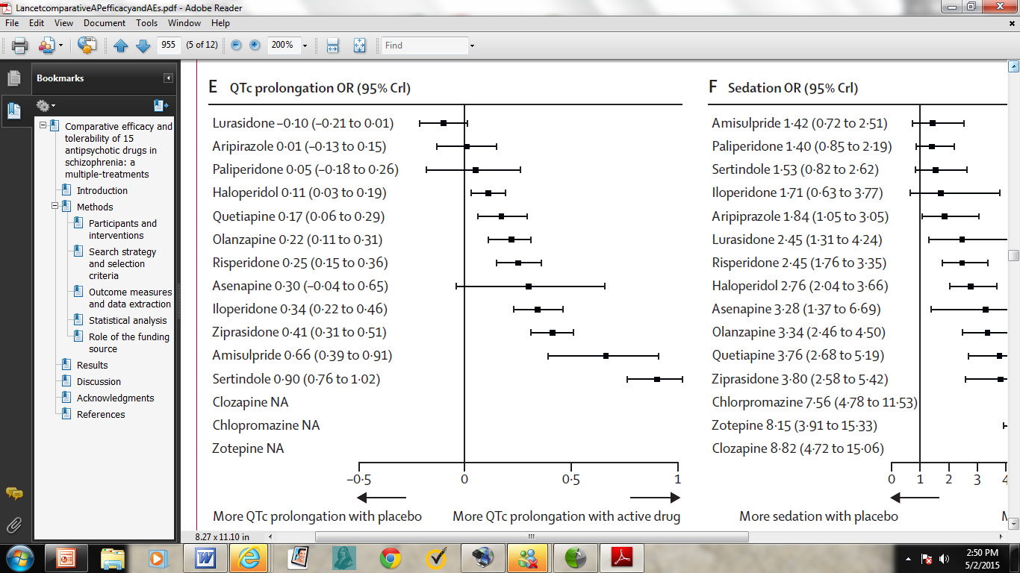
Meta-analysis Comparing 15 Antipsychotics
N= 212 trials,
43,049 participants
Leucht et al. Lancet 2013; 382: 951–62
Notes:
Given lack of direct comparative data, there have been a # of attempts to use statistical analysis to compare risk of different APs. Meta-analysis of randomised controlled trials to compare 15 antipsychotic drugs and placebo in the acute treatment of schizophrenia. Searched many databases, including FDA reports and data from pharm companies. The primary outcome was efficacy but also examined all-cause discontinuation, weight gain, EPS, prolactin increase, QTc prolongation, and sedation. Included 212 suitable trials, with data for 43,049 participants. This is a forest plot for effect sizes of antipsychotic
drugs compared with placebo for QTc prolongation.Treatments are ranked according to their surface under the cumulative ranking (SUCRA) values. OR=odds ratio. CrI=credible interval. SMD=standardised mean difference. Lurasidone, aripiprazole, paliperidone, and asenapine were not associated with significant QTc prolongation compared with placebo. The standardised
mean differences of the other drugs compared with placebo ranged from marginal (0·11, haloperidol) to large (0·90, sertindole). Iloperidone may have comparable QTc effect to ziprasidone and Haldol but unlike Haldol, has not been a/w TdP.

Slide 27
Antipsychotics and QT Prolongation
Overall risk based on this and related data:
  Minimal: Aripiprazole, Lurasidone
  Low: Haloperidol (oral), Olanzapine
  Moderate: Risperidone, Quetiapine
  High: Ziprasidone, Iloperidone, low-potency phenothiazines (Thioridazine), IV Haloperidol (?)
FDA 2000; Leucht 2013

Slide 28
How Should I Use Antipsychotics in Patients at Risk for QT Prolongation?
Using antipsychotics in the inpatient medical setting
  Check baseline ECG and at least one follow-up (although there is not clinical data to support this, and it may be unnecessary if the dose and risk has not changed, some recommend daily ECG or telemetry for IV Haloperidol)
  Ensure repletion of electrolytes
  Minimize other risk factors
  For QTc > 500 msec, consider adjunctive/alternative agents
Using antipsychotics in outpatient setting
  No monitoring for patients without risk factors unless prescribing Thioridazine, Ziprasidone, or Iloperidone
  For patients with QTc risk factors, obtain ECG at baseline and intermittently after initiation of any antipsychotic

Slide 29
Cardiotoxicity with Clozapine
Tachycardia (occurs in 10% of patients)
Orthostatic hypotension
Hypertension
ECG abnormalities (less than 1%)
Early myocarditis
Cardiomyopathy
At least two studies suggests 30-50% of patients treated with clozapine may have subclinical cardiac dysfunction (asymptomatic subnormal output from both ventricles)
Curto et al. 2016
Curto M, et al. Curr Psychiatry Rep, 2016

Slide 30
Clozapine-induced Myocarditis
More than 250 cases reported since 1980; Rates of 0.01-3%
Likely acute Type I reaction (Ig-E mediated hypersensitivity)
Most cases in first 2-3 months in previously healthy, non-geriatric patients
Tachycardia, SOB, fever, flu-like symptoms, nausea, dizziness
  **Chest discomfort only occurs sometimes
Mortality 10-30%
No association with dose or rate of increase
Treatment involves stopping clozapine and supportive care
  Some cases of successful re-challenging have been reported

Slide 31
Clozapine-induced Myocarditis
Proposed Diagnostic Considerations
1. Onset of symptoms within 45 days of starting clozapine
2. Absence of other cause or cardiac history
3. New signs of cardiac dysfunction (tachycardia, peripheral edema, etc)
4. At least one of the following
a. Peripheral eosinophilia
b. Elevated Troponin or CK-MB
c. ECG changes including ST-segment depression or T-wave inversion
d. Radiographic evidence of pulmonary congestion or heart failure
e. Echocardiographic evidence of ventricular dysfunction
5. MRI evidence of myocarditis
6. Definitive histologic findings from cardiac tissue biopsy
Ronaldson, et al. 2010

Slide 32
Clozapine-induced Myocarditis
Recommendations for clinical monitoring
  Clinical monitoring and symptom evaluation
  Routine vital signs, including temperature, weekly for the first month
  Add markers of inflammation (CRP, ESR) and cardiac damage (troponin or CK-MB) to weekly lab monitoring for the first 4 weeks
  Consider baseline ECG
  Repeat ECG with any clinical concern
    ECG may be of limited value owing to low specificity, but some studies recommend weekly monitoring for first month, nonetheless
  Pay attention to eosinophil count on blood monitoring
  Routine baseline and follow-up echo not currently recommended
    Cardiology consult should precede echocardiogram
Freudenreich, 2015

Slide 33
Clozapine-induced Cardiomyopathy
Reported incidence is 1/2000 but may be much higher
Most cases diagnosed in first 6-9 months in patients without cardiac history
  Latency has ranged from 1 month to 6 years
Clinical symptoms consistent with heart failure (dyspnea, tachycardia, palpitations, chest pain, fatigue), but 40-83% of reported cases have been asymptomatic
Diagnosis depends on echo evidence of reduced LVEF (<50% of normal)
  BNP is also typically elevated
Mortality rate is 12.5-24%
Treatment involves immediate suspension of clozapine and supportive care
Cessation of clozapine has improved cardiac functioning in those with EF >25%
  Those with more impairment have high rates of sustained disability and fatal outcome
Rechallenge not recommended (1 of 3 cases had recurrence)

Slide 34
What is the Relationship between Depression and Heart Disease?
Pathophysiological links exist
  Platelet dysfunction
  Autonomic dysfunction
  Inflammation
Health behaviors may also play a key role
  Poor medication adherence
  Lower rates of smoking cessation
  Poor diet and exercise regimens

Slide 35
Depression in Cardiac Patients
Outpatient Samples
MDD Prevalence %
Kessler, 2003; Hasin, 2005 ; Li, 2008; Celano 2011; Ferrari 2013; Lichtmann 2014

Slide 36
Depression and Heart Disease
Depression is associated with onset of heart disease
No CAD
CAD
MI
Survival
Notes:
Depression is associated with onset of CAD
Depression linked to onset of CAD
Johns Hopkins Precursor Study
Other longitudinal studies support this finding
Dose-response relationship (dep sx vs. disorder)
Depression predicts both incident CAD and cardiac mortality
Two large meta-analyses:
Relative risk of CAD 1.6 and 1.64 in depressed vs. nondepressed

Slide 37
Depression and Heart Disease – What’s New?
2014 AHA Statement: Depression is now considered an independent risk factor for adverse medical outcomes in patients with ACS
  In that statement, authors highlighted that depression was not conclusively an independent risk factor for incident heart disease
New evidence for depression as risk factor for incident heart disease
  18-year longitudinal study of 860 Australian women
    Baseline depression predicted incident coronary heart disease, adjusting for anxiety, typical and atypical risk factors
  The addition of depression to the Framingham Risk Equation improves accuracy for detecting 10-year coronary heart disease in women
Lichtman 2014, O’Neil 2016, O’Neil 2016

Slide 38
Depression and Cardiac Outcomes
Depression is associated with onset of heart disease
Depression is associated with heart disease progression
No CAD
CAD
MI
Survival
Notes:
Depression is associated with CAD progression
CAD patients s/p cardiac catheterization
Depression associated with 2.2x risk of cardiac events within next 12 months
19-year follow-up of CAD outpatients
Patients with moderate-severe depression had 69% greater chance of cardiac death during follow-up period
Heart and Soul study of 1017 patients with stable CAD
Depression associated with 50% higher rate of CV events over ~4.8 years of follow-up

Slide 39
Depression and Cardiac Outcomes
Baseline quality of life and depressive symptoms are the biggest predictors of unplanned re-hospitalization after ACS within the first 30 days
  12,312 patients; 1,326 patients had 1,483 unplanned readmissions
  Depression defined as PHQ-2 > 3
  Depressive symptoms are a better predictor than index length of stay
Cardiac patients with severe depression and those with significant life stressors during treatment do not respond as well to evidence-based treatments for depression
  157 patients who met DSM-IV criteria for MDD; 16 weeks
  All received 12 weeks of CBT
  Those on antidepressants at start continued; those not on antidepressants were placed on sertraline 50mg daily at Week 5 or 8 if insufficient improvement
Hess 2015, Carney 2016

Slide 40
Depression and Cardiac Outcomes
Depression is associated with onset of heart disease
Depression is associated with heart disease progression
Depression is associated with mortality (post-MI, post-CABG, HF)
No CAD
CAD
MI
Survival
Frasure-Smith 1993; Frasure-Smith 1995; Whooley 2008; Scott 2014; Cleland 2015

Slide 41
Clinical Care Tips
Diagnosing Depression
  Use standard criteria—just be sure of cardinal symptoms
Assessing Comorbidities
  Be sure to assess for anxiety disorders, especially GAD
Initiating Treatment
  Sertraline is the simplest choice in nearly all cases
    Best studied, most established cardiac safety
  Can start low, but keep going and provide stepped care
  Encourage: exercise, social support, cardiac rehabilitation
  Consider social stressors and utilize problem-solving therapies if available

Slide 42
Treatment of Depression Post-MI
SADHART: Sertraline cardiac safe and effective in treating depression post-MI
  Not powered to detect morbidity or mortality
  Secondary analysis show some advantage in subgroup with recurrent depression
  Subanalysis of SADHART data suggested that onset of depression before ACS, hx of MDD, baseline severity predicted sertraline response
CREATE: Citalopram effective in treating depression in patients with CAD
  Interpersonal therapy not superior to placebo
  Not designed to test effects on cardiac outcomes, mortality
ENRICHD: CBT reduced depression post-MI modestly at 6 months, but did not reduce mortality
  No benefit of CBT at 30 months
MIND-IT: Mirtazapine safe for post-MI depression, and showed efficacy vs placebo on some primary and secondary outcome measures at 24 weeks
Tricyclic anti-depressants are not considered safe post-MI

Slide 43
Treatment of Depression in Heart Failure
Depression is very common in HF
  15-20% point prevalence
Depression is associated with mortality in HF
  Historically—an independent risk factor for mortality
  Elevated depression associated with 5x risk of mortality
  Major depression (but not minor depression) may be strongest predictor of mortality in HF over 20-year follow-up period
Treating depression in HF is very challenging (SADHART-HF)
  SADHART-CHF: Sertraline fails to treat depression in HF patients
  MOOD-HF: Escitalopram for 18 months fails to treat depression in HF patients or reduce all-cause mortality or hospitalization
Gustad 2014; Cleland 2015, Freedland 2016, Jiang 2011 Angermann 2016

Slide 44
Treatment of Depression in Heart Failure
What does this tell us?
  Depression in HF is harder to treat
  Single trials of SSRI monotherapy and lighter care management approaches will not be enough
Probably requires
    Multiple trials, dose adjustments
    Multiple modalities of treatment
    Social support
    Physical activity and self-care focus
    Additional approaches: behavioral activation, strengths focus, reframing

Slide 45
Recommended Reading
Rector TS, Adabag S, Cunningham F, et al. Outcomes of Citalopram Dosage Risk Mitigation in a Veteran Population. Am J Psychiatry. 2016 Sep 1;173(9):896-902.
Leucht S, Cipriani A, Spineli L, et al. Comparative efficacy and tolerability of 15 antipsychotic drugs in schizophrenia: a multiple-treatments meta-analysis. Lancet. 2013;382(9896):951-62.
Curto M, Girardi N, Lionetto L, et al. Systematic Review of Clozapine Cardiotoxicity. Curr Psychiatry Rep. 2016 Jul;18(7):68.
Lichtman JH, Froelicher ES, Blumenthal JA, et al. Depression as a risk factor for poor prognosis among patients with acute coronary syndrome: systematic review and recommendations: a scientific statement from the American Heart Association. Circulation. 2014;129(12):1350-69.
Beach SR, Celano CM, Noseworthy PA, et al. QTc prolongation, torsades de pointes, and psychotropic medications. Psychosomatics. 2013 Jan-Feb;54(1):1-13.
Carney RM, Freedland KE, Steinmeyer BC, et al. Clinical predictors of depression treatment outcomes in patients with coronary heart disease. J Psychosom Res. 2016 Sep;88:36-41.
Angermann CE, Gelbrich G, Stork S, et al. Effect of Escitalopram on All-Cause Mortality and Hospitalization in Patients With Heart Failure and Depression: The MOOD-HF Randomized Clinical Trial. JAMA. 2016 Jun 28;315(24):2683-93.

Slide 46
All References
Angermann CE, Gelbrich G, Stork S, et al. Effect of Escitalopram on All-Cause Mortality and Hospitalization in Patients With Heart Failure and Depression: The MOOD-HF Randomized Clinical Trial. JAMA. 2016 Jun 28;315(24):2683-93.
Austin J, Yi K, Agius M, et al: The impact of guidance on citalopram's effects on the QT period on the practice of clinicians. Psychiatr Danub. 2014;26 Suppl 1:226-30.
Beach SR, et al. QTc prolongation, torsades de pointes and psychotropic medications. Psychosomatics. 2013 Jan-Feb;54(1):1-13.
Barbui C, Bighelli I, Carra G, et al. Antipsychotic Dose Mediates the Association between Polypharmacy and Corrected QT Interval. PLoS One. 2016 Feb 3;11(2):e0148212.
Carney RM, Freedland KE, Steinmeyer BC, et al. Clinical predictors of depression treatment outcomes in patients with coronary heart disease. J Psychosom Res. 2016 Sep;88:36-41.
Castro VM, et al. QT interval and antidepressant use: a cross sectional study of electronic health records. BMJ. 2013 Jan 29;346:f288.
Celano CM, Mastromauro CA, Lenihan EC, Januzzi JL, Rollman BL, Huffman JC. Association of baseline anxiety with depression persistence at 6 months in patients with acute cardiac illness. Psychosom Med. 2012;74(1):93-9.
Cleland J. Depression associated with 5-fold increased mortality risk in heart failure patients. Presented at Second World Congress on Acute Heart Failure, Seville, Spain, May 23, 2015.
Curto M, Girardi N, Lionetto L, et al. Systematic Review of Clozapine Cardiotoxicity. Curr Psychiatry Rep. 2016 Jul;18(7):68.
Drye LT, Spragg D, Devanand DP, et al: Changes in QTc interval in the citalopram for agitation in Alzheimer's disease (CitAD) randomized trial. PLoS One. 2014;9(6):e98426.
Ferrari AJ, Charlson FJ, Norman RE, et al. Burden of Depressive Disorders by Country, Sex, Age, and Year: Findings from the Global Burden of Disease Study 2010. Hay PJ, ed. PLoS Medicine. 2013;10(11):e1001547.
Frasure-Smith N, Lesperance F, Talajic M. Depression following myocardial infarction. Impact on 6-month survival. JAMA. 1993;270(15):1819-25.
Frasure-Smith N, Lesperance F, Talajic M. Depression and 18-month prognosis after myocardial infarction. Circulation. 1995 Feb 15;91(4):999-1005.
Freedland KE, Hesseler MJ, Carney RM, et al. Major Depression and Long-Term Survival of Patients With Heart Failure. Psychosom Med. 2016 May 16.
Freudenreich O. Clozapine-induced myocarditis: prescribe safely but do prescribe. Acta Psychiatr Scand. 2015 Oct;132(4):240-1.
Friesen KJ, Bugden SC: The effectiveness and limitations of regulatory warnings for the safe prescribing of citalopram. Drug Healthc Patient Saf. 2015;7:139-45.
Gerlach LB, Kales HC, Maust DT, et al: Unintended Consequences of Adjusting Citalopram Prescriptions Following the 2011 FDA Warning. Am J Geriatr Psychiatry. 2016.
Girardin FR, Gex-Fabry M, Berney P, et al: Drug-induced long QT in adult psychiatric inpatients: the 5-year cross-sectional ECG Screening Outcome in Psychiatry study. Am J Psychiatry. 2013;170(12):1468-76.
Gustad LT, Laugsand LE, Janszky I, Dalen H, Bjerkeset O. Symptoms of anxiety and depression and risk of heart failure: the HUNT Study. European Journal of Heart Failure. 2014;16(8):861-870.
Hasin DS, Goodwin RD, Stinson FS, Grant BF. Epidemiology of major depressive disorder: results from the National Epidemiologic Survey on Alcoholism and Related Conditions. Arch Gen Psychiatry. 2005;62(10):1097-106

Slide 47
All References
Hess CN, Wang TY, McCoy LA, et al. Unplanned Inpatient and Observation Rehospitalizations After Acute Myocardial Infarction: Insights From the Treatment With Adenosine Diphosphate Receptor Inhibitors: Longitudinal Assessment of Treatment Patterns and Events After Acute Coronary Syndrome (TRANSLATE-ACS) Study. Circulation. 2016 Feb 2;133(5):493-501.
Howland RH. QTc prolongation and haloperidol: just how risky is this drug? Psychosomatics. 2014 Nov-Dec;55(6):741-2.
Jiang W, Oken H, Fiuzat M, et al. Plasma omega-3 polyunsaturated fatty acids and survival in patients with chronic heart failure and major depressive disorder. J Cardiovasc Transl Res. 2012;5(1):92-9.
Kessler RC, Berglund P, Demler O, et al. The epidemiology of major depressive disorder: results from the National Comorbidity Survey Replication (NCS-R). JAMA .2003;289(23):3095-105.
Leucht S, Cipriani A, Spineli L, et al. Comparative efficacy and tolerability of 15 antipsychotic drugs in schizophrenia: a multiple-treatments meta-analysis. Lancet. 2013;382(9896):951-62.
Li Y, Glance LG, Cai X, Mukamel DB. Mental illness and hospitalization for ambulatory care sensitive medical conditions. Med Care. 2008;46(12):1249-56
Lichtman JH, Froelicher ES, Blumenthal JA, et al. Depression as a risk factor for poor prognosis among patients with acute coronary syndrome: systematic review and recommendations: a scientific statement from the American Heart Association. Circulation. 2014;129(12):1350-69.
Maljuric NM, Noordam R, Aarts N, et al. Use of selective serotonin re-uptake inhibitors and the heart rate corrected QT interval in a real-life setting: the population-based Rotterdam Study. Br J Clin Pharmacol. 2015 Oct;80(4):698-705.
O’Neil A, Fisher AJ, Kibbey KJ, et al. Depression is a risk factor for incident coronary heart disease in women: An 18-year longitudinal study. J Affect Disord. 2016 May 15;196:117-24.
O’Neil A, Fisher AJ, Kibbey KJ, et al. The addition of depression to the Framingham Risk Equation model for predicting coronary heart disease risk in women. Prev Med. 2016 Jun;87:115-20.
Ray WA, Chung CP, Murray KT, et al: High-Dose Citalopram and Escitalopram and the Risk of Out-of-Hospital Death. J Clin Psychiatry. 2016.
Rector TS, Adabag S, Cunningham F, et al. Outcomes of Citalopram Dosage Risk Mitigation in a Veteran Population. Am J Psychiatry. 2016 Sep 1;173(9):896-902.
Ronaldson KJ, Taylor AJ, Fitzgerald PB, et al. Diagnostic characteristics of clozapine-induced myocarditis identified by an analysis of 38 cases and 47 controls. J Clin Psychiatry. 2010 Aug;71(8):976-81.
Scott KM. Depression, anxiety and incident cardiometabolic diseases. Curr Opin Psychiatry. 2014;27(4):289-93. doi: 10.1097/YCO.0000000000000067
Thase M, Larsen KG, Reines E, et al. The cardiovascular safety profile of escitalopram. Eur Neuropsychopharmacol. 2013 Nov;23(11):1391-400.
Tully PJ, Turnbull DA, Beltrame J, et al. Panic disorder and incident coronary heart disease: a systematic review and meta-regression in 1 131 612 persons and 58 111 cardiac events. Psychol Med. 2015;45(14):2909-20
Whooley MA, de Jonge P, Vittinghoff E, et al. Depressive Symptoms, Health Behaviors, and Risk of Cardiovascular Events in Patients With Coronary Heart Disease. JAMA . 2008;300(20):2379-2388. doi:10.1001/jama.2008.711.

