Slide 1
Delirium (When things really do go bump in the night!)
APM Resident Education Curriculum
Revised 2019: Cheryl L. Hurd, MD, FAPA, Mehreen Khan, MD, MHA
Revised 2013: Thomas W. Heinrich, MD, FAPM, Kristi Estabrook, MD
Original version: Thomas W. Heinrich, MD, Associate Professor of Psychiatry & Family Medicine, Chief, Psychiatric Consult Service at Froedtert Hospital, Department of Psychiatry & Behavioral Medicine, Medical College of Wisconsin
Kristi Estabrook, MD, Fellow, Department of Psychiatry and Behavioral Medicine, Medical College of Wisconsin
Version of March 15, 2019

Slide 2
Objectives
List DSM-5 criteria for delirium
Identify signs and symptoms of delirium
Identify risk factors for delirium
Recognize common precipitating causes of delirium
Describe differences between delirium and other similar disorders
Describe the assessment and treatment for patients with delirium

Slide 3
Sequence of presentation
DSM-5 Criteria
Synonyms and terminology
Prevalence
Recognition
Risk Factors
Clinical features
Pathophysiology
A CASE PRESENTATION
Etiology
Assessment
Treatment
Prevention

Slide 4
DSM 5 Criteria - Delirium
Disturbance in attention and awareness
Develops over short period; fluctuates
Additional disturbance in cognition
Not accounted for by other neurocognitive disorders
Caused by a general medical condition
Can be multiple etiologies
American Psychiatric Association: Diagnostic and Statistical Manual of Mental Disorders, 5th Edition. Arlington, VA, American Psychiatric Association, 2013.
Notes:
Disturbance in attention and awareness (i.e., reduced ability to direct, focus, sustain and shift attention and reduced orientation to the environment)
Disturbance develops over a short period of time, is distinctly different from baseline and tends to fluctuate (Fluctuation is hours to a few days)
Has an additional disturbance in cognition (e.g., memory deficit, disorientation, language, visuospatial ability, or perception)
Not accounted for by other neurocognitive disorders
Caused by a general medical condition; can be multiple etiologies (Can be caused by a general medical condition, substance intoxication or withdrawal, toxin exposure or multiple etiologies)
There is evidence from the history, physical examination or laboratory findings that the disturbance is a direct physiological consequence of another medical condition, substance intoxication or withdrawal (i.e. due to a drug of abuse or to a medication), or exposure to a toxin, or is due to multiple etiologies.
Reference:
American Psychiatric Association: Diagnostic and Statistical Manual of Mental Disorders, 5th Edition. Arlington, VA, American Psychiatric Association, 2013.

Slide 5
DSM 5 Criteria
Classification of delirium
Delirium due to another medical condition
Substance intoxication delirium
Substance withdrawal delirium
Delirium due to multiple etiologies
Medication induced delirium
Notes:
There is evidence from the H & P and or Lab of a medical condition causing the physiological effects
Both with substance intoxication and withdrawal, if the symptoms are severe enough to warrant medical attention, then they should be diagnosed with the delirious version, not simply intoxication or withdrawal
Use multiple etiologies as the diagnosis if the H & P and work up indicate more than one etiology, including a medical condition and substance intoxication
Medication induced delirium is basically for a side effect from a prescribed medication
Reference
American Psychiatric Association: Diagnostic and Statistical Manual of Mental Disorders, 5th Edition. Arlington, VA, American Psychiatric Association, 2013
European Delirium Association, American Delirium Society (2014). The DSM-5 criteria, level of arousal and delirium diagnosis: inclusiveness is safer. BMC medicine, 12, 141. doi:10.1186/s12916-014-0141-2

Slide 6
DSM 5 Criteria
Further Specifiers
Time
Acute : Hours/Days
Persistent: Weeks/Months
Level of activity
Hyperactive
Hypoactive
Mixed level of activity
Notes:
Hyperactive: psychomotor activity is elevated in addition to mood lability, agitation, or refusing to cooperate
Hypoactive: psychomotor retardation, sluggishness, lethargy (often misdiagnosed as depression)
Mixed: normal psychomotor activity even with disturbed attention and awareness, or someone whose motor activity fluctuates.
Picture: Overlap between hypoactive delirium and reduce arousal states (hyperactive delirium not included.
Reference
American Psychiatric Association: Diagnostic and Statistical Manual of Mental Disorders, 5th Edition. Arlington, VA, American Psychiatric Association, 2013
European Delirium Association, American Delirium Society (2014). The DSM-5 criteria, level of arousal and delirium diagnosis: inclusiveness is safer. BMC medicine, 12, 141. doi:10.1186/s12916-014-0141-2

Slide 7
Synonyms for Delirium
Acute confusional state
Encephalopathy
Acute brain failure
ICU psychosis
Altered mental status
Acute reversible psychosis
Reversible dementia
Acute mental status change
Organic brain syndrome
Notes:
* Only 54% of providers use the term delirium to indicate the disorder of acute change in mental status, inattention, disorganized thinking and altered level of consciousness
* It is important to use the correct terminology and be aware of differences across languages and specialties among clinicians and researchers.
Reference:
Morandi, A., Pandharipande, P., Trabucchi, M. et al. Intensive Care Med (2008) 34: 1907. https://doi.org/10.1007/s00134-008-1177-6

Slide 8
Prevalence of Delirium
Notes:
Emergency department patients: 10-30%
Hospitalized medically ill: 14-24%
Hospitalized elderly patients: 10-40%
Intensive care unit elderly patients: 70-87%
Hospitalized cancer patients: 25%
AIDS patients: 30-40%
Post operative patients: 15-53%
Post CABG: 51%
Post repair of fractured hip: 50%
Terminally ill patients: 83%
Nursing home patients: 60%
Severe burn patients: 20%
Reference
American Psychiatric Association: Diagnostic and Statistical Manual of Mental Disorders, 5th Edition. Arlington, VA, American Psychiatric Association, 2013
Miller, Marcia O. “Evaluation and Management of Delirium in Hospitalized Older Patients”. American Family Physician, vol. 78, no. 11; pp. 1265-1270, December 1, 2008.
Han J, Wilson A, & Ely E., (2013). Delirium in the Older Emergency Department Patient – A Quiet Epidemic. Emerg Med Clin North Am. doi: [10.1016/j.emc.2010.03.005]

Slide 9
Recognition of Delirium
Delirium is commonly unrecognized
ER physicians miss 87-83% of cases (Han, Wilson & Ely, 2013)
Hospital admission 14-24% (overall prevalence 1-2%) (Fong, Tulebaev & Inouye, 2011)
Nurses recognize delirium more frequently than physicians, 45% v. 20%
Delirium should always be considered when there is an acute or subacute deterioration in behavior, cognition or function
30-40% of delirium cases are preventable (Hshieh, et. Al, 2015)
Notes:
Despite delirium’s negative consequences, emergency physicians miss 57% to 83% of cases due to lack of appropriate and routine screening.
The overall prevalence of delirium in the community is 1-2% but in the hospital setting, it increases to 14-24%. (Fong, Tulebaev & Inouye, 2011)
The incidence of delirium arising during a hospital stay ranges from 6-56% (not including specialized populations such as post-operative, ICU, palliative care etc). (Fong, Tulebaev & Inouye, 2011)
At least 30-40% of delirium cases are preventable. There is a strong correlation between delirium and hospital-related falls. Most hospitals do not have delirium prevention protocols or their protocols are inconsistently implemented, with variable adherence. (Hshieh, et. Al, 2015)
Reference:
Fong, T. G., Tulebaev, S. R., Inouye, S. K., (2009). Delirium in elderly adults: diagnosis, prevention and treatment. Nature Review Neurology 5, 210-220. doi: [10.1038/nrneurol.2009.24]
Han J, Wilson A, & Ely E., (2013). Delirium in the Older Emergency Department Patient – A Quiet Epidemic. Emerg Med Clin North Am. doi: [10.1016/j.emc.2010.03.005]
Hshieh, T. T., et al. (2015). "Effectiveness of multicomponent nonpharmacological delirium interventions: a meta-analysis." JAMA Intern Med 175(4): 512-520

Slide 10
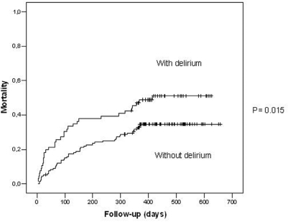
Consequences of Delirium
Increased Mortality
Almost 25% more chances of death with delirium in hospitalized patients (Curyto et. al, 2007)
Adjusted risk of death – twice as compared to non-delirious controls (Inouye et. al, 1998)
Increased Morbidity
Poor functional recovery
Possible future cognitive decline
Increased risk of complications
Increased nursing home placement
Increased costs and LOS
Depression, PTSD
Notes:
- 3-year mortality for hospitalized elderly with index episode of delirium was 75% vs. 51% for non-delirious controls (Curyto et. Al, 2001)‏
No difference in pre-hospital levels of depression, global cognitive performance, physical functioning or medical co-morbidity
- Delirious patients experienced an adjusted risk of death of almost 2.0 compared to non-delirious controls (Inouye et al 1998)‏
Even after controlling for age, gender, ADL, dementia and APACHE II
References:
Curyto KJ, Johnson J, TenHave T, et al: Survival of hospitalized elderly patients with delirium: a prospective study. Am J Geriatr Psychiatry 9:141-147, 2001.
Lima, P. D., Ochiae, E. M., Lima, B. A., Curiati, J. A., Farfel, M. J., Filho, J. W., (2010). Delirium in Hospitalized Elderly Patients and Post-Discharge Mortality. Clinics (Sao Paulo) 65(3), 251-255. doi: [10.1590/S1807-59322010000300003]

Slide 11
Risk Factors for Delirium (Partial List)
Elderly
Impaired acetylcholine neurotransmission
Vascular changes
Pharmacokinetic changes
CNS disorders
Major neurocognitive disorders represents one of the greatest risk factors
Multiple medications (including starting more than 3-5 new meds)
Burn patients
Low serum albumin
Drug and Alcohol Abuse
Notes:
References:
National Clinical Guideline Centre (UK). Delirium: Diagnosis, Prevention and Management [Internet]. London: Royal College of Physicians (UK); 2010 Jul. (NICE Clinical Guidelines, No. 103.) 7, Risk factors for delirium: non-pharmacological. Available from: https://www.ncbi.nlm.nih.gov/books/NBK83983/

Slide 12
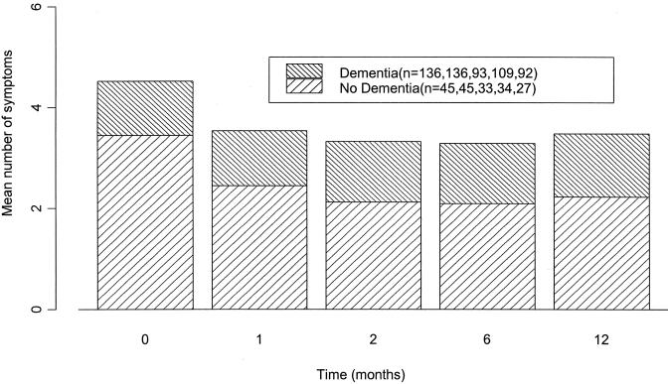
Clinical Features of Delirium
Temporal course
Abrupt or acute onset
Within days
Fluctuation in symptom severity
Waxing and waning
Worse at night
May result in diagnostic uncertainty
Notes:
Picture reference: (McCusker et., al, 2003)
Mean number of delirium symptoms at baseline and follow-up in demented and non-demented patients
Patients with dementia had a consistently higher mean number of symptoms at each time.
References:
Khan, B. A., Zawahiri, M., Campbell, N. L., Fox, G. C., Weinstein, E. J., Nazir, A., Farber, M. O., Buckley, J. D., Maclullich, A., … Boustani, M. A. (2012). Delirium in hospitalized patients: implications of current evidence on clinical practice and future avenues for research--a systematic evidence review. Journal of hospital medicine, 7(7), 580-9.
McCusker, J., Cole, M., Dendukuri, N., Han, Ling., Belzile., (2003). The Course of Delirium in Older Medical Inpatients. A prospective study. Journal of General Internal Medicine 18(9) 696-704. doi: [10.1046/j.1525-1497.2003.20602.x]

Slide 13
Clinical Features
Diffuse cognitive impairment
Attentional deficits
Reduced ability to focus, sustain or shift attention
“Clouding of consciousness”
Memory impairment
Long and short term
Disorientation
Commonly to time and place
Rarely to person
Executive dysfunction
Notes:
Reference:
Khan, B. A., Zawahiri, M., Campbell, N. L., Fox, G. C., Weinstein, E. J., Nazir, A., Farber, M. O., Buckley, J. D., Maclullich, A., … Boustani, M. A. (2012). Delirium in hospitalized patients: implications of current evidence on clinical practice and future avenues for research--a systematic evidence review. Journal of hospital medicine, 7(7), 580-9.

Slide 14
Clinical Features
Thought disturbances
Disorganized
Language disturbances
Word finding problems
Dysgraphia
Dysarthria
Dysnomia
Perceptual disturbances
Misperceptions
Hallucinations (Visual >> Auditory)‏
Notes:
Reference:
Khan, B. A., Zawahiri, M., Campbell, N. L., Fox, G. C., Weinstein, E. J., Nazir, A., Farber, M. O., Buckley, J. D., Maclullich, A., … Boustani, M. A. (2012). Delirium in hospitalized patients: implications of current evidence on clinical practice and future avenues for research--a systematic evidence review. Journal of hospital medicine, 7(7), 580-9.

Slide 15
Clinical Features
Psychomotor abnormalities
Hyper, hypo or mixed
Sleep-wake cycle disturbance
Insomnia
Frequent napping or drowsiness during the day
Reversal of sleep/wake cycle
Delusions
Usually paranoid and not systematized
Affective lability
Neurologic abnormalities
Notes:
Neurologic abnormalities include:
-Autonomic hyperactivity or instability such as flushing, pallor, sweating, tachycardia, dilated pupils, nausea, vomiting, Fever:
-Myoclonic jerking, cerebellar signs, generalized hyperreflexia
-Nystagmus and ataxia
-Tremor
-Asterixis: renal or hepatic insufficiency
References:
Khan, B. A., Zawahiri, M., Campbell, N. L., Fox, G. C., Weinstein, E. J., Nazir, A., Farber, M. O., Buckley, J. D., Maclullich, A., … Boustani, M. A. (2012). Delirium in hospitalized patients: implications of current evidence on clinical practice and future avenues for research--a systematic evidence review. Journal of hospital medicine, 7(7), 580-9.
Caplan JP and Stern TA: Mnemonics in a mnutshell: 32 aids to psychiatric diagnosis. Current Psychiatry 7(10):27-33, 2008.

Slide 16
Differential Diagnosis of Delirium
Delirium
Dementia
Depression
Onset
Abrupt
Slow and insidious
Variable
Daily Course
Fluctuating
Usually stable
Usually stable
Length
Hours to weeks
Years
Variable
Consciousness
Reduced
Clear
Clear
Alertness
Increased or decreased
Usually normal
Normal
Activity
Increased or decreased
Variable
Variable
Attention
Impaired
Usually normal
Usually normal
Orientation
Impaired
Impaired
Normal
16
Notes:
References:
Virtual Mentor. 2008. Differentiating among Depression, Delirium, and Dementia in Elderly Patients. 10(6):383-388. doi: 10.1001/virtualmentor.2008.10.6.cprl1-0806
16

Slide 17
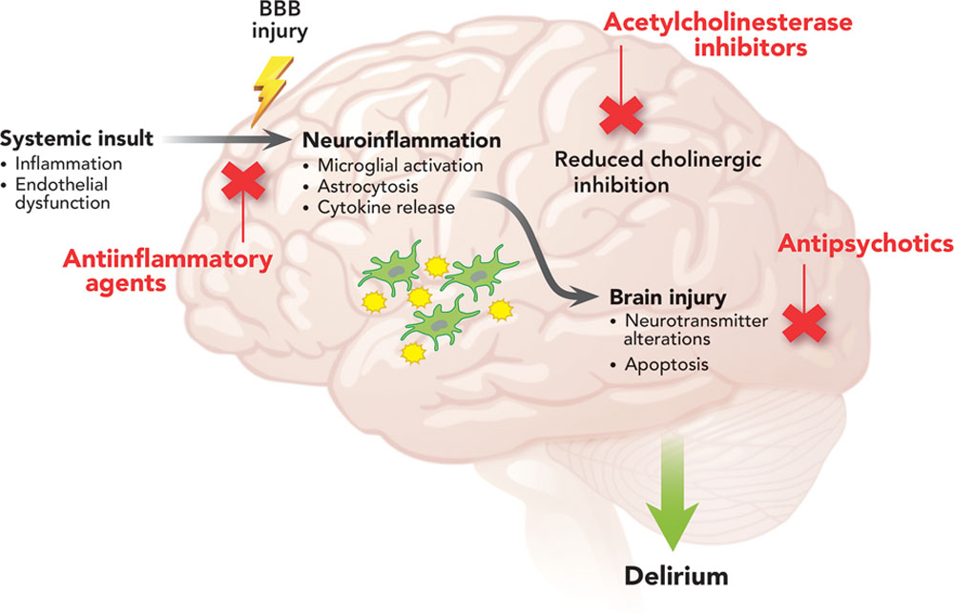
Pathophysiology of Delirium: Acetylcholine
Acetylcholine
The cholinergic system is involved in:
Attention
Arousal
Memory
Decreased cholinergic activity produces deficits in:
Information processing
Arousal
Attention and ability to focus
Various metabolic insults, thiamine deficiency and anti-cholinergic medications all can produce delirium through a decrease in cholinergic activity
Notes:
Delirium is associated with ↑ serum anticholinergic activity
Anticholinergic activity is found in delirious patients taking no anticholinergic drugs
Acetylcholine is an important neurotransmitter for cognitive processes, and pesticides, particularly organophosphates, can cause cholinergic overload as the pathology of toxic exposure
Picture reference: Potential mechanisms and therapies for ICU delirium. Hypothesized mechanisms include systemic inflammation, endothelial dysfunction, increased blood–brain barrier (BBB) permeability, and reduced cholinergic control of the inflammatory response that, along with baseline patient vulnerability factors, predispose patients to neuroinflammation and subsequent neuronal injury. Primed and overactivated microglia from these processes may also exacerbate the pathophysiologic changes. Therapeutic agents studied for the prevention or treatment of ICU delirium have targeted these pathways.
Reference:
Inouye, S. K., & Ferrucci, L. (2006). Elucidating the pathophysiology of delirium and the interrelationship of delirium and dementia. The journals of gerontology. Series A, Biological sciences and medical sciences, 61(12), 1277-80.
Christina J. Hayhurst, Pratik P. Pandharipande, Christopher G. Hughes; Intensive Care Unit Delirium: A Review of Diagnosis, Prevention, and Treatment. Anesthesiology 2016;125(6):1229-1241. doi: 10.1097/ALN.0000000000001378.

Slide 18
Pathophysiology of Delirium: Dopamine
Dopamine
An excess of dopamine may be a source of the agitation, delusions and psychosis in delirious patients
There is an inverse relationship between dopamine and acetylcholine levels
Dopaminergic agents may induce delirium
Dopamine antagonists are an effective treatment for delirium

Slide 19
Pathophysiology of Delirium
Other suggested neurotransmitters
GABA
Increased in hepatic encephalopathy
Decreased in alcohol withdrawal
Histamine
Serotonin
Cytokines
Implicated in delirium resulting from tissue destruction, infection or inflammatory causes
Notes:
Serotonin excess or deficiency: result of altered tryptophan-to-phenylalanine ratio (MDMA or Ecstasy affects Serotonin)
Cytokines (interleukin-2, tumor necrosis factor), as seen in patients with cancer or infections

Slide 20
Relationships Between Etiological Factors in Delirium
Fong, T. G., Tulebaev, S. R., Inouye, S. K., (2009). Delirium in elderly adults: diagnosis, prevention and treatment. Nature Review Neurology 5, 210-220
Notes:
Relationships between various etiological factors in delirium. Systemic inflammation can be the result of systemic infection, trauma or surgery. Neurotransmitters with possible roles in delirium include acetylcholine, dopamine, 5-hydroxytryptamine, norepinephrine, glutamate and γ-aminobutyric acid.
References:
Fong, T. G., Tulebaev, S. R., Inouye, S. K., (2009). Delirium in elderly adults: diagnosis, prevention and treatment. Nature Review Neurology 5, 210-220. doi: [10.1038/nrneurol.2009.24]

Slide 21
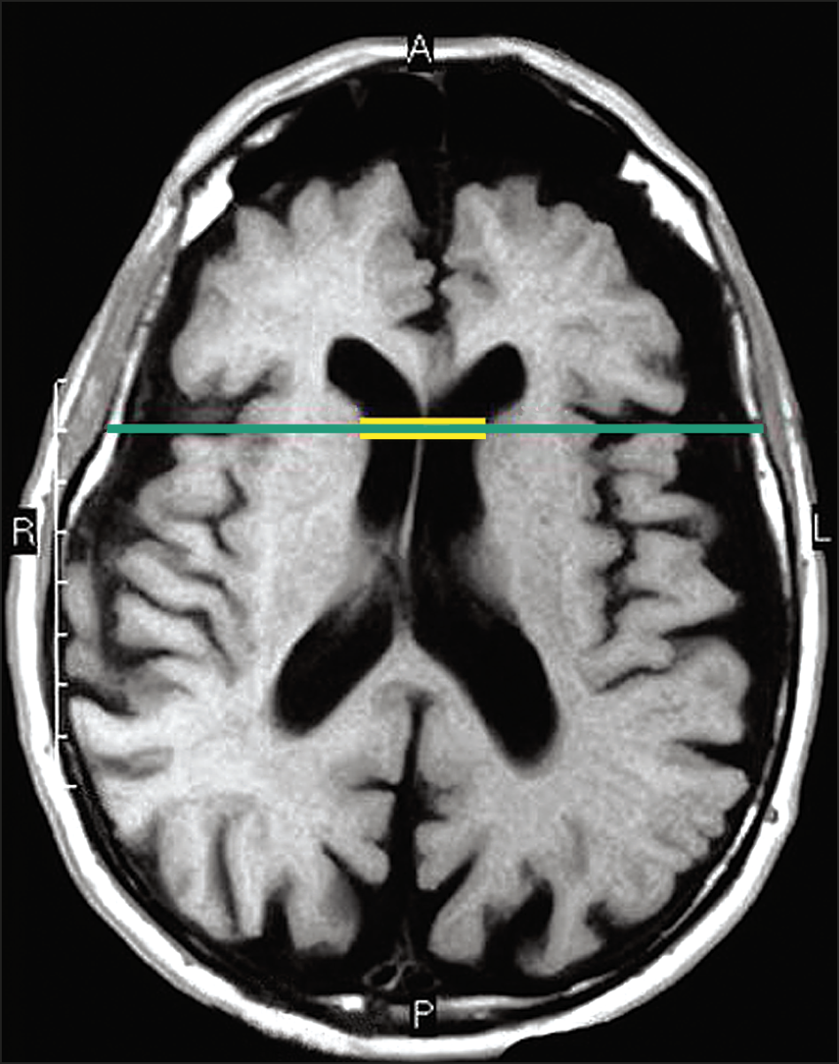
A Case of an Angry 82 Year-Old
82 year-old male – nursing home resident
H/o Alzheimer’s disease, CAD, and DM has been admitted from a nursing home
C/o worsening confusion and behavioral problems/problems sleeping 3 days ago.
“Knock you on your ass!”
Medical records from the ED report similar behavior and reports of “seeing things.”
Given prn Lorazepam prior to head CT
CT Head – atrophy and white matter disease
Notes:
82 year-old male with a history of probable Alzheimer’s disease, CAD, and DM has been admitted from a nursing home for worsening confusion and behavioral problems. The nursing personnel at the NH report that the symptoms have become progressively worse since he began having problems sleeping 3 days ago.
Attempts to examine the patient upon arrival to the floor are complicated by his attempts, as he eloquently states, to “Knock you on your ass!”
Review of the medical records from the ED report similar behavior and reports of “seeing things.” He was given lorazepam prior to the CT of his head. He slept through the CT, which only showed atrophy and white matter disease, but is now quite awake and potentially dangerous.
Picture reference:
Brickman AM, Honig LS, Scarmeas N, et al. Measuring Cerebral Atrophy and White Matter Hyperintensity Burden to Predict the Rate of Cognitive Decline in Alzheimer Disease. Arch Neurol. 2008;65(9):1202–1208. doi:10.1001/archneur.65.9.1202

Slide 22
The Angry 82 Year-Old (continued)‏
Importance of collateral information
Acute change in current state
Symptoms worse at night
Symptoms improve
Disoriented - place and time
Easily distracted
When he attempts to answer your questions he has trouble finding the right words and staying on question
Notes:
Since the patient is presently being slightly less than cooperative with your attempts to gather a history, you collect collateral information…
Although he has some baseline memory problems his current state represents an acute change
His behavior tends to be worse at night when he does not sleep and is more confused and sometimes suspicious
The nurse reports that he is doing better now that she has given him some ice cream, she wonders if you would like to complete your history now…
You identify the fact the patient is disorientated to place and time
He is easily distracted by events in the hall and can not concentrate on your questions
When he attempts to answer your questions he has trouble finding the right words and staying on question

Slide 23
The Angry 82 Year-Old (continued)‏
Diagnosis: Delirium
Next: Finding potential etiologies
Review of the NH records reveal…
D/C of donepezil (Aricept) secondary to worsening dementia
Diphenhydramine (Benadryl) was started 3 days ago
Chronic digoxin therapy
Chronic urinary incontinence without mention of dysuria
Labs normal
Notes:
With your diagnosis of delirium you set out to determine potential etiologies of this dangerous condition
Review of the NH records reveal…
Recent discontinuation of donepezil (Aricept) secondary to worsening dementia
Diphenhydramine (Benadryl) was started 3 days ago to help him get some sleep
Chronic digoxin therapy
Chronic urinary incontinence without mention of dysuria
Most recent labs (CBC and BMP performed 6 months ago) were grossly normal

Slide 24
The Angry 82 Year-Old (continued)‏
Examination of the patient
Normal Vitals, afebrile
Heart, lungs and abdomen are benign
Some intermittent myoclonic jerks and a nonfluent aphasia
Mental status/state examination reveals…
Impaired attention
Digit span of only “3”
MMSE score of 10 (score of 21 one year ago)‏
Orientated X 3/10
0/3 at 5 minutes
Poor repetition and 3 step-command
Unable to spell “WORLD” backwards
Impaired drawing
Notes:
Examination of the patient
The patient is afebrile with normal vitals
Heart, lungs and abdomen are benign
Neurologically he displays some intermittent myoclonic jerks and a nonfluent aphasia
Mental status/state examination reveals…
Impaired attention
Digit span of only “3”
MMSE score of 10 (score of 21 one year ago)‏
Orientated X 3/10
0/3 at 5 minutes
Poor repetition and 3 step-command
Unable to spell “WORLD” backwards
Impaired drawing

Slide 25
The Angry 82 Year-Old (continued)‏
Laboratory evaluation of the patient
CBC, BMP - WNL
LFTs - WNL (except for a low albumin)
TSH, B12, Folate, and RPR - WNL
Digoxin level is supratherapeutic
Cardiac enzymes – WNL
U/A is positive for nitrates and leukocyte esterase
“Reflex” culture is pending
CT of head revealed global atrophy and chronic microvascular disease
EKG only shows rate controlled atrial fibrillation
Notes:
CBC, BMP are all normal
LFTs are normal except for a low albumin
TSH, B12, Folate, and RPR are also normal
Digoxin level is supratherapeutic
Cardiac enzymes are normal
U/A is positive for nitrates and leukocyte esterase
“Reflex” culture is pending
CT of head revealed global atrophy and chronic microvascular disease
EKG only shows rate controlled atrial fibrillation
Picture reference:
https://health.unl.edu/laboratory

Slide 26
The Angry 82 Year-Old (continued)‏
Potential etiologies identified
Medications
Digoxin toxicity coupled with its anticholinergic properties
Diphenhydramine’s anticholinergic properties
Recent discontinuation of the cholinesterase inhibitor - donepezil
Infection
UTI
Malnutrition

Slide 27
The Angry 82 Year-Old (continued)‏
Treatment
Treat potential etiologies
Ciprofloxacin started and await urine culture results
Hold digoxin until levels normalize
Restart donepezil (Aricept)‏
Stop diphenhydramine (Benadryl)
Avoid anticholinergic medications
Watch nutrition and hydration
Continued vigilance for other contributions to delirium

Slide 28
The Angry 82 Year-Old (continued)‏
Treatment (continued)‏
Management of behavioral symptoms
Nursing institutes environmental changes to help maintain the patient’s orientation
QTc on ECG is <460msec
Quetiapine (Seroquel) 25mg PO QHS scheduled to help with reports of worsening behavior overnight
Quetiapine 25mg PO q6 PRN agitation

Slide 29
Etiology of Delirium
Identification of underlying cause is paramount to treatment
Common causes
General medical conditions
Medications
Substance intoxication
Substance withdrawal
Multiple etiologies
Notes:
References:
Fong, T. G., Tulebaev, S. R., Inouye, S. K., (2009). Delirium in elderly adults: diagnosis, prevention and treatment. Nature Review Neurology 5, 210-220. doi: [10.1038/nrneurol.2009.24]

Slide 30
Etiology of Delirium
Intoxication with drugs
Many drugs implicated, especially anticholinergic agents, NSAIDs, antiparkinsonism agents, antimicrobials, steroids, opiates, sedative-hypnotics, and illicit drugs
Withdrawal syndromes
Alcohol, sedative-hypnotics, and barbiturates
Metabolic causes
Hepatic, renal or pulmonary insufficiency
Endocrinopathies such as hypothyroidism, hyperthyroidism, hypopituitarism or hypoglycemia
Disorders of fluid and electrolyte balance
Notes:
References:
Fong, T. G., Tulebaev, S. R., Inouye, S. K., (2009). Delirium in elderly adults: diagnosis, prevention and treatment. Nature Review Neurology 5, 210-220. doi: [10.1038/nrneurol.2009.24]

Slide 31
Etiology of Delirium
Infections
Sepsis, meningitis, pneumonia, syphilis and urinary tract infection
Head trauma
Subdural hematoma, closed head injury/concussion
Epilepsy
Neoplastic disease
CNS metastasis or limbic encephalopathy
Vascular disorders
Cerebrovascular (stroke)
Cardiovascular (acute MI, ACS, Hypertensive Emergency)
Notes:
References:
Fong, T. G., Tulebaev, S. R., Inouye, S. K., (2009). Delirium in elderly adults: diagnosis, prevention and treatment. Nature Review Neurology 5, 210-220. doi: [10.1038/nrneurol.2009.24]

Slide 32
Life Threatening Causes of Delirium (Caplan and Stern, 2008)‏
W: Wernicke's encephalopathy; withdrawal (alcohol or BZDs)‏
H: Hypoglycemia; hypoxia; hypoperfusion of CNS; hypertensive crisis, hyper or hypothermia
I: Infections; intracranial processes
M: Metabolic derangements; Meningitis/encephalitis
P: Poisons
S: Seizures (status epilepticus)
Notes:
References:
Caplan JP and Stern TA: Mnemonics in a mnutshell: 32 aids to psychiatric diagnosis. Current Psychiatry 7(10):27-33, 2008.

Slide 33
Assessment of Delirium
Recognition
Consider screening tool for ancillary staff (e.g. brief cognitive assessment)
History
Establish course of mental status changes
Talk to family or caregivers
Recent medication change(s)‏
Symptoms of medical illness
Review medical record
Review anesthesia record if post-op
Onset of delirium is best clue to causality
Notes:
References:
Fong, T. G., Tulebaev, S. R., Inouye, S. K., (2009). Delirium in elderly adults: diagnosis, prevention and treatment. Nature Review Neurology 5, 210-220. doi: [10.1038/nrneurol.2009.24]

Slide 34
Assessment of Delirium
Physical and neurologic examination
Vitals and focused physical exam
Mental status
Observe for behavioral signs
Cognitive tests
Folstein Mini Mental State Exam
Clock drawing task
Digit span
Months backwards
Notes:
Reference:
Fong, T. G., Tulebaev, S. R., Inouye, S. K., (2009). Delirium in elderly adults: diagnosis, prevention and treatment. Nature Review Neurology 5, 210-220. doi: [10.1038/nrneurol.2009.24]

Slide 35
Assessment of Delirium
Basic laboratory test
Blood chemistries
Complete blood count
Hepatic function panel
TSH
B12 and folate
RPR
ABG
Serum drug levels
Urinalysis and collection for culture
Additional tests
ECG
EEG
Cardiac enzymes
HIV
Chest X-ray
ANA, RF, CRP
Lumbar puncture
Blood cultures
Heavy metals
CT or MRI
Notes:
In most cases, the basic laboratory listed above is necessary, especially electrolytes because large shifts can cause osmotic demyelination. Additional tests should be based on history and physical findings. Brain imaging in the absence of focal neurologic deficits is low yield, but still standard of care because in cases where no secondary cause can be found, the imaging reveals the source.
Lumbar puncture is less useful in hospital-acquired delirium, but should be considered in those with delirium who had recent neurosurgery, immunosuppressed patients, or recent TBI patients.
Reference:
Brown, E. G. and V. C. Douglas (2015). "Moving Beyond Metabolic Encephalopathy: An Update on Delirium Prevention, Workup, and Management." Semin Neurol 35(6): 646-655.

Slide 36
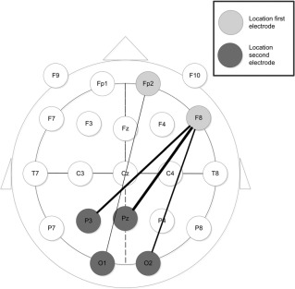
Assessment of Delirium
Electroencephalogram
Helpful to confirm the diagnosis
Usually generalized slowing
Low voltage fast activity in alcohol or sedative-hypnotic withdrawal
Picture: Delirium Detection Using EEG
Structural Neuroimaging
Focal neurologic signs
History or concern of head trauma
No clear cause of delirium found
Notes:
EEG:
Despite its frequency and impact, delirium is poorly recognized in postoperative and critically ill patients. EEG is highly sensitive to delirium but, as currently used, it is not diagnostic.
Picture: Most optimal electrode combinations for delirium detection, based on first four rankings of the eyes-closed condition. The thickness of the connecting line corresponds with the rank of the electrode combination: The thickest line represents the highest rank.
Reference:
Kooi, W. A., Zaal, I., Klijn, F., Koek, L. K., Meijer, C. R., Leijten, F., Slooter, A., (2015). Delirium Detection Using EEG. Chest 1 (147) 94-101.
Soiza, R., Sharma, V., Ferguson, K., Shenkin S., Seymour, D., MacLullich, A., (2008). Neuroimaging studies of delirium: A systemic review. Journal of Psychosomatic Research 65(3) 239-248.

Slide 37
Treatment of Delirium
Two important aspects
Identify and reverse the reason(s) for the delirium
Managing behaviors
Sitter
Restraints (Not appropriate)
Reduce psychiatric or behavioral symptoms of delirium
Non pharmacologic treatment
Pharmacologic treatment
Notes:
Managing behaviors:
Sitter:
Allowing a family member or other caregiver to stay with the patient at the bedside may help to manage the patient's behavior. This person can provide reassurance, answer questions, reorient the patient, and notify staff if the person needs assistance. In some cases, the hospital is able to provide a sitter if a family member is unavailable. However, a familiar and trusted family member or friend can provide additional reassurance to the patient.
Restraints:
The use of restraints (to tie a person to their bed or chair) is almost never appropriate, as restraints can increase agitation and create additional problems by preventing the person from moving around as needed. Preventing movement also potentially allows skin sores (called pressure ulcers) to develop from sitting or lying in the same position for long periods. The use of restraints has not been shown to prevent harmful falls among hospitalized patients.
However, in the rare situation where the patient is at high risk for harm and restraints are applied, hospital staff should monitor the patient at least every two hours, untying the restraints and changing the patient's position. The restraints should be removed as soon as possible.
Picture reference:
Kernisan, L., (n.d.). Better Health While Aging. https://betterhealthwhileaging.net/hospital-delirium-what-to-do/
Notes from Uptodate: Delirium

Slide 38
Treatment of Delirium
Non-pharmacologic Interventions
Aims
Cognitively non-demanding
Limit the risk of harm to self and/or others
Types
Avoid interruption of sleep
Room close to nursing station
Sitter, feeding assistance and encouragement during meals
Clocks and calendar and orientation board
Adequate lighting
Sensory aids, cleaning of ear wax
Notes:
Very modest stimulation is important: too much adds to confusion, too little leaves patient locked in own internal disorganized perceptions and thoughts, thus exacerbating the delirium.
Ensure adequate intake of nutrition and fluids, may need assistance with meals.
The staff needs to be educated on the patients’ delirium
Assess the patient for safety (such as falls, wandering, inadvertent self-harm)
Educate and support the patient and family
Frequent reorientation (clocks, calendar, radio)
Patients should be oriented to the day-night cycle with open blinds if rooms have windows, or change in lighting; nightlights often help
Familiarity with objects, photos, presence of family members.
Minimize restraints and using a sitter is preferred because the restraints can also agitate the patient.
If patients wear glasses or have hearing aids, make sure family brings them and the patient has access to them.
Reference:
Hshieh, T. T., et al. (2015). "Effectiveness of multicomponent nonpharmacological delirium interventions: a meta-analysis." JAMA Intern Med 175(4): 512-520.

Slide 39
Treatment of Delirium
Major classes of medications utilized
Antipsychotics
Typical
Atypical
Cholinesterase inhibitors
Benzodiazepines
Notes:
Medications to control difficult behavior are only to be considered as a last resort, if the patient's agitation is so extreme as to be a potential source of harm. Some classes of drugs, especially sedatives such as lorazepam (Ativan) and diazepam (Valium), can build up in the bloodstream and cause the person to become more confused. Antipsychotic medications, such as haloperidol (Haldol), may be considered, but only in small doses and for short periods of time. If necessary, these medications should be stopped frequently, with direction or approval by the physician, so that the patient can be reevaluated. Antipsychotic medications are not recommended for long-term treatment.
Reference: UptoDate

Slide 40
Treatment of Delirium
Typical Antipsychotics
Low potency
Not recommended (anti-cholinergic can worsen)
High potency - Haloperidol the “gold standard”
Virtually no anticholinergic properties
Little risk of hypotension
Does not suppress respiration
Can be given IV
Not FDA approved
Note: IV haldol is twice the potency of PO haldol
Fast acting

Slide 41
Treatment: Haloperidol Dosing
Haloperidol starting dose
Elderly
Mild agitation: 0.5mg
Moderate agitation: 1mg
Severe agitation: 2mg
Young adult
Mild agitation: 1-2mg
Moderate agitation: 2-5mg
Severe agitation: 5-10mg
Dose may be repeated at regular intervals until patient is calm
Max dose: 10mg/d for elderly & 20mg/d for youth
Notes:
Haldol can be given orally, IM or IV. Dosing is usually 1-2mg every 2-4 hours to a max of 500mg/24hrs. IV dosing has been shown to reduce EPS and other side effects, but telemetry monitoring needs to occur in this setting. (10mg/hour continuous);

Slide 42
Treatment: Haloperidol Side Effects
Haloperidol side effects
Extrapyramidal reactions (EPS)‏
Very low rate of EPS with IV administration (Tesar GE et al 1985)‏
Co-administration with lorazepam may further lower the incidence (Menza MA et al 1988)‏
Hypotension
Usually related to volume depletion

Slide 43
Treatment: Haloperidol Side Effects
Haloperidol side effects
QTc prolongation
Rare
Recommendations
Pretreatment determination of QTc
Avoid other medications that may prolong QTc
Monitor potassium and magnesium
Monitor QTc during treatment
Stop haloperidol if QTc > 500 msec or if baseline QTc increases by more than 60 msec

Slide 44
Treatment: Atypical Antipsychotics
Atypical antipsychotics
Increasingly more randomized, prospective studies evaluating efficacy
Use partially supported on the basis of clinical experience, case reports and small case studies
Theoretical lower risk of extrapyramidal side effects
Acute dystonic reactions
Drug-induced parkinsonism
Akathisia
Continued risk of QTc prolongation

Slide 45
Treatment: Atypical Antipsychotics
Atypical antipsychotics (continued)‏
Quetiapine (Seroquel)‏
Better than placebo in randomized control study
Only oral formulation
Dosage
Starting dose 12.5mg-25mg qhs and titrate to effect
Can also use 12.5mg-25mg q6h prn
Aripiprazole (Abilify)‏
No randomized prospective studies available
Multiple formulations
Oral tablet, oral tablet (disintegrating), oral solution, and intramuscular
Maybe lower risk of QTc prolongation
Dosage
???

Slide 46
Treatment: Atypical Antipsychotics
Atypical antipsychotic (continued)‏
Risperidone (Risperdal)‏
Has been found in small randomized trials to match Haldol, Olanzapine in efficacy
Multiple formulations
Oral tablet, oral tablet (disintegrating), oral solution, and long-acting decanoate
Dosage
Starting dose 0.25mg-0.5mg/day scheduled
Can also use 0.25-0.5mg q6h prn agitation
Usually no more than 2mg/day required
Ziprasidone (Geodon)‏
No randomized prospective studies available
Intramuscular route available
Dosage
20 mg IM/6 hours but maximum 40mg IM/24 hours

Slide 47
Treatment: Atypical Antipsychotics
Atypical antipsychotics (continued)‏
Olanzapine (Zyprexa and Zydis)‏
Small prospective, randomized-control studies show efficacy matching Haldol
Multiple formulations
Oral tablet, oral tablet (disintegrating), oral solution, and intramuscular
Dosage
Starting dose 2.5mg-5mg qhs
Can use 2.5-5mg 6h prn agitation
Usually no more than 10mg/day required

Slide 48
Treatment: Other Agents
Cholinesterase inhibitors
Physostigmine
Diagnostic tool for anticholinergic toxicity
Rarely needed for treatment
Usual dose 0.16 mg to 2 mg or 3 mg/hour IV
Benzodiazepines
Most appropriate for alcohol or sedative-hypnotic withdrawal
Potential adjunct to high potency antipsychotics
Can worsen confusion
Vitamins
-- B vitamins
-- Nicotinamide
Notes:
Benzodiazepines (BZDs) are often exacerbators of delirium because they can cause sedation, behavioral disinhibition, amnesia, ataxia, respiratory depression, rebound insomnia, euphoria and withdrawal. They are not as effective as antipsychotics except in combination when assisting with sleep or desire for lower dosing of the antipsychotic. However, BZDs are the drug of choice in BZD or alcohol withdrawal delirium, or when the seizure threshold needs to be raised, or if the side effects of the antipsychotics would be detrimental to the patient’s condition. If necessary, the BZDs Lorazepam, Oxazepam, and Temazepam should be used because they are predominantly metabolized by glucuronidation, not oxidation. Also, they have shorter half-lives, which is important in liver failure.
Vitamin replacement, especially B vitamins and nicotinamide, are important in malnutrition from alcohol dependence or any sort of starvation/malabsorption.

Slide 49
Treatment: Other Agents
Dexmedetomidine
Selective alpha-2 agonist
Approved for short-term use (<24 hours) in patients initially receiving mechanical ventilation
Has been shown to help with ventilator weaning (Ricker et al 2009; Reade et al 2009) and be associated with less incident of delirium as compared with other sedative agents
Not well studied as an agent for long-term administration
Side effects
Bradycardia
Hypotension (especially with hypovolemia)
Sedation

Slide 50
Screening and Prevention of Delirium
More focus recently on better detection and prevention of delirium
UK NICE guidelines for delirium have evidence based recommendations
Use CAM or CAM-ICU for delirium screening
13 specific guidelines to prevent delirium
Entire guideline available
Notes:
-Delirium is under recognized in the acute setting. The average patient with delirium has about $2,500 more cost associated with their care than those without delirium. Thus, detection is key.
-Prevention of delirium is possible.
-The NICE criteria has the most comprehensive guide to delirium prevention and screening using evidence based recommendations
Delirium, NICE Clinical Guideline (July 2010). http://guidance.nice.org.uk/CG103
Picture reference: https://www.imta.ch/en/blog

Slide 51
Confusion Assessment Method (CAM)
-A tool to screen for delirium
Features
Acute change in mental status with a fluctuating course
Inattention
Disorganized thinking
Altered level of consciousness
Scoring the CAM
Diagnosis of delirium requires the presence of features 1 and 2 and either 3 or 4
Notes:
Reference: Inouye, S., van Dyck, C., Alessi, C., Balkin, S., Siegal, A., Horwitz, R., (1990). Clarifying confusion: The confusion assessment method. Annuals of Internal Medicine, 113(12), 941-948.

Slide 52
Predisposing Factors to Delirium (targets for prevention efforts)
Cognitive impairment or disorientation
Dehydration or constipation
Hypoxia
Immobility or limited mobility
Infection
Multiple medications
Pain
Poor nutrition
Sensory impairment
Sleep disturbance
Notes:
Reference: Fong, T. G., Tulebaev, S. R., Inouye, S. K., (2011). Delirium in elderly adults: diagnosis, prevention and treatment. Nature Review Neurology 5, 210-220. doi: [10.1038/nrneurol.2009.24]

Slide 53
Prevention of Delirium
Cognitive impairment or disorientation
Provide appropriate lighting and clear signage. A clock and a calendar should also be easily visible to the person at risk
Reorient the person by explaining where they are, who they are, and what your role is
Introduce cognitively stimulating activities
Facilitate regular visits from family and friends
Hypoxia
Assess for hypoxia and optimize oxygen saturation if necessary
Notes:
Reference: Fong, T. G., Tulebaev, S. R., Inouye, S. K., (2011). Delirium in elderly adults: diagnosis, prevention and treatment. Nature Review Neurology 5, 210-220. doi: [10.1038/nrneurol.2009.24]

Slide 54
Prevention of Delirium
Multiple medications
Carry out a medication review for people taking multiple drugs, taking into account both the type and number of medications
Infection
Look for and treat infection
Avoid unnecessary catheterization
Implement infection control procedures
Comfort
Prevent or treat constipation, urinary retention
Notes:
Reference: Fong, T. G., Tulebaev, S. R., Inouye, S. K., (2011). Delirium in elderly adults: diagnosis, prevention and treatment. Nature Review Neurology 5, 210-220. doi: [10.1038/nrneurol.2009.24]

Slide 55
Prevention of Delirium
Sleep disturbance
Avoid nursing or medical procedures during sleeping hours, if possible
Reduce noise to a minimum during sleep periods.
Good sleep hygiene should be advised in people with any sleep disturbance
Immobility or limited mobility
Encourage the person to walk, mobilize quickly post-op
Encourage all people, including those unable to walk, to carry out active range-of-motion exercises
Notes:
Reference: Fong, T. G., Tulebaev, S. R., Inouye, S. K., (2011). Delirium in elderly adults: diagnosis, prevention and treatment. Nature Review Neurology 5, 210-220. doi: [10.1038/nrneurol.2009.24]

Slide 56
Take Home Points
Delirium is acute alteration in cognitive functioning with fluctuations in attention span and other symptoms
Delirium is a serious, though under-recognized condition
Frailty increases risk of delirium
Management involves maximization of medical condition while minimization of polypharmacy
Prevention, detection and education are key

Slide 57
REFERENCES
Brown TM and Boyle MF: Delirium. BMJ. 325(7365):644-7, 2002.
Brown, E. G. and V. C. Douglas (2015). "Moving Beyond Metabolic Encephalopathy: An Update on Delirium Prevention, Workup, and Management." Semin Neurol 35(6): 646-655.
Brickman AM, Honig LS, Scarmeas N, et al. Measuring Cerebral Atrophy and White Matter Hyperintensity Burden to Predict the Rate of Cognitive Decline in Alzheimer Disease. Arch Neurol. 2008;65(9):1202–1208. doi:10.1001/archneur.65.9.1202
Caplan JP and Stern TA: Mnemonics in a mnutshell: 32 aids to psychiatric diagnosis. Current Psychiatry 7(10):27-33, 2008.
Christina J. Hayhurst, Pratik P. Pandharipande, Christopher G. Hughes; Intensive Care Unit Delirium: A Review of Diagnosis, Prevention, and Treatment. Anesthesiology 2016;125(6):1229-1241. doi: 10.1097/ALN.0000000000001378.
Curyto KJ, Johnson J, TenHave T, et al: Survival of hospitalized elderly patients with delirium: a prospective study. Am J Geriatr Psychiatry 9:141-147, 2001.
Delirium, NICE Clinical Guideline (July 2010). http://guidance.nice.org.uk/CG103. Reviewed 2015 without updates added

Slide 58
REFERENCES
Devlin, JW et al. “Impact of Quetiapine on resolution of individual delirium symptoms in critically ill patients with delirium: a post-hoc analysis of a double-blind, randomized, placebo-controlled study”. Critical Care; vol. 15(5): R215; September 17, 2011.
Diagnostic and Statistical Manual of Mental Disorders, Fifth Edition. American Psychiatric Association, Washington, D.C., 2013.
Drake, Robert E, Caton, Carol, et al. “A Prospective 2-Year Study of Emergency Department Patients with Early-Phase Primary Psychosis or Substance-Induced Psychosis”. American Journal of Psychiatry 168:7; pp.742-748, July 2011.
European Delirium Association, American Delirium Society (2014). The DSM-5 criteria, level of arousal and delirium diagnosis: inclusiveness is safer. BMC medicine, 12, 141. doi:10.1186/s12916-014-0141-2
Flaherty, J. H., et al. (2017). "Dissecting Delirium: Phenotypes, Consequences, Screening, Diagnosis, Prevention, Treatment, and Program Implementation." Clin Geriatr Med 33(3): 393-413.
Flurie, R. W., et al. (2015). "Hospital delirium treatment: Continuation of antipsychotic therapy from the intensive care unit to discharge." Am J Health Syst Pharm 72(23 Suppl 3): S133-139.

Slide 59
REFERENCES
Fong, T. G., Tulebaev, S. R., Inouye, S. K., (2011). Delirium in elderly adults: diagnosis, prevention and treatment. Nature Review Neurology 5, 210-220. doi: [10.1038/nrneurol.2009.24]
Francis, Joseph. “Prevention and Treatment of Delirium and Confusional States”. Up-to-date 2011.
Grover S, Kumar V, Chakrabarti S. Comparative efficacy study of haloperidol, olanzapine and risperidone in delirium. J. Psychosom. Res. 2011; 71: 277–281.
Han CS, Kim YK. A double-blind trial of risperidone and haloperidol for the treatment of delirium. Psychosomatics 2004; 45: 297–301.
Han J, Wilson A, & Ely E., (2013). Delirium in the Older Emergency Department Patient – A Quiet Epidemic. Emerg Med Clin North Am. doi: [10.1016/j.emc.2010.03.005]
Hshieh, T. T., et al. (2015). "Effectiveness of multicomponent nonpharmacological delirium interventions: a meta-analysis." JAMA Intern Med 175(4): 512-520
Inouye SK, Rushing JT, Foreman MD, et al: Does delirium contribute to poor hospital outcome? J Gen Intern Med 13:234-242, 1998.

Slide 60
REFERENCES
Inouye, S., van Dyck, C., Alessi, C., Balkin, S., Siegal, A., Horwitz, R., (1990). Clarifying confusion: The confusion assessment method. Annuals of Internal Medicine, 113(12), 941-948.
Kalish, V. B., et al. (2014). "Delirium in older persons: evaluation and management." Am Fam Physician 90(3): 150-158.
Khan, B. A., et al. (2015). "Update on Pharmacotherapy for Prevention and Treatment of Post-operative Delirium: A Systematic Evidence Review." Curr Anesthesiol Rep 5(1): 57-64.
Kim, S., et al. (2017). "Delirium characteristics and outcomes in medical and surgical lnpatients: A subgroup analysis." J Crit Care 43: 156-162.
Kooi, W. A., Zaal, I., Klijn, F., Koek, L. K., Meijer, C. R., Leijten, F., Slooter, A., (2015). Delirium Detection Using EEG. Chest 1 (147) 94-101.
Lewis LM, Miller DK, Morley JE, et al: Unrecognized delirium in ED geriatric patients. Am J Emerg Med. 13(2):142-5, 1995.
McCusker, J., Cole, M., Dendukuri, N., Han, Ling., Belzile., (2003). The Course of Delirium in Older Medical Inpatients. A prospective study. Journal of General Internal Medicine 18(9) 696-704. doi: [10.1046/j.1525-1497.2003.20602.x]

Slide 61
REFERENCES
Morandi, A., Pandharipande, P., Trabucchi, M. et al. Intensive Care Med (2008) 34: 1907. https://doi.org/10.1007/s00134-008-1177-6
Oldham, M. A., et al. (2017). "Responding to Ten Common Delirium Misconceptions With Best Evidence: An Educational Review for Clinicians." J Neuropsychiatry Clin Neurosci: appineuropsych17030065
Miller, Marcia O. “Evaluation and Management of Delirium in Hospitalized Older Patients”. American Family Physician, vol. 78, no. 11; pp. 1265-1270, December 1, 2008.
Remington, Gary and Kapur, Shitij. “Antipsychotic Dosing: How Much but also How Often?”. Schizophrenia Bulletin, vol. 36 no. 5 pp. 900-903, July 21, 2010.
Rockwell K, Cosway S, Stolee P, et al: Increasing the recognition of delirium in elderly patients. J Am Geriatr Soc. 42(3):252-6, 1994.
Tahir TA, Eeles E, Karapareddy V et al. A randomized controlled trial of quetiapine versus placebo in the treatment of delirium. J. Psychosom. Res. 2010; 69: 485–490.
Taylor, John B, et al: Delirium. In Massachusetts, General Hospital: Psychiatry Update and Board Preparation. MGH Psychiatry Academy Publishing, 2012.

Slide 62
REFERENCES
The Cochran Collaboration. “Antipsychotics for Delirium”. Published by John Wiley & Sons, Ltd. Issue 1, 2009.
Sandeep, Grover et al. “Comparative efficacy study of haloperidol, olanzapine and risperidone in delirium”. Journal of Psychosomatic Research; vol. 71, issue 4, pp. 277-281, October 2011.
Serafim, R. B., et al. (2015). "Pharmacologic prevention and treatment of delirium in intensive care patients: A systematic review." J Crit Care 30(4): 799-807.
Skrobik YK, Bergeron N, Dumont M, Gottfried SB. Olanzapine vs haloperidol: Treating delirium in a critical care setting. Intensive Care Med. 2004; 30: 444–449.
Soiza, R., Sharma, V., Ferguson, K., Shenkin S., Seymour, D., MacLullich, A., (2008). Neuroimaging studies of delirium: A systemic review. Journal of Psychosomatic Research 65(3) 239-248.
Stahl, S. M: Essential Psychopharmacology, 4th Ed. Cambridge University Press, 2016
Virtual Mentor. 2008. Differentiating among Depression, Delirium, and Dementia in Elderly Patients. 10(6):383-388. doi: 10.1001/virtualmentor.2008.10.6.cprl1-0806
Wang, Phillip et al. “Risk of Death in Elderly Users of Conventional vs. Atypical Antipsychotic Medications”. New England Journal of Medicine; 353; pp. 2335-2341; December 2005.
Wong, Camilla, et al. “Does This Patient Have Delirium? Value of Bedside Instruments”. Journal of the American Medical Association, vol. 304, no. &; pp 779-785; August 18, 2010.

