Slide 1
Informed Consent and Capacity
ACLP Resident Education Curriculum
James Knowles Rustad, MD, Psychiatrist, White River Junction VA Medical Center, Burlington VA Lakeside Community Based Outpatient Clinic, Clinical Assistant Professor, Department of Psychiatry, Geisel School of Medicine at Dartmouth, Clinical Assistant Professor, Department of Psychiatry, The University of Vermont Larner College of Medicine
Thomas W. Heinrich, MD, Associate Professor of Psychiatry & Family Medicine, Chief, Psychiatric Consult Service at Froedtert Hospital, Department of Psychiatry & Behavioral Medicine, Medical College of Wisconsin
Version of March 15, 2019

Slide 2
Learning Objectives
Acquire knowledge of the process of obtaining informed consent for medical and surgical procedures
Define the terms competence and capacity
Learn the skills necessary to assess of capacity
Apply the four abilities model of criteria for decision-making capacity
List relevant questions to ask consultees and patients in a capacity evaluation for medical decision-making
Explain the use of substitute decision-makers in medical and surgical settings

Slide 3
Introduction
Helping to decide whether a patient has the clarity of mind (i.e., capacity) to agree to or refuse a treatment or procedure is one of the most common reasons for a psychiatric consultation in the general hospital (Huffman and Stern, 2003)
This presentation will review case scenarios commonly encountered in the practice of consultation-liaison psychiatrists and clarify key points in the determination of capacity

Slide 4
Case Example
Capacity to consent for a surgical procedure?
Ms. W an 83 year old female with a history of cognitive impairment and known CAD was admitted with chest pain. EKGs and enzymes are abnormal and a cardiac catheterization is recommended. You are asked to see if you think the patient can consent to the procedure…
What do you do now?

Slide 5
Informed Consent
A little bit of history…
Prior to informed consent
Objection to treatment usually respected
However, consent was often inferred or evoked by incomplete or misleading information
Formal Informed Consent Process (late 1960s/early 1970s)
Goal is to allow an individual with decision-making capacity to exercise effective and informed self-decision-making

Slide 6
Purpose and Basis of Informed Consent
Purpose of informed consent
To promote individual autonomy
To foster rational decision-making
Informed consent is founded on two distinct legal principles
The right of self-determination
The physician’s fiduciary responsibility to the patient

Slide 7
Elements of Informed Consent
1) Disclosure of information
2) Voluntary choice
3) Capacity to decide

Slide 8
Exceptions to Informed Consent
Emergency
Time required to obtain consent is not available without threatening the patient’s life
Therapeutic privilege
In some circumstances, in which disclosure itself may be harmful to the patient, physicians may withhold certain information
Waiver
Patients waive their rights to consent
Lack of capacity

Slide 9
Informed Consent: Disclosure of Information
Accepted set of information to disclose
The diagnosis and the nature of the condition being treated
The reasonably expected benefits of the proposed treatment
The nature and the likelihood of the risks involved
The inability to precisely predict the results of the proposed treatment
The expected risks, benefits, and results of alternative, or no, treatment
Information provided in an accurate, balanced, and understandable manner
How much to disclose
Professional standard: What a reasonable member of the profession would discuss with a patient in a similar situation
Reasonable patient standard: What a reasonable patient would find material in making a decision
The standard for what information is required varies from state to state

Slide 10
Informed Consent: Voluntariness
The capacity to make a choice freely in the absence of coercion
The use of coercion by medical professionals is unethical
Represents the patient’s ability to act in accord to what is right for them in light of their…
Situation
Values
History

Slide 11
Important Definitions: Capacity vs. Competency
Capacity
The ability to accept or refuse treatment recommendations
Determined by a clinician upon specific elements of a mental status exam
Does not have to be psychiatrist or psychologist
Competency
A legal concept formally determined in a court of law
Judges often rely on the clinician’s recommendations
The law presumes competence until proven otherwise

Slide 12
Definition of Lack of Capacity
Lack of capacity constitutes a status onto the individual that is defined by…
Functional deficits judged to be sufficiently great that the person currently can not meet the demands of a specific decision making situation and its inherent consequences

Slide 13
Important Points About Capacity
Determined on a situation-by-situation basis (Querques et al., 2010)
Patient can have capacity to make some decisions, but not all
Must clarify the specific capacity question
“Sliding scale” is used to assess capacity (Roth et al., 1977):
e.g., patient may have capacity to refuse phlebotomy (risk-to-benefit ratio is low, hence standard to declare patient incapacitated is high)
but not capacity to refuse urgent cardiac surgery (risk-to-benefit ratio of refusal is high, hence standard to declare patient incapacitated is low).
“Sliding scale” is attempt to honor patients’ autonomy while doing no harm
Capacity can change over time (e.g., delirious patient may be able to make decision once sensorium clears)
Capacity refers to the specific condition or current situation; not an enduring status
Reassessment periodically recommended

Slide 14
Assessment of Capacity: Who Should Assess and What Information is Needed in Advance of the Assessment?
Who should assess capacity?
Treating physician is often the best choice
Consultation with psychiatry or neuropsychology is appropriate in difficult cases in which there is a high risk of reaching a faulty conclusion; some states require psychiatric assessment of capacity in individuals with psychiatric disorders
What should the consultant know before seeing the patient?
Why is the consult being requested?
Why do you think the patient may lack capacity?
What is the patient’s medical situation?
What are the treatment choices faced? Risks and benefits of these choices?
What has already been communicated to the patient?
Capacity to make what specific decision?

Slide 15
Assessment of Capacity: Important Considerations
The question posed: Does this patient have sufficient ability to make a meaningful decision, given the current circumstances with which he/she is faced?
There is no single threshold for the level of ability necessary
The patient’s abilities (expressing, understanding, appreciating, and reasoning) are important, but influenced by…
Demands of the situation
Consequences of choices
Being unable to demonstrate capacity is effectively the same as lacking it
For example, if intense affect proves intractable and obstructive, it might (in sufficiently high-stakes medical situations) leave the patient unable to demonstrate capacity

Slide 16
Assessment of Capacity: Important Considerations
Lack of capacity depends on functional demands
Determination of capacity or incapacity will depend in part on the demands of the specific tasks the patient faces
Capacity is dependent on the match or mismatch of the patient’s
Functional decision making abilities
Demands of the situation the patient faces
Therefore, there is no absolute level of ability that defines capacity or lack of capacity across all situations
It depends on how much is demanded
Lack of capacity depends on the consequences of abiding by the patient’s choices
The degree of disability required to categorize a patient as lacking capacity is adjusted upward or downward depending on the degree of harm associated with the patient’s choice

Slide 17
How to Assess Capacity: Four Abilities Model Appelbaum, 2007
Communicate a (consistent) choice
Understand the Relevant information
Appreciate the circumstances and consequences
Rationally Manipulate the information
Mnemonic: CRAM
Notes:
These 4 elements are considered by many as the standard theoretical framework by which to assess capacity. In considering how stringently to apply these 4 elements, must consider the risk/benefit of the decision to be made; for example, if a patient is refusing a high benefit/low risk intervention (such as antibiotics for sepsis), then a more stringent/stricter capacity assessment should be done; on the other hand, if the patient is refusing a low benefit/high risk intervention (such as palliative chemotherapy for an incurable cancer), then a less stringent standard would be applied- ie, a consistent refusal and a basic understanding of what is being refused might be adequate

Slide 18
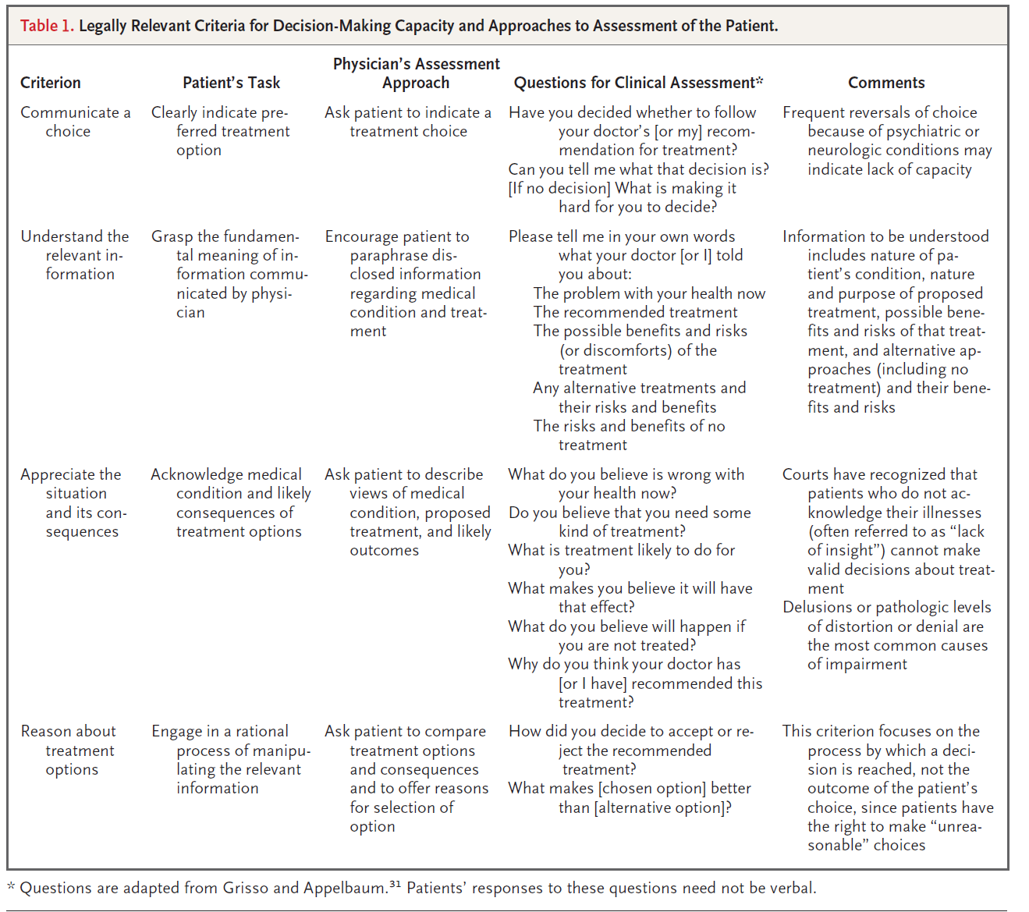

Slide 19
Functional Abilities of Capacity: Understanding Appelbaum, 2007
Ability to understand
Understanding should be assessed in all cases in which the patient expresses a choice
Can the patient assimilate the information disclosed regarding the nature of the illness, the treatment options, the prognosis (with and without treatment), and the risks/benefits of treatment?
Suggested questions to ask:
Tell me in your own words…
The nature of your condition
The recommended treatment along with possible benefits and risks
The possible benefits and risks of alternative treatment or no treatment

Slide 20
Functional Abilities of Capacity (Understanding): Case Example
Capacity to accept treatment with psychotropic medication?
Ms. V is a 92 year old female with a history of mild-moderate dementia with significant depressive symptoms on whom you would like to start a selective serotonin reuptake inhibitor to help moderate these symptoms.
The patient initially consents to the medication but, when handed the prescription, she politely thanks you for these vitamin pills.
When you query her further about what she understands this new medication is for, she happily responds that it “lowers my sugars.”

Slide 21
Functional Abilities of Capacity (Appreciation) Appelbaum, 2007
Ability to Appreciate
Appreciation relates to the patient’s ability to apply the information to his/her own situation.
The focus is on the patient’s beliefs rather than knowledge
Belief of illness
Belief of treatments
Suggested questions:
What do you believe is wrong with you now?
Do you think that you need some type of treatment?
What do you believe will happen to you if you do not get treated?

Slide 22
Functional Abilities of Capacity (Appreciation): Case Example
Capacity to refuse surgical procedure?
Mr. K is a 60 year old male alcoholic with a known history of cirrhosis admitted with hematemesis.
The patient continues to have several bouts of bloody emesis now complicated by emerging hypotension and worsening anemia despite aggressive supportive care.
When approached about the need to perform an EGD to band the likely bleeding varices the patient refuses. He states that he has a bad case of “heartburn” and that no one has ever died of heartburn so he will “be fine.”

Slide 23
Functional Abilities of Capacity (Reasoning) Appelbaum, 2007
Ability to reason
Does the patient use the information disclosed to engage in a rationale process of options?
Is there a “reasonable reason” for the patient’s choice?
Takes into account the patient’s past preferences and life decisions
Suggested questions:
Tell me how you reached this decision?
How did you weigh the information provided?

Slide 24
Functional Abilities of Capacity (Reasoning)
Capacity to refuse surgical procedure?
A 52 year old man suffering from chronic paranoid schizophrenia presented to the emergency department after he jumped of a bridge in an attempt to escape the “feds” who were chasing him because of his ability to communicate with aliens. The patient has suffered extensive fractures and requires surgery.
The patient quickly identifies the fact that he has suffered numerous orthopedic injuries and that the orthopedic trauma service would like to perform surgery in an attempt to repair his injuries.
He, however, flatly refuses surgery because he is convinced that the surgeon will implant a device that will block his impressive ability to communicate with “those not from this world” and allow the FBI to track him.

Slide 25
Functional Abilities of Capacity Appelbaum, 2007
Summary of functional abilities
Expressing a choice
Ability to state a preference
Understanding
Ability to comprehend the information provided in the treatment disclosure required for informed consent
Appreciation
The patient’s beliefs about the disorder and proposed treatments and to apply it realistically to their own situation
Reasoning
Ability to process information and one’s preference in a logical manner
Notes:
Make sure to conduct capacity assessment in a way that helps patients bring all strengths to bear/do the best they can

Slide 26
When Should Decision-Making Capacity Be Assessed?
It is often done at every patient encounter, but unrecognized
Abrupt changes in mental status
When patients refuse treatment recommendations, including AMA discharges
When patients consent to especially risky treatment
When patients have a risk factor for impaired decision-making

Slide 27
Documentation of the Capacity Assessment
Careful documentation in the medical record is imperative
An appropriate note should include
A description of the information disclosed
A description of the potential consequences of the patient's choice
A brief note on the patient’s mental status
A statement on the patient’s performance on the four abilities
Documentation of opinion of capacity
Impression of why patient lacks capacity and what might be done to restore capacity (if possible)

Slide 28
What Types of Conditions Can Diminish Capacity?
Psychological factors/Cognitive Biases
Psychiatric diagnoses
Neurocognitive disorders

Slide 29
Cognitive Biases Can Diminish Capacity Brock and Wartman, 1990
Myopic approaches to problem-solving
Downplaying of risk
Optimistic framing of problems
Blindness to the effects of one’s decisions on others

Slide 30
Psychiatric Diagnoses Can Diminish Capacity
Kontos et al. (2015) suggest that every incapacity determination, with the exception of those associated with devastating neurological conditions (e.g., coma), be backed up by a psychiatric diagnosis
Suspicion or presence of incapacity should trigger pursuit of mental illness-based explanations for it (Appelbaum, 1994)
Diagnoses say what is incapacitating the patient and how: “If this patient is incapacitated, what is he incapacitated by?” (Kontos et al., 2015)
Would optimally provide recommendations for treating the psychiatric illness in hope of restoring capacity

Slide 31
Cognitive Impairment Can Diminish Capacity Kontos et al., 2015
Clinical assessment of incapacity due to cognitive impairment should be supported by cognitive screening that includes a standardized instrument such as the Montreal Cognitive Assessment (Nasreddine et al., 2005)

Slide 32
Substitute Decision Making
Once deem patient to lack capacity, need substitute decision maker
Options for substitute decision making:
Advanced directives
Decision directives (living will)
Documents the patient’s choice(s) of treatment under specific circumstances
Proxy directives (POA)/Healthcare proxy
Patients designate persons they desire to make decisions for them when they are incapacitated
Effectiveness depends on patient sharing their choices with the proxy
Family/Close friend/Partner
If there is no advanced directive, families are usually asked to make decisions
Some states have laws which specify which family members have priority

Slide 33
Substitute Decision Making if no Proxy/Family Available
Courts
Decision makers of last resort
Many hospitals turn to the courts to adjudicate incompetence and appoint a decision-maker in the absence of an advanced directive
Patients can challenge findings of incapacity in court
May go to court for treatment order or for guardianship
Consider guardianship when:
No substitute decision maker
Capacity not likely to be restored in near future
Ongoing medical decisions will likely need to be made

Slide 34
Ethical Issues in Capacity Assessment
Many capacity consults are not about capacity at all, but rather ethical dilemmas (Kontos et al., 2013)
Psychiatrist’s role = elucidate the “real” issue, relay that finding to the consultee, and be one among many, albeit oftentimes the first person, to broach it with the patient (Kontos et al., 2013)

Slide 35
References
Appelbaum PS: Assessment of patients’ competence to consent to treatment. N Engl J Med 2007; 357: 1834-1840.
Appelbaum PS: Almost a Revolution: Mental Health Law and the Limits of Change. New York, NY: Oxford University Press; 1994.
Appelbaum PS, Grisso T: Capacities of hospitalized, medically ill patients to consent to treatment. Psychosomatics. 1997; 38: 119-125.
Beauchamp TL, Childress JF. Principles of Biomedical Ethics, 6th ed. New York, NY: Oxford University Press, 2009.

Slide 36
References
Brendel RW, Schouten R: Legal concerns in Psychosomatic Medicine. Psychiatr Clin N Am 2007;30:663-676.
Brock DW, Wartman SA: When competent patients make irrational choices. N Engl J Med 1990; 322: 1595-1599.
Grisso T, Appelbaum PS: Assessing competence to consent to treatment: a guide for physicians and other health professionals. New York: Oxford University Press, 1998.
Huffman JC, Stern TA: Capacity Decisions in the General Hospital: When Can You Refuse to Follow a Person’s Wishes? Primary Care Companion J Clin Psychiatry 2003; 5(4).

Slide 37
References
Kontos N, Freudenreich O, Querques J. Beyond Capacity: Identifying Ethical Dilemmas Underlying Capacity Evaluation Requests. Psychosomatics 2013; 54: 103-110.
Kontos N, Querques J, Freudenreich O: Fighting the good fight: responsibility and rationale in the confrontation of patients. Mayo Clin Proc 2012; 87: 63-66.
Kontos N, Querques J, Freudenreich O: Capable of More: Some Underemphasized Aspects of Capacity Assessment. Psychosomatics 2015; 56: 217-226.
Nasreddine ZS, Phillips NA, Bedririan V, et al: The Montreal Cognitive Assessment, MoCA: a brief screening tool for mild cognitive impairment. J Am Geriatr Soc 2005; 53: 695-699.

Slide 38
References
Pellegrino ED, Thomasma DC. For the Patient’s Good: The Restoration of Beneficence in Health Care. New York, NY: Oxford University Press, 1988, pp 7.
Pellegrino ED: Patient and physician autonomy: conflicted rights and obligations in the physician-patient relationship. J Contemp Health Law Policy 1994; 10: 47-68.
Querques J, Kontos N, Freudenreich O: Determination of decision-making capacity: A first step (Letter to the Editor). Crit Care Med 2010; 38: 1614-1615.
Roth LH, Meisel A, Lidz CW: Tests of competency to consent to treatment. Am J Psychiatry 1977; 134: 279-284.
Tauber AI: Sick autonomy. Perspect Biol Med 2003; 46: 484-495.

