Slide 1
Introduction to Consultation-Liaison Psychiatry
Larkin Kao, MD
Consultation-Liaison Psychiatrist, VA Boston Healthcare System
Notes:
Last updated January 2019

Slide 2

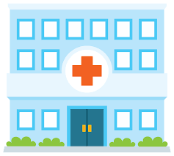
Consultation-Liaison (C-L) Psychiatry
Notes:
Historically, medicine and psychiatry have often been viewed as separate specialties with minimal overlap. This relates to the concept of mind-body dualism or Cartesian dualism, viewing the mind and the body as independent entities. In recent decades there has been increasing recognition that the overlap between mental health and physical health is in fact large, with mental health affecting physical health and vice-versa. This increasing recognition has added to the importance of consultation-liaison (C-L) psychiatry, which is a medical subspecialty positioned at the interface of psychiatry and the rest of medicine.

Slide 3
Consultation-Liaison (C-L) Psychiatry
Unfortunately, many still view psychiatry as separate from the rest of medicine, and expect that psychiatrists do not need to know about other areas of medicine
On the contrary, broad medical knowledge is relevant for all psychiatrists
  C-L psychiatrists require an even greater understanding of medical conditions and treatments
For trainees who are considering psychiatry but are concerned about being isolated from other medical colleagues or not using other medical knowledge, C-L provides an excellent setting at the interface of psychiatric and medical care
Notes:
Unfortunately, even with this growing awareness, some medical students anticipate psychiatry to be a specialty separate from the rest of medicine, and expect that psychiatrists do not need to know about other areas of medicine to practice. On the contrary, medical knowledge is relevant for all psychiatrists caring for patients, and C-L psychiatrists are required to have an even greater understanding of other medical conditions and treatments, particularly as they relate to psychiatric concerns. For students who think they may be interested in psychiatry but do not want to be isolated from their medical and surgical colleagues or acute medical settings, C-L psychiatry provides an excellent venue for psychiatrists to use knowledge of psychiatry as well as other medical specialties in everyday work.
Recent medical students on my service noted that while rotating on C-L, they were pleasantly surprised by how much knowledge of other medical specialties was involved, the variety of patients they encountered (both in types of illness and severity of illness), and how many patients they saw recover from acute psychiatric conditions.

Slide 4

What is Consultation-Liaison (C-L) Psychiatry?
Subspecialty at the interface of medicine and psychiatry
Includes:
  Inpatient and outpatient practices
  Reactive and proactive consultations
  Official and unofficial liaisons
Also known as:
  Psychosomatic medicine
  Medical psychiatry
Notes:
Consultation-liaison psychiatry (C-L psychiatry) is a subspecialty of psychiatry situated at the interface of medicine and psychiatry
C-L psychiatrists may work in the inpatient or outpatient setting. Consults may be completed reactively (after the primary physician consults psychiatry) or proactively (an arrangement where a psychiatrist identifies cases that could benefit from psychiatric consultation). C-L psychiatrists may have specific relationships with certain medical or surgical teams or subspecialties, known as liaisons.
HISTORY:
Development of C-L as we know it dates back to the mid twentieth century when Weissman, Kornfeld Hackett and others studied the interface between psychiatric symptoms and medical illness
In the 1970s, C-L became a required rotation in psychiatry residency programs
By the 1990s, there were nearly 50 U.S. fellowship programs in C-L
C-L psychiatry was recognized by the American Board of Medical Specialties as a subspecialty in 2003
At times known as psychosomatic medicine, the official title of the specialty as of 2018 is consultation-liaison (C-L) psychiatry
The national academic organization for C-L is the Academy of Consultation-Liaison Psychiatry (ACLP); more information can be found at clpsychiatry.org
Given the current imbalance between psychiatrists and patients seeking psychiatric help, C-L psychiatry provides a way for psychiatrists to provide care to greater numbers of patients
Source: Gitlin 2017 (https://psychnews.psychiatryonline.org/doi/full/10.1176/appi.pn.2017.12a14)

Slide 5
Consultation
Liaison
Consultant: a person who provides expert advice professionally
Notes:
As the name “consultation-liaison” suggests, C-L psychiatrists have a dual role as consultant and liaison. As the consultant, we are providing psychiatric expertise to other medical professionals. For example, an inpatient medical team or outpatient primary care physician may consult psychiatry for assistance with a safety assessment for a suicidal patient.

Slide 6
Consultation
Liaison
Consultant: a person who provides expert advice professionally
Communication or cooperation that facilitates a close working relationship between people or organizations
Notes:
The liaison aspect of our work refers to the piece beyond simply seeing a patient and delivering recommendations. This refers to our place in the medical system working as a member of the outpatient or inpatient medical team, providing formal and informal education and support. We build relationships with medical teams that help to educate those teams on how to manage psychiatric patients. This extends to physicians, nurses, social workers, physical therapists, etc. This includes helping team members deal with their own affect around difficult cases (for example, sadness related to a young individual with a terminal illness), and helping to reframe and absorb affect in challenging medical situations (for example, assisting team members in identifying and processing countertransference toward an angry or nonadherent patient)
The liaison role is important for every consult in an informal manner, but may also occur in a formal manner, for example if a specific psychiatrist discusses each cardiac transplant candidate with the transplant team, or if each OB/Gyn related psychiatry consult is assigned to the same two psychiatrists who specialize in perinatal psychiatry.

Slide 7
Consultation
Liaison
Quality consultations strengthen liaison relationships
Notes:
Good consults yield better liaison relationships, as providers and teams come to know and trust the psychiatrist or psychiatry team

Slide 8
Consultation
Liaison
Quality consultations strengthen liaison relationships
Liaisons yield more effective consultations
Notes:
In turn, strong liaison relationships yield more psychiatry consults and more effective consultations. For instance, a team that works closely with psychiatry may be more attuned to early, subtle signs of delirium and thus consult psychiatry earlier for those cases.

Slide 9
Consultation
Liaison
Quality consultations strengthen liaison relationships
Liaisons yield more effective consultations
In both roles: serve both patient and team
Notes:
Both as the consultant and the liaison, the C-L psychiatrist has obligations to serve both the patient and medical provider or team

Slide 10
Differences from other areas of psychiatry
Obligation to both consultant and patient
C-L psychiatrist
Primary Team
Patient
Notes:
Ideally, the obligations to the patient and primary team work synergistically. For example, a C-L physician who sees a depressed patient in primary care could give the primary physician recommendations on antidepressant medications, and could help educate the patient and the provider on options for psychotherapy. By working with the C-L psychiatrist, the primary team could come to better understand how to monitor and titrate antidepressant medications (helping the patient), and the patient could learn more about how his depression affects his adherence with medical appointments, allowing him to improve his adherence and communication with his PCP (helping the provider).

Slide 11
Differences from other areas of psychiatry
Patient may be unaware of referral and is often not self-referred
Might be the patient’s first visit with a psychiatrist
  … and possibly the last
Notes:
There are several key differences between C-L psychiatry and other areas of psychiatry. A main difference is that in outpatient or inpatient psychiatry, the patient generally knows he is going to be seen by a psychiatrist, and has often (though not always) presented by choice. In contrast, C-L psychiatrists often see patients who did not ask or want to see a psychiatrist, and may even be unaware of the referral. Seeing a C-L psychiatrist, whether in the inpatient or outpatient setting, may also be the patient’s first encounter with a psychiatrist. This can feel overwhelming to patients and often triggers negative reactions informed by stigma. A key role of the C-L psychiatrist is to discuss these reactions with the patient. Being a C-L provider also offers a chance to normalize psychiatric care and provide psychiatric care to patients who otherwise might not request or receive necessary mental health services. As this may also be the last time a patient sees a psychiatrist, the C-L psychiatrist has an important task of building rapport and demonstrating that seeing a psychiatrist can be helpful rather than harmful.

Slide 12



Differences from other areas of psychiatry
Notes:
Other differences between C-L and other parts of psychiatry relate to the medical setting.
The inpatient medical setting provides various challenges to the psychiatric interview:
Patients are acutely ill and often in pain
Minimal privacy leads to challenges in confidentiality and patients feeling comfortable disclosing vulnerable information
Rather than having a fixed appointment with the patient, C-L psychiatrists adjust their visits with patients around the schedules of other teams and procedures
The outpatient medical setting can provide similar challenges related to physical discomfort, a sense of limited confidentiality if another provider is involved, and time limitations.
All of these features of C-L psychiatry require flexibility. While these can be challenging aspects of C-L psychiatry for both the provider and the patient, learning how to provide quality psychiatric care amidst these obstacles is a key part of psychiatric training.

Slide 13
What types of patients?
Psychiatric presentations of medical conditions | Psychiatric complications of medical conditions or treatments
Medical presentations of psychiatric conditions | Medical complications of psychiatric conditions or treatments
Psychological reactions to medical conditions or treatments | Comorbid medical and psychiatric conditions
Lipowski 1967
Notes:
A common question relates to what types of patients a C-L psychiatrist might treat. The short answer is that C-L psychiatrists see a very broad range of patients. Compared to patients seen by general psychiatrists, C-L patients are more likely to be medically complex and often have multiple medical and psychiatric comorbidities. C-L psychiatrists often see patients with neurocognitive disorders and somatoform disorders.
Examples of categories (Lipowski 1967)
Psychiatric presentation of a medical condition (for example, patient presenting with psychosis as the first symptom of a brain tumor)
Psychiatric complications of medical conditions or treatments (for example, steroid-induced psychosis)
Medical presentations of psychiatric conditions (for example, a patient presenting with failure to thrive as a result of depression)
Medical complications of psychiatric conditions or treatments (for example, a patient with clozapine-induced myocarditis)
Psychological reactions to medical conditions or treatments (for example, a patient with low mood after cancer diagnosis)
Comorbid medical and psychiatric conditions (for example, management of a patient with asthma and panic attacks who may have trouble differentiating the two)

Slide 14
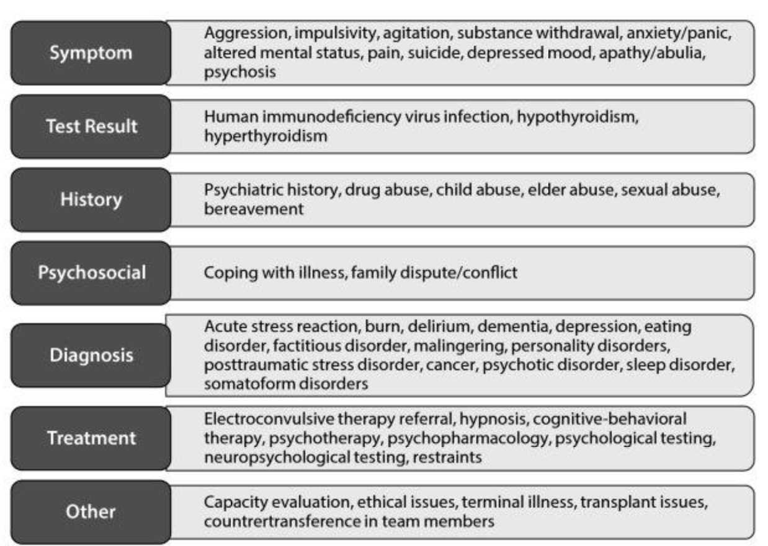
Common reasons for consultation
Lokko 2015
Notes:
This chart summarizes from another perspective various common issues that may prompt a psychiatry consultation, based on different aspects of the patient’s exam, history, diagnosis and treatment

Slide 15
How does medical illness impact mental health?
Direct effects of the disease process
Side effects of medications/treatments
Psychosocial stressor
Modifying factor in selection of appropriate therapies
Barrier to access to care
Notes:
On a practical level, when asked to see a patient as a psychiatry consultant, it can be helpful to recall some broad categories of how medical illness can impact mental health, and consider how each of these may be at play for your patient

Slide 16
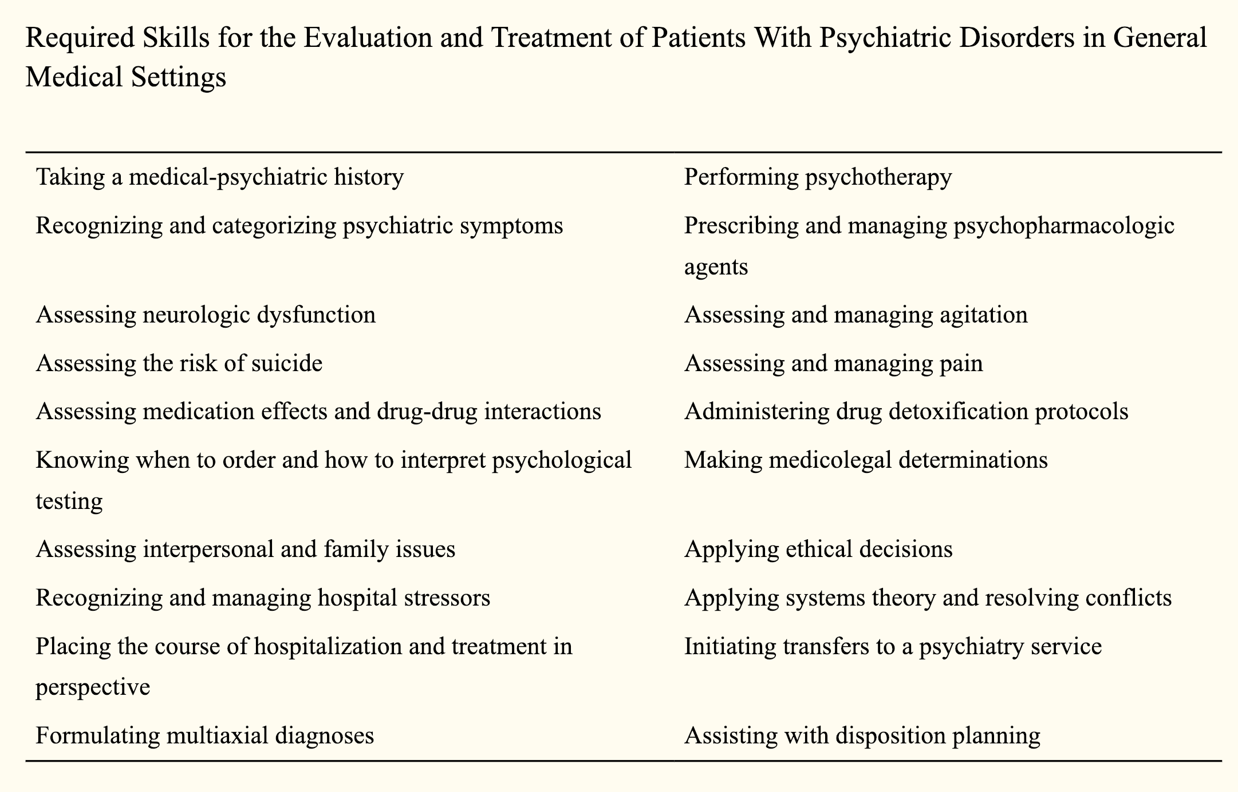
Skills of the C-L Psychiatrist
Lokko 2015
Notes:
As one might imagine based on the preceding slides, C-L psychiatrists must cultivate a wide variety of skill sets. Some of the required skills are summarized in this table.

Slide 17
Major tasks of the C-L psychiatrist
1.) Clarify the question
2.) Complete a psychiatric assessment
3.) Discuss recommendations with the team
Notes:
The next several slides will summarize the basic tasks a C-L psychiatrist completes when asked to see a patient as in consultation

Slide 18

1.) Clarify the question
Always discuss with consultee
  What is the question they are asking, and what is the question they are not asking?
  Help consultee reformulate question
There is almost always some way we can help
Notes:
Though the consultee generally presents a question to the C-L psychiatrist, the question may be poorly articulated. It can be helpful to separate manifest questions (those stated) from latent questions (those not explicitly stated). There may be many reasons for a poorly articulated question. Other providers may not understand what they need (i.e. an inpatient team may ask for a depression evaluation for a patient who turns out to be delirious). Alternatively they may ask for a consult due to countertransference (for example, asking a psychiatrist to “rule out depression” when team is frustrated that patient is refusing proposed interventions), or may know they need help but not know how to phrase their findings or question (for example, a provider calling psychiatry because “the patient seems off”).
Though it can be frustrating to receive a vague or seemingly irrelevant question, it is important to not demand a question but rather to help the provider or team reformulate how psychiatry can assist.
On a busy day, it may feel tempting to push back on a consult request, but it is recommended to avoid this. Occasionally, upon reformulation of question it may turn out that the team does not need your help. In that care, reassure them that if that changes they can call you back. Otherwise, see the patient and determine how you can be of help (whether to the patient and/or the team). If you refuse a consult that the team is asking for, that patient is not being helped and the team is not being helped. The next time a patient needs help, that team is less likely to call psychiatry, depriving the team of our help and depriving the next patient of psychiatric care.
While clarifying the question, it is also helpful to know whose idea the consult was (family, doctor, nurse, patient), and whether the patient knows psychiatry has been called

Slide 19
2.) Complete a psychiatric assessment
Chart review
See the patient
  Interview
  Exam
Close the loop

Slide 20
Chart review
Pay particular attention to:
  Psychiatric history (any outpatient providers?)
  Medical comorbidities (past and present)
  Medications (psychiatric and non-psychiatric, noting recent changes)
Notes:
Once the question is clarified, review the chart. In addition to general chart review strategies, be sure to consider:
Psychiatric history (outpatient providers, past hospitalizations, suicide attempts, violence, medication trials)
Medical comorbidities/history and how these conditions may affect the patient’s psychiatric presentation and treatment options. For instance:
Hepatic or renal insufficiency affect drug metabolism
Electrolyte abnormalities may cause delirium and lower seizure threshold
Addition of a non-psychiatric medication may affect levels of a psychiatric medication, and vice-versa (for instance, if omeprazole, a CYP2C19 inhibitor, was recently added for GERD, the levels of a CYP2C19 substrate such as citalopram may need to be adjusted)

Slide 21

See the patient
Introduce team and role
  Sit down when possible
  Ensure privacy as much as possible
  Optimize environment
Address surprises (if any) that psychiatry was called
Notes:
Though the therapeutic alliance on C-L may be more brief compared to those formed during an extended inpatient stay or with an outpatient provider, it is just as important. In some senses the alliance is even more critical, as we often have only a short time to build an alliance, under circumstances inherently stressful and uncomfortable for the patient
Introduce team and role
- Sit down when possible (generally assumed in the outpatient setting, but may be less common in inpatient or emergency settings)
- Ensure privacy as much as possible (again this should be assumed in the outpatient setting but may become more problematic in the inpatient or emergency setting. Remember to close doors, draw curtains, and use a relatively low volume when speaking if you are discussing patient matters in a setting where you may be overheard)
- Optimize environment (if outpatient: consider having the patient move to a chair from the exam table if appropriate. If inpatient: turn off TV or other background noise. In any setting: help patient to comfortable position, attend to any physical discomfort)
Address surprises (if any) that psychiatry was called
- Remember that patient may have no prior psychiatric encounters

Slide 22
Interview the patient
Special focus on:
  What brings them to the medical setting (inpatient or outpatient) and how they feel about it
  How physical symptoms or medical treatments relate to psychiatric symptoms or treatments, and vice-versa
  How they are coping with current circumstances
  How we can bolster supports
  Collateral
Notes:
Reason for hospitalization or visit to a medical specialist may include the precipitant to the current psychological and physical difficulties. Gauge patient’s reaction to recent events, as well as their usual coping mechanisms. If the patient has had similar medical issues in the past, asking about these experiences may shed light on the current scenario (for instance, asking about psychiatric symptoms and/or medical complications in past pregnancies for a patient presenting with anxiety in her third trimester of pregnancy)
Coping: Has the patient dealt with worse stressors before? If so, what helped him through that?
Bolstering supports: does the patient mention friends or family who may be able to help? Does he find support in religious community? Might he benefit from a social work referral?
Collateral includes personal contacts (friends/family) and other providers (outpatient and inpatient). In the inpatient setting, nursing, PT and other staff can be very helpful. In the outpatient setting, similarly consider other staff in your clinic and/or others. The front desk receptionist in a clinic, for instance, may be able to share quite a bit about the patient’s emotional reactions and distress tolerance?

Slide 23
Exam
Mental status exam is critical
  May attempt to observe patient when you are not in the room
Focused physical exam may be appropriate
  i.e. testing for cerebellar dysfunction, or tests to delineate whether perceived weakness is psychogenic
Cognitive exam
  Consider MoCA or abbreviated selection of tests to assess various brain areas

Slide 24
Close the loop: communication with team
If the provider or team is present, speak with them in person
  Otherwise, page/call to discuss
Explain your impressions, see if there are other questions, express plans for how you will follow. Focus on:
  Answering any specific questions asked
  Removing impediments to medical care
  Bringing new perspectives to clinical dilemma, as needed
  Facilitating mutual understanding between patient, doctor, treatment team
  Educating team about psychiatric needs of the patient

Slide 25
3.) Consultation note
General principles
History
Formulation
Recommendations

Slide 26
General principles
Remember that the note is to be read and used by other members of the medical team
  Consider what they will want to read
    Be concise and avoid jargon
    Length of note inversely correlates with likelihood of being read
    Remove extraneous information (being careful of auto-populated templates in the electronic medical record)
  Consider confidentiality. Anyone caring for the patient can read your note, and in many systems it is very easy for patients to also read their notes.
    Include details necessary to care but do not go into excessive detail about interpersonal situations or trauma
    This is not a process note
  Avoid passive aggression (“chart wars”)
Notes:
- Note may be read by doctors, nurses, PT/OT, lawyers, SW, ethics… and the patient

Slide 27
History
  Articulate in your one-liner why the patient is at his medical appointment or in the hospital, and why psychiatry is involved
  Provide all relevant information related to the consultation question asked, including recent psychiatric and medical issues
    It may be helpful to articulate a time course relationship between medical and psychiatric symptoms, for example describing a PNES patient’s anxiety symptoms as they relate to his seizure symptoms and seizure frequency
  Include psychiatric and medical review of systems

Slide 28
Formulation
Second to recommendations, this is section most frequently read by others
Key elements:
  Summarize key findings from assessment
  Explain what you think is going on (biopsychosocial)
    Include stressors, functional status
  Include medical and psychiatric differential for symptoms
  Psychiatric safety assessment as indicated

Slide 29
Recommendations
Include:
  Any further work up we recommend (tox screen, UA, B12/folate)
  Medication recommendations
    Dose schedule, reason for PRN
    Side effects to look out for; lab monitoring needed
  Behavioral approaches that may help engage the patient
  Legal issues (for example, involuntary holds)
  Psychosocial needs (for example, recommendation of social work consult or housing resources)
  Your plans to follow the patient

Slide 30
Summary
C-L psychiatry is a specialty at the interface of medicine and psychiatry where psychiatrists practice in the medical setting
C-L psychiatry involves close work with medical teams and patients, and an obligation to both the consultee and the patient
Quality consultations yield liaison relationships; liaisons with primary teams yield more and better consults
Consultees may need help formulating and articulating the type of help they need
Consider your audience when writing a consult note

Slide 31
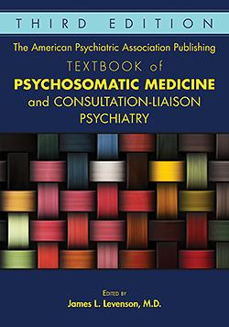
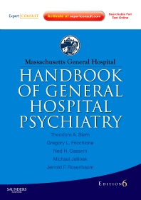
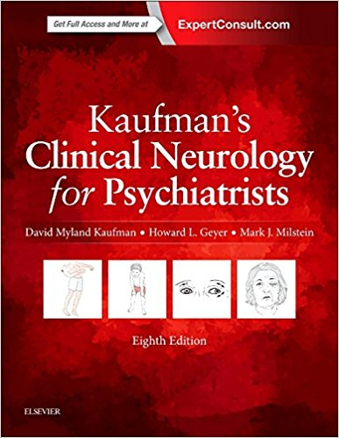

Further reading
Notes:
Pictured here are a few of many resources available to you to learn more about C-L psychiatry. A great central resource is the Academy of Consultation-Liaison Psychiatry (ACLP) website, clpsychiatry.org, along with the Academy’s journal, Psychosomatics.

Slide 32
References
Garrick, T. R., & Stotland, N. L. (1982). How to write a psychiatric consultation. The American journal of psychiatry.
Gitlin, D. (2017, November 28). In the name of… Consultation-Liaison Psychiatry. https://doi.org/10.1176/appi.pn.2017.12a14.
Levenson, J. L. (Ed.). (2018). The American Psychiatric Association Publishing Textbook of Psychosomatic Medicine and Consultation-liaison Psychiatry. American Psychiatric Pub.
Lipowski, Z. J. (1967). Review of consultation psychiatry and psychosomatic medicine: II. Clinical aspects. Psychosomatic Medicine, 29(3), 201-224.
Lokko, H. N., & Stern, T. A. (2015). Collaboration and Referral Between Internal Medicine and Psychiatry. The primary care companion for CNS disorders, 17(1), 10.4088/PCC.14f01746. doi:10.4088/PCC.14f01746

