Slide 1
Navigating the ACLP Annual Meeting: Tips & Tricks
Sunday, August 6, 2023
6:00 - 7:30 PM EDT

Slide 2
Navigating the ACLP Annual Meeting: Tips & Tricks
Sunday, August 6, 2023
6:00 - 7:30 PM EDT,

Slide 3
Sponsors/Participants
Mentorship (Carrie Ernst, Scott Beach)
Annual Meeting (Sejal Shah)
Workshops & Symposia (Anne Gross, Natalie Jacobowski)
Medical Student Education (Samantha Zwiebel, Jeffrey Zabinski)
Oral Papers & Posters (Michael Peterson)
Local Arrangements (Emily Holmes, Jack Owens)
Preconference Courses (Marian Fireman, Durga Roy)
Networking (Paulo Sales, Sandra Rackley)
DEI (Leena Mittal, Chandan Khandai)
Notes:
--Local Arrangements --Preconference Courses --Oral Papers & Posters and Workshops & Symposia --Networking and Mentorship --Diversity, Equity, and Inclusion --Medical Student Education

Slide 4
Agenda
Introduction and Overview
Medical Student Subcommittee
Local Arrangements
Workshops & Symposia/Oral Papers & Posters
Preconference Courses
Networking
Mentorship
DEI
Q & A

Slide 5
Medical Student
Subcommittee

Slide 6
Medical Student Education Subcommittee
Samantha Zwiebel
Samantha.zwiebel@pennmedicine.upenn.edu
Jeffrey Zabinski
jz3291@cumc.columbia.edu
Where to find meeting information?
Should I attend if I’m a trainee, not presenting, or don’t know anyone going?
How to register/trainee rates?
What to wear, and is there food available?

Slide 7
Where can I find meeting information?
www.clpsychiatry.org
https://clp2023.eventscribe.net/

Slide 8
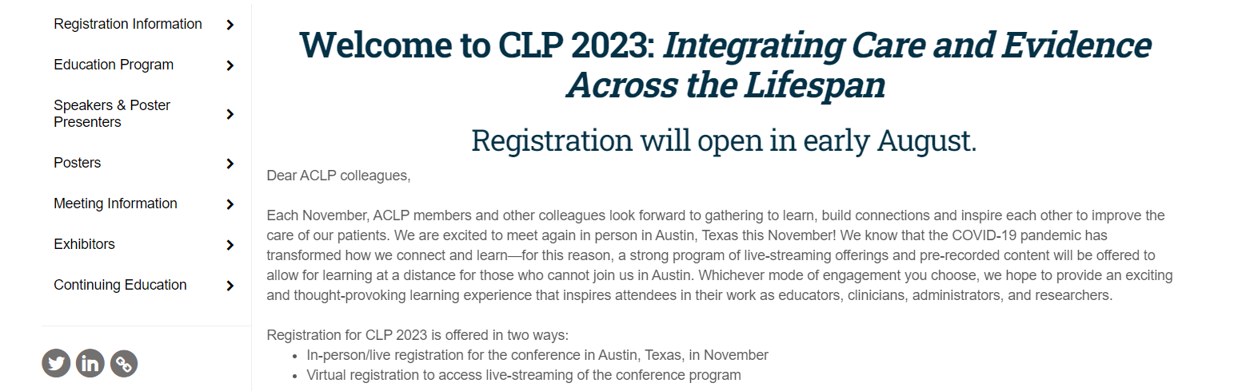

Slide 10
Should I attend the meeting if I’m…
…a medical student? Resident? Fellow?
…a practicing psychiatrist with minimal C-L experience/work?
…not presenting anything?
…the only one from my institution going?
…not sure if I know anyone else attending?
YES!
And here’s why!

Slide 11
What to wear? Will there be food?
There is no formal dress code
Recommend business casual, ie., more formal than jeans, less formal than suit
However, if presenting, consider more formal; many people choose to wear a suit
Would encourage comfortable shoes, particularly if staying off-site
Consider bringing a backpack, tote bag, or portfolio folder
Some meals are covered
It can differ from year to year; covered meals are listed in conference schedule
Consider bringing snacks and a water bottle; there are typically beverage stations
Many institutions will host a group dinner, so it’s a great idea to let your department know you’ll be coming

Slide 12
Local Arrangements

Slide 13
Workshops & Symposia/
Oral Papers & Posters

Slide 14
Workshops & Symposia Oral Papers & Posters
Michael Peterson (mpeterson2@wisc.edu)
What are the different types of sessions?
How is the Conference organized?
What will be available online later?
Etiquette and tips for sessions.

Slide 15
What are the different sessions?
Workshops
Interactive, based on adult learning theory
Some may be very full
Brief Oral Papers (BOPs)
5 shorter presentations on a theme
Often works in progress, preliminary data.
More likely presented by trainees and early career
Posters
Live and interactive session
Great for networking and socializing!
Notes:
Other sessions – covered by Sejal? (Plenary sessions; Debate;
Workshops: Th and Fr (AM and PM)
BOPs: Fr (AM and PM)
Posters: Th evening

Slide 16
How is is the Conference organized?
Workshops:
40 total (9 – Th AM, Th PM; 5 – Fr AM, Fr PM; 10 – Sat AM)
BOPs:
5 per session x 10 sessions (5 – Fr AM, Fr PM)

Slide 17
How is is the Conference organized? (2)
Program will include “Tracks” based on conference themes
These are optional but helpful tools for picking sessions!
Eg – DEI, Training/Education/Career Development, Research/EBM, etc.
Pick and chose different types of sessions, different topics.
Most sessions will have content appropriate for all learners – but find sessions most interesting to you!

Slide 18
What will be available online later?
Pre-recorded symposia (12 sessions; more “traditional” didactic learning)
All 38 workshops at the conferences will be recorded and available to attendees

Slide 19
Etiquette and tips for sessions.
Please arrive on time and stay through the sessions
BOPs – if you need to leave, exit between talks.
BOPs – NOTE – different BOP sessions are not “synced”.
Some workshops will be popular and can be very full
Arrive early to be sure to get a seat.
Do not “squeeze in” or sit on the floor/stand in the back.
Pick another session, review recording later.

Slide 20
Etiquette and tips for sessions (2).
Participation is encouraged!
Don’t feel intimidated, even as an early trainee.
Ask questions, participate in interactive workshop sessions
BOPs
The speakers love to get audience questions!
Posters
These are often the best sessions to ask direct questions, meet people and network – everyone from senior members to other trainees!
Presenters love to have people visit their poster and ask for explanations!

Slide 21
Preconference Courses

Slide 22
Preconference Course Day Wednesday November 8, 2023
Morning - 8am to 12 noon
Updates Course – open to everyone
APP course – focused toward Advanced Practice Practitioners (NPs, PAs, etc) but open to everyone – extra fee
Lunch 12-1pm
Afternoon – 1pm to 5pm
Skills Courses – Open to everyone, extra fee
Research Colloquium – By application only (12-5pm)

Slide 23
Updates Course
Transgender Care
Morgan Faeder, MD
Women’s Health
Nancy Byatt, MD
Autoimmune Encephalitis
Gena Mooneyham, MD
Addictions
Shamin Nejad, MD
Pulmonary
Yelizaveta Sher, MD
Rheumatology
James Levenson, MD

Slide 24
Skills Courses
You Don’t Need a Title to be a Leader: Practical Leadership Skills for the C/L Psychiatrist
The Social (Media) Being: Psychiatrists Guide to the Trials and Tribulations of the Virtual Self Across the Lifespan
Lessons Learned in the Creation and Maintenance of Telemedicine Services for Consultation-Liaison and Emergency Psychiatry Coverage in a Diverse Multiple Hospital system: A Telepsychiatry SIG-sponsored skills course
From PMDD to Menopause: Psychopharmacology Basics for the General Consultation Psychiatrist
Standing Shoulder to Shoulder with our Intensivist colleagues: How Critical Care Psychiatrists can Enhance the Application of the A-F bundle
Care in Living Color: A Primer for C/L psychiatrists on Integrated Care for Transgender and Gender Non-binary persons

Slide 25
Research Colloquium
Not part of the Preconference Course Program
By application only
Likely too late to apply for this year
Information available on ACLP website under:
Developing Scholars Research Colloquium
Apply next year if interested!

Slide 26
Networking

Slide 27
Networking within ACLP: The unspoken paths to meaningful relationships
Paulo Sales, MD, MS Vice-Chair, Networking Subcommittee Academy of Consultation-Liaison Psychiatry

Slide 28
Our Mission:
To link ACLP members in the event, remove barriers to collaboration, and promote social integration events that focus on:
Professional/ Career development
Education
Social Integration

Slide 29
Agenda Items
Social events
Networking for introverts
What if poster session and trainee mixers overlap?
Meeting a Program Director
Joining a SIG to nourish long-term relationships

Slide 30
Being Social in ACLP
Professional Organization
Professional Identity: What events, who to meet, focus?
Low-key, flexible, and creative group
Highly diverse: Private↔Academic | Frontline↔Leaders
Joining a committee, SIG, or other focus groups
Attending networking events during our conference
Attending “secret events” (Dinners, other activities)

Slide 31
What if I am an introvert?
We need people like you!
Find an extroverted partner to group up/follow
Attend events that have Ice Breakers:
Trainee Mixer
ACLP Live! Trivia
Networking Lunches
Ask us Anything
Follow your inherent nature and be a great listener!

Slide 32
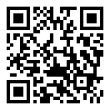
You said Social Media?
Whatsapp Groups
Social media platform on Cadmium (ACLP App)
Consultation-Liaison Psychiatry Educational Network (CL-PEN): https://www.facebook.com/groups/clpen/

Slide 33
Overlapping Events?
Know your priorities:
Make new connections? Find a liaison to introduce you!
See old friends/colleagues
Absorb new knowledge
Check if there are similar events to meet your goals
Network: ACLP Saloon, SIG meetings, Trainee Mixer, Networking Lunches, Ask us anything
Concurrent sessions vs. Plenary topic?
Wellness: Morning Run / Mindfulness-Meditation
Notes:
Poster Session with Authors ends at 7:15 pm – no issues with the trainee mixer

Slide 34
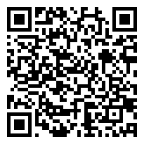
Meeting a fellowship Program Director
ACGME Rules:
Limit post-interview communication
Atmosphere of safety and free of bias
Cannot ask illegal questions
Opportunity to see their friends and network too
Be professional and courteous
Positive remarks or a unique fact

Slide 35
Should I join a SIG?
The foundation of the academy
Group of like-minded people: Role models + Mentors
Opportunities to develop academic deliverables
Catalyst to new ideas and projects
Carrie Ernst will expand on the matter

Slide 36
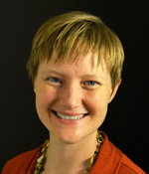
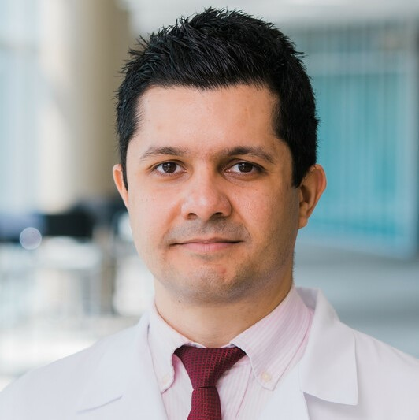
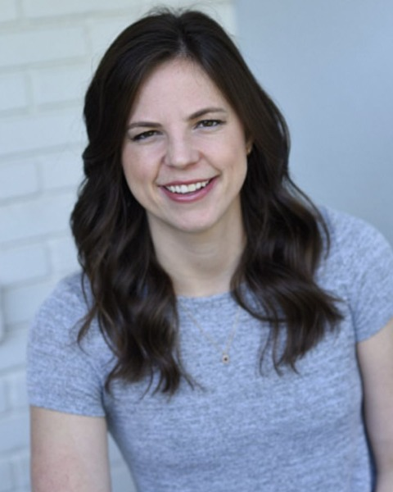
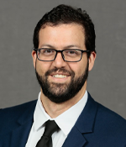
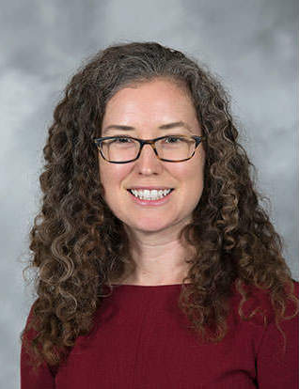
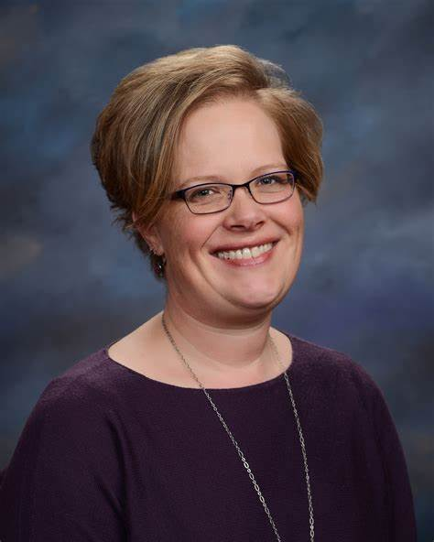
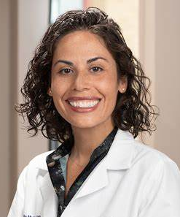
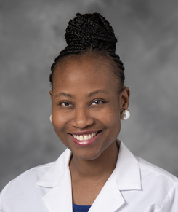
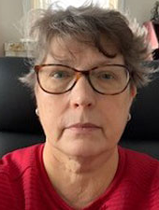
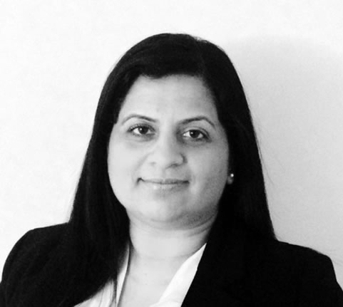
Find us in the annual meeting!
Sandy Rackley, MD, FACLP | Paulo Sales, MD, MS | Katherine Crist, MD | Diego Garces, MD | Emily Holmes, MD
Valerie Houseknecht, MD | Inder Kalra, MD | Cristina Montalvo, MD | Tiwalola Osunfisan, MD | Christine Skotzko, MD, FACLP

Slide 37
Mentorship Subcommittee

Slide 38
Mentorship & the Annual Meeting
Why attend
How to get the most out of the meeting
SIGS vs committees
Utilizing down time between sessions

Slide 39
Benefits of Attending the Annual Meeting
Meet leaders in the field
Exposure to multiple perspectives
Learn about new research & ideas
Present your work
Meet new peers, mentors
Networking for jobs, training positions, collaborations
Break from home institution
Improve burnout, career satisfaction, work excitement
Explore new city
Notes:
Distance lends enchantment or a perspective to your work. When we are caught up in the day to day grind at home, you have no time for an honest reflection. Innovations, perhaps as simple as a cork, may be apparent only when you are not frantically bailing a leaky boat. A good conference has the capacity to bring you, no matter your career stage, out of a slump

Slide 40
How to Make the Most of an Academic Conference
Have (and revise) goals: Education, Inspiration, Evaluation, Presentation, Recreation
Prepare
Arrange meetings in advance
Practice your elevator pitch
Conquer your FOMO
Don’t forget basic needs
Review key locations
Ask questions/meet speakers
Don’t just attend bigger events or sit in the back
Attend a SIG or caucus/forum meeting
Have plan for brain break/downtime
Remember to network
Be confident
Follow up on connections after the meeting
Complete evals/give feedback
https://www.oxford-royale.com/articles/first-academic-conference/
Notes:
Objectives: Education- to update knowledge; Inspiration- to hear new ideas and meet professional leaders; Evaluation- to review your own work and plan for the future; Presentation- a platform for your own research; Recreation
Preparation: - pretest; review meeting schedule in advance, identify sessions of interest and attendees of interest; make sure have time for meals, snacks; see if anyone you know is going to meeting; good chance to reconnect with old mentors, supervisors, peers; potential employers/training directors, clinical or research mentors (Hello, Dr. Smith. I am very interested in your research on XX/am working in the XX area, and I look forward to your presentation next week. I’d like to meeting with you for five minutes after your presentation to ask you a few questions, if your schedule permits)
Elevator pitch- if someone asks you about yourself- can say your current position/institution, perhaps a few areas of interest or activities FOMO_ so much to attend- can’t do it all- need breaks for food, bathroom, socializing, downtime, calling home, etc- prioritize, assume you won’t go to half of what you initially plan to attend
Basic needs- bathroom, food, water (bring snack, bring something to do if need break)
Network- prospective training directors, supervisors, someone whose work you admired- if see them standing alone- go up to them, introduce self; can ask them about their work/institution; could even ask them what they have attended at meeting so far or what sessions they might suggest; don’t just sit with your friends
Confidence- It’s understandable if you’re nervous, but your first academic conference will be so much better if you can manage to find some confidence. Nervousness can manifest itself in lots of different ways: perhaps you’ll end up sitting at the back of a room where you can’t hear very well or see the slides; perhaps you’ll avoid asking a worthwhile question because you were scared to speak up; perhaps you’ll miss out on opportunities to make useful connections because you didn’t want to initiate a conversation with anybody.
Introverts may benefit from the occasional break.It’s no surprise that most advice on conferences is advice for introverts. Conferences reward extroversion, mixing, mingling and getting to know new people. This is why, if you’re not a people-person, taking lots of breaks is such a good idea; because then, when you do go back into things, you’ll have charged up your batteries sufficiently to get talking to people.

Slide 41
Using Down-Time Between Sessions
Self-care, home check-in
See old friends/mentors
Arrange meetings with new contacts
Introduce self to presenters/org leaders
Sight-see
Review job board
Review/revise meeting goals

Slide 42
 | Special Interest Group https://www.clpsychiatry.org/sigs/how-to-join/ | Committee/ Subcommittee
What is it? | Bring together participants to discuss clinical care, teaching, and research in subspecialty areas | Established bylaws; conduct work/carry out mission and goals; President can establish new subcommittees
What are the benefits of participation? | networking, mentoring, and collaborative support; meeting submissions | Service to ACLP; mentorship, networking; projects; meeting submissions
When do they meet? | annual meeting + throughout the year via listserv, teleconferencing, and email. | Annual meeting + throughout the year via email, monthly teleconferencing
How do I join? | Attending meeting or email chair; join via ACLP profile or email info@CLpsychiatry.org https://www.clpsychiatry.org/sigs/how-to-join/ | Apply during the annual (deadling 8/6) open call; must be ACLP Member
Notes:
Women’s Caucus; forums (Div Directors, Fellowship Directors)

Slide 43
DEI Subcommittee

Slide 44
Diversity Equity and Inclusion at every level of planning of the 2023 Annual Meeting
Meeting Content: every submission was required to consider DEI in the content of the presentation as well as the composition of the speaker panel
Local arrangements – minoritized and LGBTQ+ friendly establishments to support
DEI track
Please attend the Business meeting! Issues of meeting location and impact on marginalized members will be discussed
Partnership with Health Justice: preliminary findings and Organizational Equity Assessment

Slide 45
Health Justice will launch an organizational equity assessment survey in August
Goal: explore members’ perceptions and experiences within ACLP related to several domains including decision-making and influence, organizational culture, and organizational and leadership commitment to equity.
Gathering data about important aspects of the the identity of our membership
Demographic data will be gathered and reported only in aggregate
Completely anonymous
Preliminary presentation from Health Justice and the Annual Meeting

Slide 46
ACLP Organizational Equity
Assessment Survey launches
August!
Look out for an ACLP Email about the Survey!

