Slide 1
Overview of Perinatal Psychiatric Disorders and Non-Pharmacological Management ACLP Resident Education Curriculum
Christina L. Wichman, DO, FACLP
Medical Director, The Periscope Project
Director, Women’s Mental Health
Associate professor of Psychiatry & behavioral Medicine and Obstetrics & Gynecology
Version March 15, 2019

Slide 2
Objectives
Differentiate between baby blues, perinatal depression and bipolar disorder.
Differentiate between the intrusive thoughts of an anxiety disorder versus a psychotic disorder.
List validated tools for screening of perinatal depressive and anxiety symptoms.
Describe non-pharmacologic options for treatment and management of perinatal mood and anxiety disorders.

Slide 3
Perinatal Psychiatric Disorders

Slide 4
Why Talk about Perinatal Mental Health?
Suicide is the 2nd leading cause of death among post-partum women.
Mental health disorders are the most common complication of pregnancy.
Maternal mental health impacts the entire family.
Notes:
CW

Slide 5
Definition: ‘Perinatal Psychiatric Disorders’
All mental health conditions during pregnancy and up to one year after delivery

Slide 6
Types of Perinatal Psychiatric Disorders
Baby Blues | Perinatal Depression | Perinatal Anxiety
Temporary phenomenon with prominent mood swings in the immediate postpartum period. Effecting 80% Normal! Self-limited with resolution within 2 weeks | Episode of major depression Affects functioning and ability to care for self or baby During pregnancy to 1 year postpartum Effecting 1 out of 7 | Spectrum of anxiety disorders During pregnancy to 1 year postpartum Estimated 8.5-13% will experience
Symptoms: Tearful Irritability Sleep changes | Symptoms: Depressed mood Loss of interest Excessive guilt/worry Thoughts of death or suicide ideation | Symptoms: Excessive worrying Inability to relax Physiological symptoms

Slide 7
Perinatal Depression

Slide 8
Depression in Pregnancy
Same diagnostic criteria as episode of major depressive disorder
> 2 weeks duration of symptoms that impact functioning
Onset during pregnancy or up to one year postpartum
Depression may be overlooked in pregnancy
Symptoms related to somatic experiences of pregnancy
Poor sleep, appetite changes, decreased energy, decreased libido
Symptoms to guide diagnosis: lack of interest in pregnancy, guilty ruminations, profound anhedonia, suicidal ideation

Slide 9
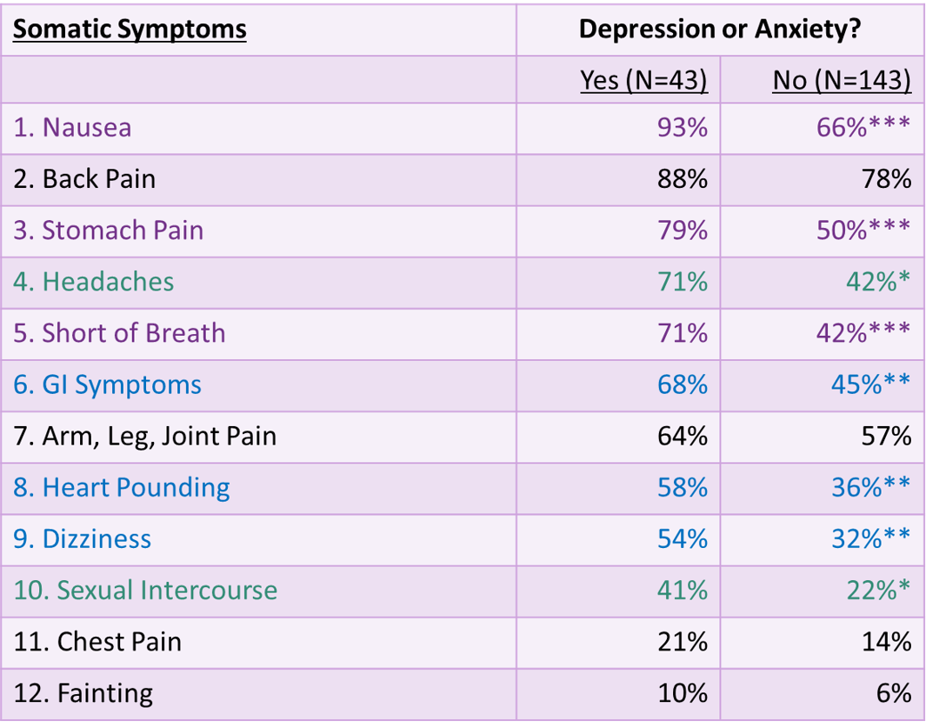
Somatic Symptoms of Pregnancy Depression and Anxious Diagnosis vs. Not
Kelly, R, et al. GHP 23(2001) 107-113 *p<.05 **p<.01 ***p<.001

Slide 10
Bipolar Disorder
A mood disorder consisting of both depressive symptoms as well as mania (or hypomania)
Onset: Prior to pregnancy, during pregnancy, or in the postpartum period (often precipitated by disturbed sleep)
Duration: Persists until treated
Signs/Symptoms:
May present with depressive symptoms, as previously delineated
Mania characterized by a decreased need for sleep, risk-taking behaviors (e.g., gambling, promiscuity), euphoria or irritability, increased goal-directed activity, grandiosity

Slide 11
Postpartum Psychosis
A true psychiatric emergency! Affects 1-2/1000
Onset: Abrupt within 3-14 days postpartum, prodromal signs in 1st three days PP
Other symptoms: bizarre disorganized behavior, lack of insight, delusions of persecution that revolve around the infant, self neglect, unusual psychotic symptoms
Bi-directional, strong link with bipolar disorder. Meta-analysis review of 37 articles:
If history of bipolar disorder, 37% risk of postpartum relapse
If history of postpartum psychosis, 31% risk of relapse
Much higher rates (66%) if medication-free during pregnancy, as compared to prophylactic treatment (23%)
New-onset psychosis work-up needed; 4% may be due to autoimmune encephalitis

Slide 12
Perinatal Anxiety

Slide 13
Perinatal Anxiety
Spectrum of anxiety symptoms
During pregnancy and/or the postpartum period
As common as perinatal depression!
Estimated 8.5-13% of women
Anxiety may occur in conjunction with perinatal depressive symptoms
Usually a more severe illness, and more difficult to treat or independently of mood disturbances
Screening of perinatal anxiety disorders
Certain items on EPDS scale target anxiety
Perinatal Anxiety Screening Scale (PASS)
Onset:
If anxiety symptoms present during pregnancy, they most commonly present in the first trimester
If onset is postpartum, symptoms may present in the first 2 weeks to 6 months following delivery
Symptoms:
Persistent and excessive worries
Inability to relax
Physiological arousal
Intrusive thoughts!

Slide 14
Intrusive Thoughts
COMMON, often regarding harming infant
NO intention of harming infant
Will go to great strides to avoid infant
Incredibly distressing; have insight into thoughts
Need to differentiate from psychotic symptoms
Hesitant to share, fearful of child protection involvement

Slide 15
Obsessive-Compulsive Disorder
Repeated, intrusive obsessive thoughts that are accompanied by compulsive, sometimes ritualistic behaviors performed to relieve anxiety associated with the intrusive thoughts.
Insight that thoughts as being irrational
Fearful, disturbed by thoughts
Onset: Throughout perinatal period
Prevalence: 4% of women
Signs/Symptoms:
Disturbing repetitive thoughts that are recognized as irrational, including thoughts of harming the baby
Compulsive behaviors often involve behaviors dedicated to protecting the baby
(e.g., frequent checking, hand washing, etc.)

Slide 16
Post-traumatic Stress Disorder
Anxiety symptoms precipitated by a traumatic experience
Preexisting PTSD may also be exacerbated by a traumatic birth experience!
Onset: May be present prior to pregnancy or result from a traumatic experience during pregnancy/postpartum
Prevalence: Affects an estimated 2-15% of women
Signs/Symptoms:
Syndrome that may include nightmares
Hyperarousal
Pervasive thoughts or re-experiencing of past trauma
Irritable mood
Tendency to avoid disturbing stimuli
Physiological arousal symptoms

Slide 17
Factors Associated with Increased Risk of Perinatal Mood or Anxiety Disorders
Lack of social support
Marital discord
Living alone
Multiple children, particularly if < 1 year between pregnancies
Unwanted pregnancy
Younger age
Personal or family history of affective illness
Discontinuation of antidepressants at conception
68% relapsed
26% relapsed if remained on antidepressants during pregnancy

Slide 18
Dose Dependent Effect of Depression
Utah PRAM survey data. N = 4,296. 2009-2011.
Stress, depression, and intimate partner violence, and the duration and severity of each, were determined by questionnaire.
Compared to diagnosis of postpartum depression.
Clinical Scenario | Odds Ratio of developing PPD (compared to women with no depression)
Depressed before but not during their pregnancy | 7.67
Depressed during pregnancy but not before | 17.65
Depressed both before and during pregnancy | 58.35
Notes:
Utah’s Pregnancy Risk Assessment Monitoring System of 4,296 women who gave birth during 2009-2011. Stress, depression, and intimate partner violence, and the duration and severity of each, were determined by questionnaire. Those determinations were compared with the outcomes of gestational age, birth weight, neonatal ICU admission, and the symptoms and diagnosis of postpartum depression.
(2015 Sep-Oct;64[5]:331-41).

Slide 19
Impact of Untreated Perinatal Psychiatric Disorders

Slide 20
Risk of Untreated Maternal Depression on Infant
Threatens mother-child dyad
Higher risk of NICU admission
Delays in development
Child may become less responsive to treatment over time
Not breastfeeding or early cessation of breastfeeding
As early as 2 month, infants of depressed mothers look at the mother less often, show less engagement with objects, and lower activity level
Infant is at risk for:
Failure to thrive
Attachment disorder
Childhood psychiatric disorders
Notes:
pregnancy (2015 Sep-Oct;64[5]:331-41).

Slide 21
Impact on Breastfeeding
Relationship between breast-feeding and PPD is NOT clear!
Studies have demonstrated:
No relationship between BF and PPD
BF mothers have higher rates of depression
Women who formula feed have higher rates of depression
PPD interferes with BF: less likely to BF, typically BF for a shorter duration
Obviously contrasting conclusions!
Likely due to result of interactions between physiological, psychological, and sociocultural mechanisms
Varying methods for studying associations

Slide 22
Screening & Follow Up
Notes:
Ask participants how many are screening for maternal depression using a validated screening tool

Slide 23
Why is Screening Important?
Routine screening for antenatal depression is uncommon!
30-50% of women who have postpartum depression had depressive symptoms during pregnancy
< 20% of women diagnosed with PPD had reported their symptoms to a provider
When identified, perinatal depression is often not treated or only partially treated
< 30% of women with positive screen attend a mental health visit
< 10% adhere to full treatment course

Slide 24
Standard of Care Recommendations
October 2010:
Screen for depression in pregnant and postpartum patients
Utilizing a validated screening tool
With appropriate systems and follow up in place
May 2015:
January 2016:

Slide 25
Valid & Reliable Screening Tools
Edinburgh Postnatal Depression Scale (EPDS)
10 items
< 5 minutes to administer
23+ languages, adding continually
Sensitivity 59–100% Specificity 49–100%
Free to administer
Assesses suicidality
Patient Health Questionnaire – 9 (PHQ-9)
9 items
< 5 minutes to administer
Sensitivity 75% Specificity 90%
Free to administer
Assesses suicidality

Slide 26
Routinely Screen
Recommended screening timeline:
Initial prenatal visit
28 weeks gestation
2-4 weeks postpartum (or at OB 6 week postpartum visit)
12 weeks postpartum
Consider another screening at 9-12 months postpartum
Acknowledge screening all women regardless of symptoms
Notes:
CW

Slide 27
Follow Up After Screening
Sit down, face her and thank mother for completing the screening
Normalize and acknowledge the tremendous changes that motherhood brings
Review score together, regardless of the score
“Help me understand why you chose the answers that you did”
Ask open ended and specific questions
Is the transition to motherhood meeting your expectations?
Are you able to sleep when the baby is sleeping?
Address any concerns for suicidality if noted in screening.
Document screening in notes

Slide 28
Assessing Suicidal Ideation
Lower Risk
Higher Risk
No prior attempts
No plan
No intent
No substance use
Protective factors
“What prevents you from acting on these thoughts?”
Suggests outpatient evaluation and follow-up
History of suicide attempt
High lethality of prior attempts
Current plan
Current intent
Substance use
Lack of protective factors or social support
Suggests urgent/emergent evaluation!

Slide 29
Assessing Thoughts of Harming Baby
Thoughts of Harming Baby that Occur Secondary to Obsessions/Anxiety
Thoughts of Harming Baby that Occur Secondary to Postpartum Psychosis
Good insight
Thoughts are intrusive & scary
No psychotic symptoms
Thoughts cause anxiety
Poor insight
Psychotic symptoms
Delusional beliefs with distortion of reality present
Suggests not at risk of harming baby
Suggests at risk of harming baby

Slide 30
Non-pharmacologic Treatment Options

Slide 31
Treatment Options
Options with evidenced based use in the perinatal period
Psychotherapy
Light box therapy
Complementary Alternative Options
Self-care
Sleep hygiene

Slide 32
Psychotherapy
Supportive psychotherapy: includes comforting, advising, encouraging, reassuring, and mostly listening, attentively and sympathetically
Cognitive behavioral therapy (CBT): challenges distorted cognitions and change destructive patterns of behavior
Interpersonal Psychotherapy (IPT): focuses on social roles and relationships
Areas of focus: Role disputes, Role transitions, Unresolved grief, Interpersonal deficits
Mindfulness-based cognitive therapy (MBCT): modified form of cognitive therapy that incorporates mindfulness practices such as meditation and breathing exercises
Most can be done in individual or group settings

Slide 33
Lightbox Therapy
Useful for patients with a seasonal component to their depressive symptoms
Luxe > 10,000 to be effective
Minimum of 30 minutes daily to begin within 10 minutes of awakening
Must EXTEND sunlight hours – morning prior to sunrise is most effective
Do NOT recommend utilization at night, as may interrupt sleep
Can utilize with multi-tasking: eating breakfast, on computer, getting ready in bathroom
Can buy online or through medical supply store and submit for reimbursement through insurance with proper diagnosis

Slide 34
Complementary Alternative Options: Specific to the Perinatal Population
Solid evidence base
Inconclusive evidence
Exercise: 30 minutes/day on most days
Massage
Relaxation techniques
Omega-3 Fatty Acids: 1 gram EPA + DHA daily
Folate supplementation: 0.4-5 mg/day
St. John’s Wort: no studies of safety during pregnancy to recommend
S-adenosyl l-methionine (SAMe): no studies of safety during pregnancy to recommend
Acupuncture: evidence is divided

Slide 35
Self Care
Good nutrition
If breastfeeding, need additional ~ 500 calories.
Consider eating/drinking every time infant is feeding
Have several healthy, on-the-go options available
Once cleared to exercise, attempt to do so daily
Involve baby: walks with stroller, yoga
Avoid alcohol, tobacco and other drugs
Educate yourself about your diagnosis
Increase communication to those around you
Seek social support
Accept help when offered: say YES!
Give specific direction to those offering help: laundry, dishes, hold/feed baby to allow for uninterrupted shower/nap
Take time for yourself
Engage in activities take give you joy

Slide 36
Sleep Hygiene
Discuss with partner/support/family how to “split” night shifts prior to delivery
Ideally, want 4 hour uninterrupted block of sleep in each 24 hour period
Apps to utilize:
CBT-I Coach
CALM
Headspace
Red flag: If consistently unable to sleep when baby is sleeping, reach out to health care provider

Slide 37
Sleep Hygiene Principles
Do for yourself what you’d insist for your children!
Limiting daytime naps to 30 minutes
Avoiding stimulants such as caffeine and nicotine close to bedtime.
Daytime exercise.
Establishing a regular bedtime routine; to go bed and get up at same time every day.
Appropriate sleep environment.
No screens for 1 hour prior to bed; do not utilize screens when up with baby.
Move phone/clock away from view to avoid “clock watching.”

Slide 38
Questions? Thank you!
Christina L. Wichman, DO, FACLP
cwichman@mcw.edu

