Slide 1
Opioid Use Disorders in Pregnancy: ACLP Resident Education Curriculum
Christina L. Wichman, DO, FACLP
Medical Director, The Periscope Project
Director, Women’s Mental Health
Associate Professor of Psychiatry & Behavioral Medicine and Obstetrics & Gynecology
Version of March 15, 2019

Slide 2
Objectives
Identify risks of opioid use in pregnancy to fetus and neonate.
Describe potential treatment options for perinatal opioid dependence.
Understand potential ethical and legal issues when treating a pregnant woman with a substance use disorder.

Slide 3
Substance Abuse During Pregnancy
Under-diagnosed!
Pregnancy is a motivator for cessation
Persistence of substance abuse during pregnancy may represent a particularly refractory and high risk subpopulation
Higher levels of use prior to pregnancy correlate with continued use during pregnancy
Most women return to pre-pregnancy rates of smoking and alcohol abuse within 6-12 months postpartum
Notes:
. Havens JR et al. Drug and Alcohol Dependence 99 (2009) 89–95; NSDUH 2010; Harrison et al Matern Child Health J (2009) 13:386–394

Slide 5
Committee Opinion Summary. Updated August 2017.
Recommends universal screening at first prenatal visit with a validated verbal screening tool
Examples: 4Ps, NIDA Quick Screen, and CRAFFT (for women 26 years or younger).
If a woman screens positive, recommends brief intervention (i.e. motivational interviewing) and referral for treatment
Highlights the importance of recognizing comorbid psychiatric illness
Committee Opinion No. 711 Summary: Opioid Use and Opioid Use Disorder in Pregnancy. Obstet Gynecol. 2017 Aug;130(2):488-489.

Slide 6
Opioid Use in Pregnancy

Slide 7
Opioid Use Disorders in Pregnancy
90% of female opioid users in the US are of childbearing age
Most women who chronically used opioids pre-conception kept same pattern of use into pregnancy
5.63 in 1000 births: delivering mothers defined as dependent on or using opioids antenatally
High costs associated with maternal and neonatal care
Especially neonatal abstinence syndrome (NAS)
Notes:
Finnegan 1986, Patrick 2012

Slide 8
Risks of Opioid Use in Pregnancy
Obstetrical Risks
Fetal Risks
NOT teratogenic
Associated with:
Pre-eclampsia
Intrauterine growth restriction
Placental insufficiency/abruption
PPROM
IUFD/stillbirth
Postpartum hemorrhage
Risks related to peaks/troughs and intermittent withdrawal
Lifestyle factors associated with use/relapse, such as poor prenatal care and poor nutrition
Associated with:
Postnatal grown deficiency
Microcephaly
Neurobehavioral problems
Neonatal abstinence syndrome (NAS)
Sudden infant death syndrome
All increase neonatal morbidity and mortality
Can prolong hospital stay for newborn

Slide 9
Neonatal Risks
Associated with:
Postnatal grown deficiency
Microcephaly
Neurobehavioral problems
Neonatal abstinence syndrome (NAS)
Sudden infant death syndrome
All increase neonatal morbidity and mortality
Can prolong hospital stay for newborn

Slide 10
Neonatal Abstinence Syndrome
Occurs in 50-80% of neonates with in utero exposure to opioids (illicit and prescribed)
Constellation of symptoms:
CNS and autonomic irritability
GI distress, feeding issues
Respiratory symptoms
Typical onset 1-72 hours
Nonspecific scales
Treatment with morphine or phenobarbital
Can be fatal
Notes:
Every 25 minutes a baby in the US is born suffering from NAS.

Slide 12
Treatment of Opioid Use Disorder in Pregnancy
No FDA approved treatment
Gold standard of treatment is opioid agonist treatment
Methadone
Buprenorphine
Withdrawal NOT typically recommended
Consider if MAT not available or strong patient preference
Gradual (vs. abrupt) medication assisted withdrawal
Small risk of stillbirth, IUFD, preterm labor, meconium, although recent retrospective review n = 300 demonstrated no cases of fetal demise
Very high risk of relapse after discontinuation of opioids
Rementeria et al. AJOG. 1973; 116 (8): 1152-6. Towers C et al. AJOBGYN 2016
Zuspan AJOG. 1975;122(1): 43-46. Fricker Arch of Pedi & Adol Med. 1978;132(4): 360.
Luty J of Sub Abuse Treat. 2003; 24:363-67 . Jones et al. Am J Addictions. 2008; 17: 372-386
Notes:
1. Rementeria et al. AJOG. 1973; 116 (8): 1152-6. 2. Zuspan AJOG. 1975;122(1): 43-46. 3. Fricker Arch of Pedi & Adol Med. 1978;132(4): 360. 4. Luty J of Sub Abuse Treat. 2003; 24: 363-67 . 5. Jones et al. The American Journal on Addictions. 2008; 17: 372-386

Slide 13
MMT During Pregnancy
Maternal Considerations
Fetal/Neonatal Considerations
Improved OB care
Increased fetal growth
Decreased risk of HIV
Decreased risk of preeclampsia
Longer treatment retention
Fewer relapses
Increased volume of distribution
Doses typically 80-120, though may need to increase in 3rd trimester
Split dosing can be considered
Decreased heart rate and heart rate variability
Slower breathing and fetal movements on BPP
Neonatal Abstinence Syndrome
Respiratory distress

Slide 14
Buprenorphine
Partial mu agonist and kappa antagonist
Half life 24-60 hours (shorter for analgesic effects)
Diminished risk of overdose/respiratory depression
Office based treatment (vs clinic setting)
Decreased sedation

Slide 15
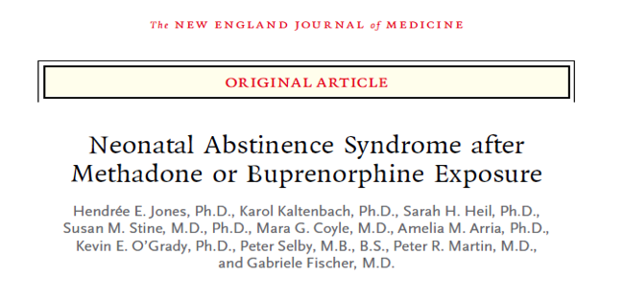
Notes:
This is the first paper out of the MOTHERs trial
While data re methadone is largely based on comparison with no treatment
Data on bup is increasingly available using methadone to compare

Slide 16
Buprenorphine vs. MMT
Maternal Considerations
Neonatal Considerations
No apparent difference between buprenorphine and methadone for:
Maternal weight gain
Cesarean section
Abnormal presentation
Use of analgesia
Positive drug screen
Medical complications at delivery
Buprenorphine exposed infants:
Less motor suppression
Lower incidence of non-reactive Non Stress Tests
HOWEVER, clinical significance of these findings not clear
NAS
Compared to methadone:
Similar incidence
Shorter duration of symptoms
Lower mean morphine requirement
Shorter hospital stay
Notes:
Jones 2012

Slide 17
Which Newborns should be Monitored?
Maternal Factors
Neonatal Factors
Known history of substance use
No/poor prenatal care
Unexplained complications in pregnancy
IUGR
Preterm labor
Placental abruption
Maternal medical complications
Identification of signs and symptoms correlated with NAS
Low APGAR scores
Microcephaly
Neonatal stroke or infarction

Slide 18
Newborn Symptom Management
Non-pharmacologic
Pharmacologic
Environmental Control
Swaddling
Pacifier
Rocking
Small, frequent feedings
Goals:
Control symptoms
Allow for appropriate growth
Treatment
Utilize drug class the infant was exposed to, if appropriate
May require additional meds for symptom control
Wean as tolerated, may take several days—weeks
Do NOT utilize naloxone!

Slide 19
Postpartum Pain Management
Maintenance doses of methadone or buprenorphine are NOT sufficient analgesia!
Patients utilizing agonist treatment report elevated pain scores and have higher medication requirements
Utilize non-narcotic methods!
Regional (epidural or spinal anesthesia)
NSAIDs
Avoid high affinity partial agonists (ex: nalbuphine)
Notes:
Alford 2006, Meye 2010, Park 2012

Slide 20
Breast-feeding
ASAM recommends breast-feeding for mothers using methadone or buprenorphine
Present in low levels in breast milk
Breastfeeding important treatment of NAS
Soothing effects
Skin-to-skin contact
Women who are interested and able to breastfeed, should be encouraged to do so.
Notes:
ASAM: American Society for Addiction Medicine

Slide 21
Documentation and Collaboration
What should be documented:
Diagnosis, current symptom burden, period of stability, risk of relapse
Non-pharmacological management/treatment options
Pharmacological management options: why choosing one medication over another?
Specific risks of psychotropic exposure to developing fetus/breastfeeding infant dependent on gestational age
Educational resources provided to patient
How you collaborated with providers (OB, MFM, methadone clinic, buprenorphine prescriber, etc.)
Review of drug monitoring database (if accessible)
Collaborate! Discuss! Pick up the phone and talk to other providers!

Slide 22
Sample Verbiage
“Given the risk of opioid withdrawal to the fetus, including bleeding, pre-eclampsia, prematurity, IUGR, and IUFD linked with opioid withdrawal during pregnancy, initiation and continuation of methadone is indicated. Her current dosage was arrived at based on her reported use of heroin, with increases based on the prn dosages that she used over the past 24 hour period. At *** mg twice daily of methadone, patient has not experienced any symptoms of withdrawal or intoxication. Split dosing is preferred in pregnancy secondary to increased metabolism and desire to keep methadone level at steady state secondary to risk of withdrawal to fetus.”

Slide 23
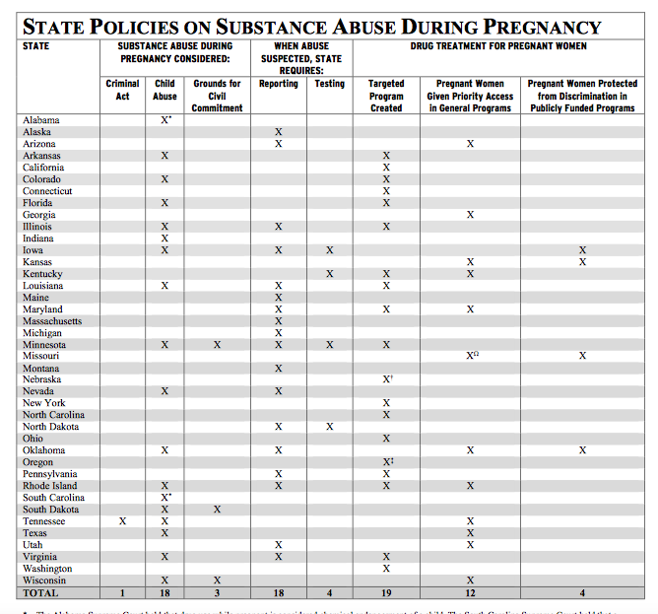
Notes:
https://www.guttmacher.org/sites/default/files/pdfs/spibs/spib_SADP.pdf
18 states declared substance use in pregnancy: child abuse
3 states: civil commitment
1 state: assault charges to be filed
18 states require health care providers to report suspected prenatal drug use
4 states mandate testing pregnant women for drug eposure if substance use is suspected
In some states, newborns can be removed from maternal custody due to positive toxicology screen at birth with no assessment for parental capacity or concern for attachment

Slide 24
Laws may deter women from seeking prenatal care
Survey of low-income postpartum women, 75% felt that punitive law for substance use in pregnancy would force pregnancy women with SUDs to avoid prenatal care and treatment
Similar rates of SUDs in all women, AA and low-income women are more likely to be reported to legal authorities by their health care providers

Slide 25
Resources
State Opioid Treatment Authority (SOTA)
http://dpt2.samhsa.gov/regulations/smalist.aspx
National Center on Substance Abuse and Child Welfare
www.ncsacw.samhsa.gov/resources
https://ncsacw.samhsa.gov/files/Collaborative_Approach_508.pdf
Motherisk
www.motherisk.org

Slide 26
Questions? Thank you!
Christina L. Wichman, DO, FACLP
cwichman@mcw.edu

