Slide 1
Team-based Proactive C-L Psychiatry
Integrated care meets inpatient C-L psychiatry
Mark Oldham, MD
Medical Director, PRIME Medicine
Assistant Professor of Psychiatry
University of Rochester Medical Center
H. Benjamin Lee, MD
John Romano, Professor and Chair
Department of Psychiatry
University of Rochester Medical Center

Slide 2
Disclosures
With respect to the following presentation, there has been no relevant (direct or indirect) financial relationship between the party listed above (and/or spouse/partner) and any for-profit company which could be considered a conflict of interest.

Slide 3
What is proactive C-L psychiatry?
An interdisciplinary model of C-L psychiatry that incorporates
Systematic screening for mental health conditions,
Early clinical intervention, and
Integration with primary teams.
To facilitate efficient care and
Improve outcomes
In a cost-effective manner.
What are the goals of proactive C-L psychiatry?

Slide 4
Unmet needs rethinking C-L psychiatry
Proactive C-L a modern approach
Daily operations the principles of proactive C-L in action
Future horizons C-L psychiatry for value-based care

Slide 5
The staggering cost of mental illness
Accounts for 1/3 of all years lived with disability^{1,2}
5 of the top 20 causes of disability in high-income countries
Disproportionately affects working-aged adults
Contributes to leading causes of death³
Heart disease, cancer, and cerebrovascular disease
Suicide itself is the 10th leading cause of death
Associated with 2x RR of all-cause mortality⁴
Meta-analysis from 29 countries across 6 continents
Can shave a decade or more off life^{4,5}
Mental illness: 10 years of life lost
Substance use: 25 years of life lost
Dual diagnosis: 30 years of life lost
¹Vigo Lancet Psychiatry 2016; ²Whiteford Lancet 2013; ³www.cdc.gov; ⁴Walker JAMA Psychiatry 2015; ⁵Oregon DHS 2008
Notes:
Vigo et al. Lancet Psychiatry 2016;171-8.
Whiteford et al. Lancet 2013; 1575-86.

Slide 6
The cost of mental illness in the general medical hospital¹⁻³
Hospital costs
Longer LOS: UC, Davis Medical Center, annual cost est. $11M¹
Constant companion & restraint use
Poorer health outcomes/readmissions
Denied days due to delay in psychiatric disposition
Staff costs
Lack of training, stigma and implicit bias
Dissatisfaction & distress
Spill-over effect to other patients
Patient costs
Compromised quality of care
Mistrust may lead patients to avoid future medical care
¹Bourgeois Psychosom 2005; ²Desan Psychsom 2011; ³Sledge Psychoth Psychosom 2015

Slide 7
Psychiatric comorbidity in medical inpatients
Psychiatric comorbidity^{1,2}
Lengthens hospitalizations
Increases risk of re-hospitalization
Increases healthcare costs
Est $11M/yr at UC Davis³
¹Jansen PLOS ONE 2018; ²Hansen 2001; ³Bourgeois Psychosomatics 2005

Slide 8
Psychiatric conditions can compromise care in myriad ways
Condition | Selected maladaptive features
Delirium | Agitation, restlessness, confusion
Dementia | Forgetfulness, sundowning, care refusal
Personality change due to TBI | Emotional lability, impulsivity
Developmental disorder | Nonverbal, oppositional, defiant
Eating disorder | Hiding food, manipulating weigh-ins
Substance use disorder | Exaggerating CIWAs, contraband
Psychotic disorder | Paranoia, cheeking medications
Anxiety disorder | Refusing workup, overuse of call button
Mood disorders | Suicidal, disruptive mania
Personality disorder | Demanding, hostile, “splitting”
Munchausen syndrome | Self-injury, deception

Slide 9
Unmet needs rethinking C-L psychiatry
Proactive C-L a modern approach
Daily operations the principles of proactive C-L in action
Future horizons C-L psychiatry for value-based care

Slide 10
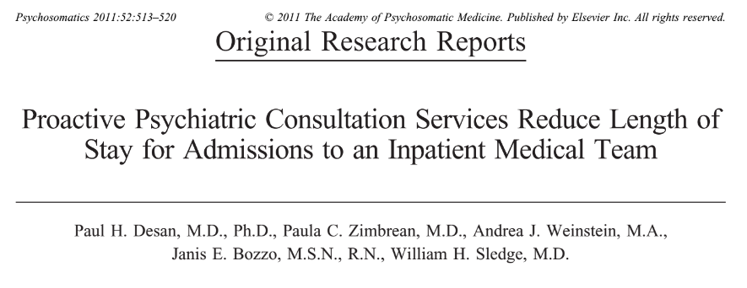
Early pilot study: Proactive psychiatric consultation
A-B-A study embedding a psychiatrist in an internal medicine service
Consult rates
A = 11%
B = 23%
Findings
Half of patients with mental illness
LOS reduced among intervention sample
(2.9 d vs 3.8 d)
Lower proportion LOS ≥ 4 d
(15% vs 28%)
Conclusion
High burden of prevalent psychiatric illness
Under-utilization of psychiatric services

Slide 11
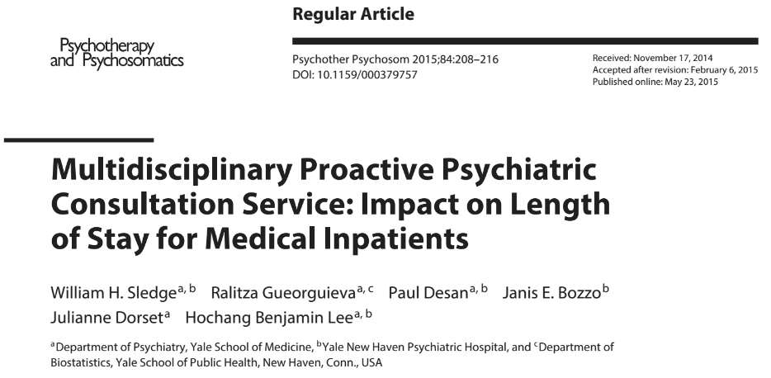
Next step: A multi-disciplinary team approach
Pre–post study on 3 medicine units (92 beds)
Team members
Half-time psychiatrist
Nurse (clinical nurse specialist; later an APRN)
Social worker
We found reduced lengths of stay
Patients with psychiatric consult: 0.65 d
(7.3 vs. 6.7 d)
Overall reduction: 0.29 d
(5.9d vs 5.6 d)

Slide 12
Cost-benefit analysis: Proactive vs traditional C-L psychiatry
Cost-benefit: 11 mos, assuming 3.3% inflation
Average direct cost per case
Includes room/board, labs, imaging, Rx, etc. (using AllscriptsTM)
$\left(\$6760\left[CL\right]−\$6550\left[BIT\right]=\$210 per case\right)x\left(509 BIT cases\right)=\$107k$
Backfill (assuming 100% occupancy)
$\frac{\left(LOS reduction=0.65\right)x\left(509 BIT cases\right)}{avg LOS = 5.8}=57 additional patients$
$\left(57 patients\right)x\left(net revenue per case=\$12,700\right)=\$724k$
Sledge et al. Health Econ & Outcome Res 2016.

Slide 13
Cost-benefit analysis: Proactive vs traditional C-L psychiatry
Gross savings: $\left(\text{per} \text{case} value=\$107k\right)+\left(backfill =\$724k\right)=\$831k$
Minus costs: $−(nurse, SW,\text{part} \text{time} \text{MD} \text{salary} \text{+ }\text{benefits}\text{)} \text{= }\text{\$306}$k
Net gain: $\left(net cost benefit\right)=\$525k$
Annualized: $\$572,000$
Sledge et al. Health Econ & Outcome Res 2016.

Slide 14
Proactive models whose screening was guided by clinical expertise in mental health care and care delivery was integrated with primary services were associated with reduced LOS¹
Found “favorable returns on investment that more than offset the increased costs of providing this level of enhanced care.”^{1–3}
¹Oldham Gen Hosp Psychiatry 2019; ²Desan Psychosom 2011; ³Sledge Health Econ Out Res 2016

Slide 15
Differences between traditional C-L and proactive C-L
Characteristic | Traditional C-L | Proactive C-L
Service delivery | Reactive (often to crises) | Proactive
Personnel | Single discipline | Multidisciplinary
Case identification | Primary team orders a consultation | Screening-driven Enriched by nursing interactions
Mode of intervention | Recommendations to primary team | Collaboration with patients treatment team (providers, nurses, social work)
Service goals | Treatment recommendation Risk reduction Crisis management | Preventing behavioral barriers to care Crisis prevention
Location | Across the hospital (typically) | Dedicated hospital units or services

Slide 16
The principles of proactive C-L
Traditional C-L
Many psychiatric needs unidentified
Mental health care crisis-focused
Proactive C-L
Team-work
Collaborative care delivery
Recs chiefly for providers
Liaison role variable
Systematic screening
Proactive care
Population approach
Integrated care
Multidisciplinary approach
Prevention mindset

Slide 17
Unmet needs rethinking C-L psychiatry
Proactive C-L a modern approach
Daily operations the principles of proactive C-L in action
Future horizons C-L psychiatry for value-based care

Slide 18
1. Population approach: systematic screening
Goal: to identify patients for whom early psychiatric intervention is likely to preempt crises, clinical deterioration, or compromised care.
Systematic: reviewing every patient on certain hospital units or services
Standardized: using a consistent, reproducible strategy
As early as feasible: prompt screening to prevent a cascade of complications
Sliding threshold: adaptable interventions based on patient volume
Step-wise: may be done in one step (e.g., positive/negative on chart review) or multi-step (e.g., screening those positive on chart review with nursing/primary team)
Human vs machine: can be by hand or automated (e.g., a report that can be generated as needed), though electronic medical records often need to be optimized

Slide 19
2. Prevention mindset: Proactive care
Tailored degree of involvement: interventions can be carried out by any number of proactive CL team members.
Curbsides: targeted recommendations w/o formal consultation often adequate
Care/behavioral plans: develop plans to address maladaptive interactions between patients and staff, care-compromising behaviors, or non-adherence
Nurse interventions: provide personalized recommendations for nurses to treat patients (e.g., delirium precautions, poor sleep hygiene)
Psychiatric disposition: prompt facilitation of disposition if psychiatric needs are anticipated (e.g., psychiatric admission, partial hospitalization)
Aftercare planning: ensuring adequate aftercare supports, community resources, and mental health referrals

Slide 20
3. Multidisciplinary approach: Teamwork
C-L psychiatrist
Director/supervision
Consultation
Legal documents
Nurse practitioner
Coordinator/triage
Consultation
Screening
Social worker
Screening
Community resources
Aftercare/disposition
Potential team members
Clinical nurse specialist
RN coordinator
Patient service manager
Health psychologist
Trainees

Slide 21
4. Integrated care: Collaborative care delivery
Corresponding expertise: physician to physician; NP to NP/RN; SW to SW/care coordinator
Aligning workflow: psychiatric care tailored to medicine & nursing workflow on dedicated units/services
Flexible intensity: not all patients
Real-time communication: the effect of which supports efficiency and develops healthy relationships, bidirectional education, and mutual trust

Slide 22
Common steps in performing a “screen”
Screen charts of admitted patients each morning.
Psychiatric comorbidity?
Behavioral concerns?
1

Slide 23
Common steps in performing a “screen”
Inquire about behavioral concerns from RN.
Any active issue(s)?
At baseline?
2
Screen charts of admitted patients each morning.
Psychiatric comorbidity?
Behavioral concerns?
1

Slide 24
Common steps in performing a “screen”
No changes in care
Curbside/targeted rec
Psychiatric consultation
± Wellness plan
Discuss potential concerns with medical team
3
Inquire about behavioral concerns from RN.
Any active issue(s)?
At baseline?
2
Screen charts of admitted patients each morning.
Psychiatric comorbidity?
Behavioral concerns?
1

Slide 25
Notes about daily workflow
Before rounds screening
Psychiatric rounds often runs similar to traditional C-L rounds
Care delivery
Interdisciplinary, nursing care, primary team rounds
Prioritize patients for care efficiency (e.g. care-compromising behaviors)
Consultations performed (often with SW)
Ongoing, real-time conversations with teams
Cuts down dramatically on the “discharge dependent” consult
Afternoons often provide opportunities for educational investment

Slide 26
Unmet needs rethinking C-L psychiatry
Proactive C-L a modern approach
Daily operations the principles of proactive C-L in action
Future horizons C-L psychiatry for value-based care

Slide 27
Future horizons for proactive C-L
The field awaits the results of randomized trials of proactive C-L
The UK HOME Study¹
Expansion to additional settings with higher costs per patient
Critical care
Oncology
Surgery
Further development within value-based care
Focus on vertical integration
Single-payer systems (e.g., VA)
¹Walker et al. The HOME Study. Trials. 2019.

Slide 28
Outcomes of interest to be explored further
Financial impact beyond reduced length of stay
Cost of sitters & security
Cost of nursing turnover
Re-admission rates
Enhanced RVU
Satisfaction: providers, nurses, patients, families
Medical staff burnout
Medical staff performance
Patient symptoms, functioning, and outcomes
Care quality: injuries (patients & staff) and falls
Handoff to outpatient providers (vertical integration)

Slide 29
Questions remain
Which elements of proactive C-L are required for which benefits?
Are there more effective ways of operationalizing the four principles of proactive C-L?
Which patient-specific factors (e.g., age, population) and hospital contexts (e.g., critical care, surgery) might experience differential benefits from different ways of delivering proactive C-L?
What factors are associated with successful implementation and delivery of proactive C-L models?

Slide 30
The ACLP Proactive C-L Special Interest Group (SIG)
Join the growing community of providers practicing proactive C-L psychiatry
The Proactive C-L SIG offers an active Listserv to learn from others in the community
Obtain peer consultations while pursuing proactive C-L
Visit the Proactive C-L SIG website (www.clpsychiatry.org/sigs/proactive-cl-sig/)
The Proactive C-L SIG Resource Center offers (…/proactive-cl-sig-resources/)
An overview of Proactive C-L Psychiatry
Curated materials from sites with Proactive C-L services
An updated bibliography on Proactive C-L
A review of previous ACLP presentations (symposia, workshops, etc.)

Slide 31
Unmet needs rethinking C-L psychiatry
Proactive C-L a modern approach
Daily operations the principles of proactive C-L in action
Future horizons C-L psychiatry for value-based care

Slide 32
Team-based Proactive C-L Psychiatry
Integrated care meets inpatient C-L psychiatry
Mark Oldham, MD
Medical Director, PRIME Medicine
Assistant Professor of Psychiatry
University of Rochester Medical Center
H. Benjamin Lee, MD
John Romano, Professor and Chair
Department of Psychiatry
University of Rochester Medical Center

